Slide 1
FM + COVID-19 Series #14
A Data-Driven Return: COVID-19’s impact on Workforce, Workplace and FM
IFMA.org

Slide 2
Coronavirus Resource Center
ifma.org/coronavirus
IFMA.org

Slide 3
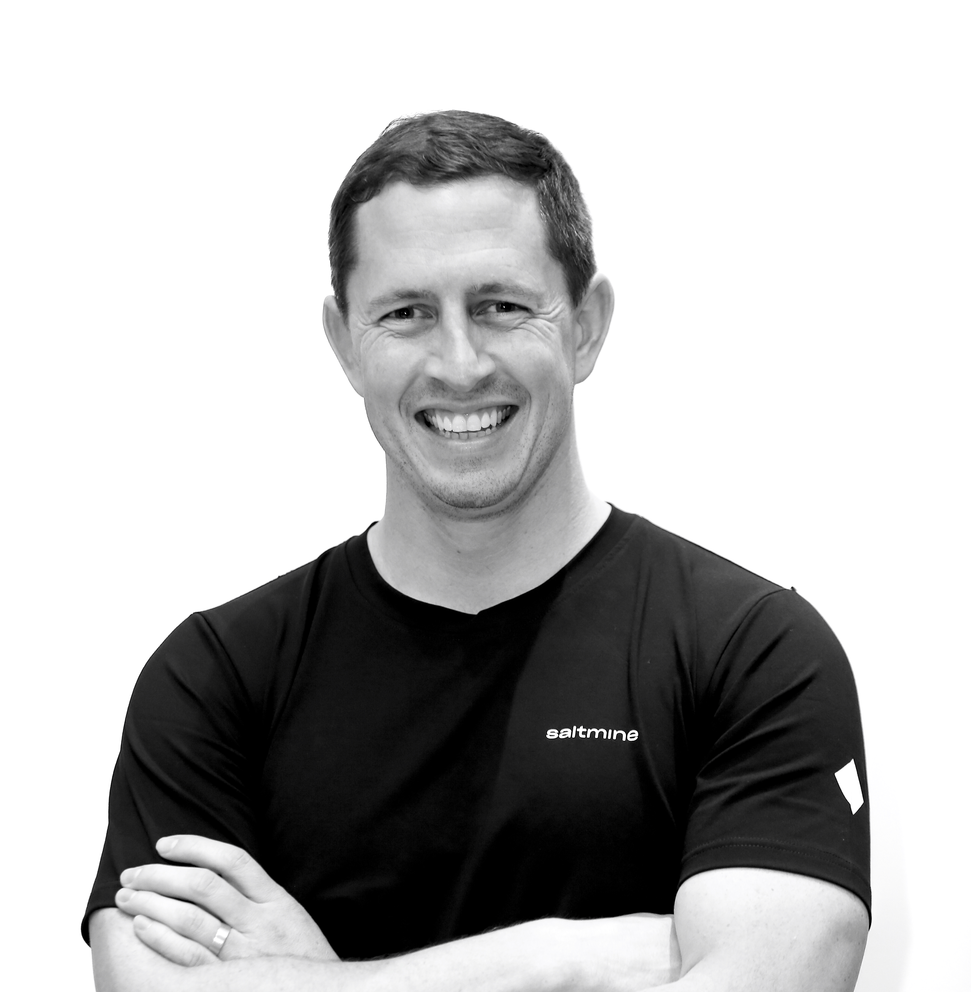
Simon Davis
Newmark Knight Frank
Moderator
Nishar Fatema
Space Matrix
Luke Rondel
Saltmine
Jane Young
Smartway2
A Data-Driven Return: COVID-19’s impact on Workforce, Workplace and FM

Slide 4
Today’s Topics
How data can help determine the re-boarding approach
Tips and tricks based on technology maturity
Real life examples of how this approach has worked
Open Discussion and Q & A

Slide 5
POLL QUESTION 1
WHERE ARE YOU IN RE-BOARDING?
Not Determined Building Open Dates
Started Planning for Future Dates
Phase 1 Re-Boarding (less than 25%)
Phase 2 Re-boarding (25% to 50%)

Slide 6
WORKFORCE PLANNING
CONSIDERATIONS
WORKFORCE MAPPING
Facilities
Employees
Teams/Business Units
TRACKING
Data Overlays:
COVID-19 – WHO, CDC, HDX
Hot Spots
ANALYSIS
Criticality
Geographical Variants
Varied Classifications of Re-Opening
Work from Home Experience

Slide 7
POLL QUESTION 2
WHAT DO YOU MOST MISS WITH THE CURRENT “WORK FROM HOME” EXPERIENCE?
Having a normal day routine
Face to face social interactions
Having variety of places to work
The ability to collaborate with colleagues
Notes:
Productivity – more, less, the same

Slide 8
WORKPLACE PLANNING
CONSIDERATIONS
WORKPLACE PLANNING
Population Thresholds
Distribution based on protocols
Criticality
DETERMINING PROTOCOLS
Social Distancing rules
Circulation Flows
Meeting Room utilization
PHASE PLANNING
Teams
Criticality
Geographical Variants
Notes:
Flexibility
Quick and confident responses
Process
Geo – APAC, Europe and US

Slide 9
POLL QUESTION 3
WHAT ARE YOU PERSONALLY MOST CONCERNED ABOUT WITH RETURNING TO THE OFFICE?
Risks to Your Health
Inability to Collaborate in the Office
Getting to the Office
Overall Risk/Benefit of Return
Notes:
Productivity – more, less, the same

Slide 10
FACILITY MANAGEMENT
CONSIDERATIONS
FACILITY MAPPING
Conference Rooms
Hot Desks
Elevators
TRACKING
Utilization/Approvals
Cleaning
Entry/Egress
Contact Tracing
TOOLS
Paper
CAD/CAFM/Booking Tools
CMMS/FM

Slide 11
Audience Q & A
Notes:
Is the vision to go back to pre-COVID?

Slide 12
FM + COVID-19 Series #15
Short and Long-Term Impacts of COVID-19
Thursday, July 16th
9:30 A.M. CDT
https://www.smartbeta.tech/events/july162020/

Slide 13
Coronavirus Resource Center
ifma.org/coronavirus
IFMA.org

