Slide 1

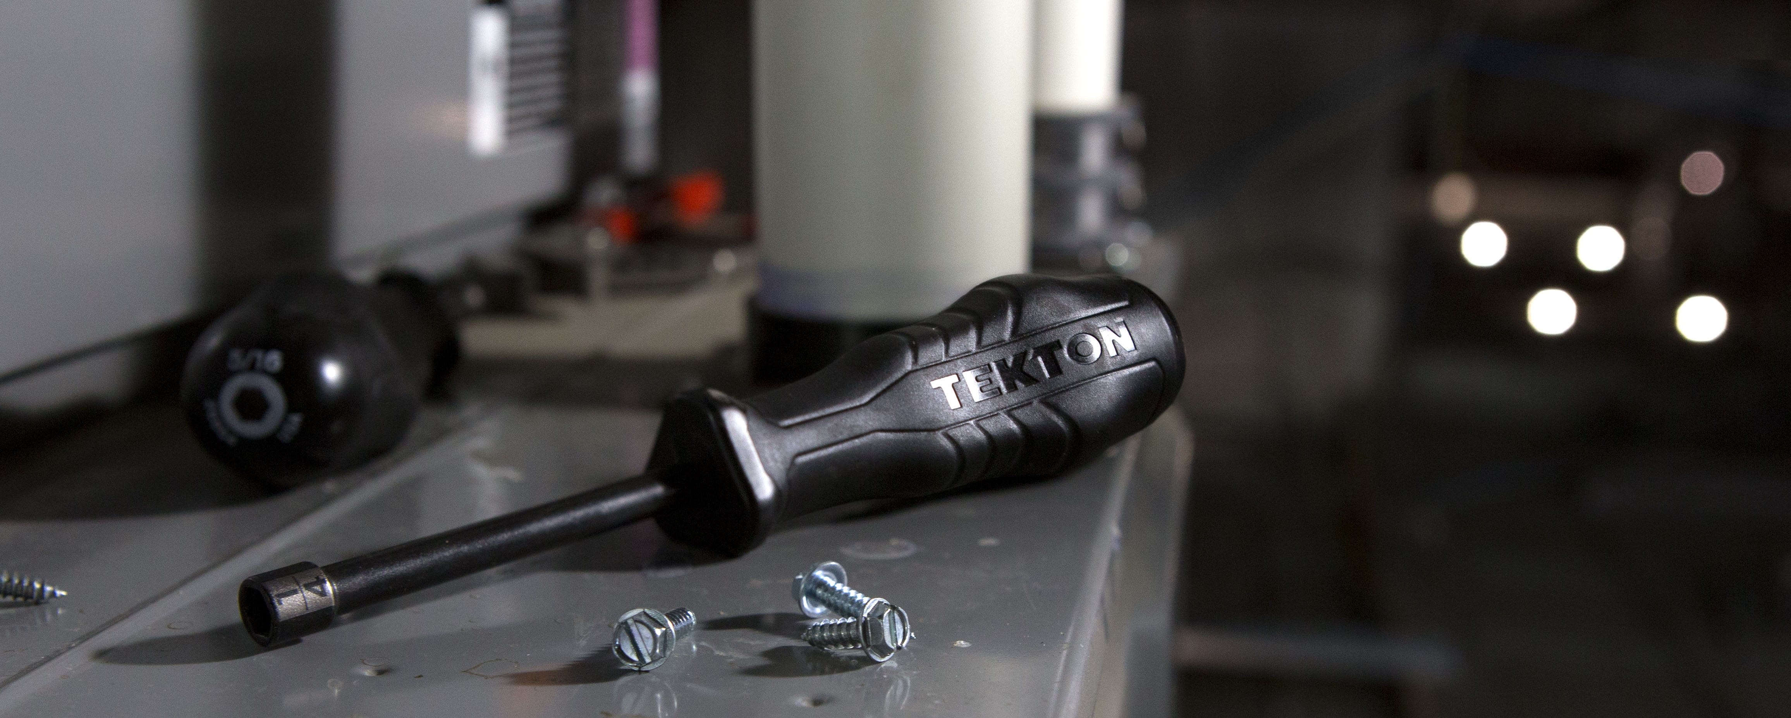
FM + COVID-19 Series #16
Strategies in Operational Performance and IAQ Improvements During and After COVID-19
IFMA.org

Slide 2
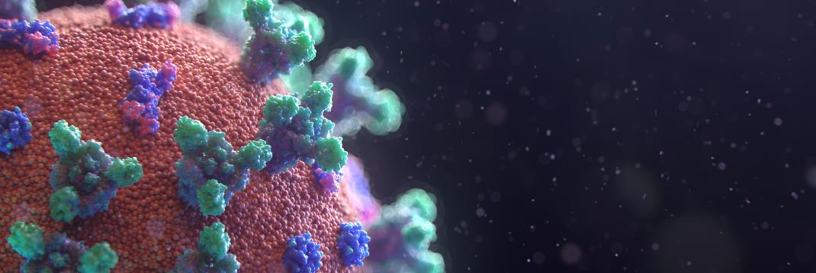
Coronavirus Resource Center
ifma.org/coronavirus
IFMA.org

Slide 3
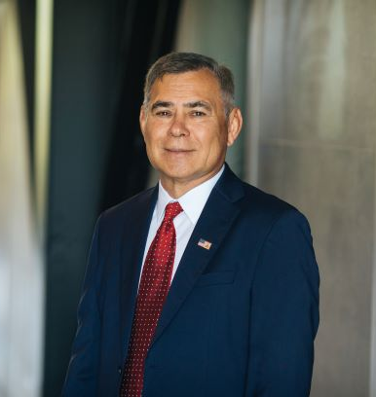

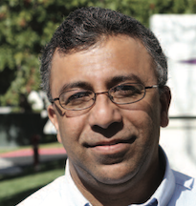
Carlos Santamaria
CEES-Advisors, Principal
Moderator
Dr. Marwa Zaatari
Chief Science Officer, Blue Box Air
Dr. Ashish Mathur
Vice President of Innovation, UVDI
Strategies in Operational Performance and IAQ Improvements During and After COVID-19

Slide 4


Today’s Topics
The important role HVAC plays during COVID-19
Basics of UVC disinfection
Cost effective strategies to optimize energy and IAQ
Operational awareness of HVAC systems
Open Discussion and Q & A

Slide 5

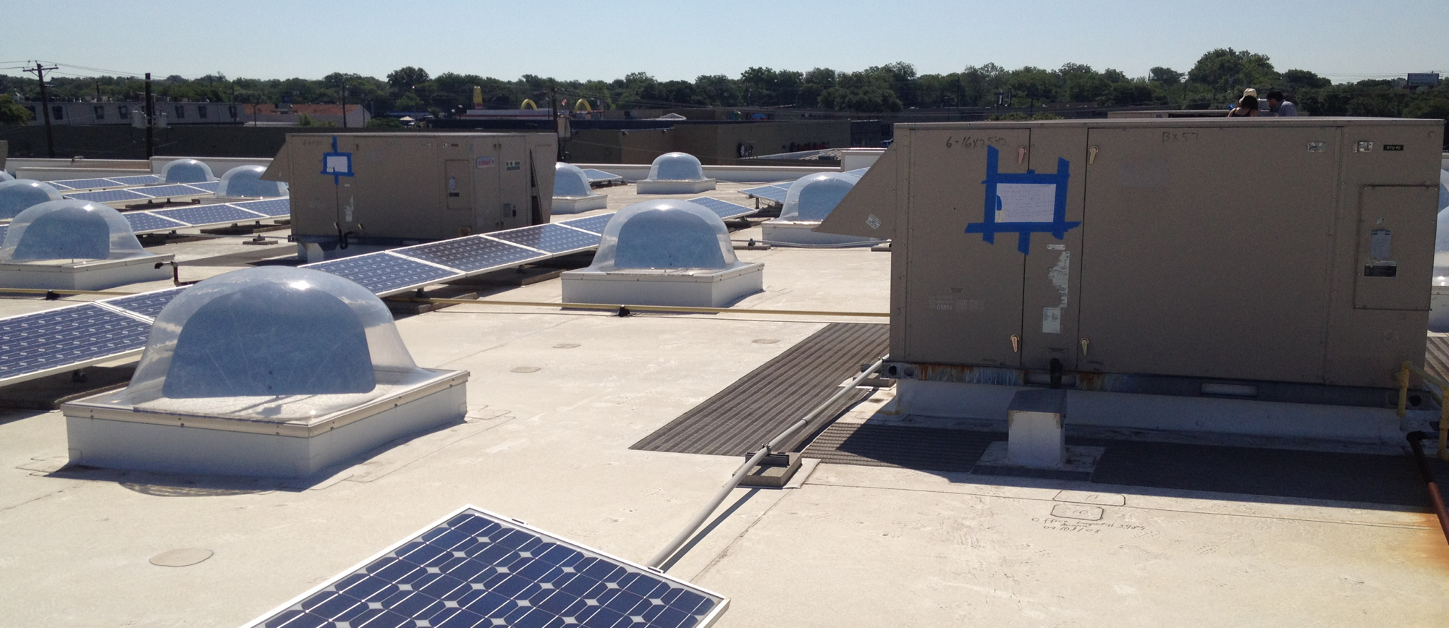
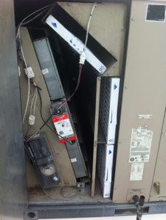
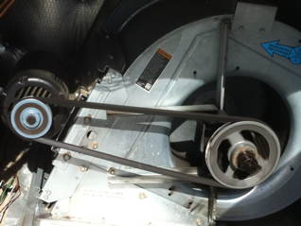
HVAC Strategies in the Age of COVID
Marwa Zaatari, PhD
August 12, 2020

Slide 6
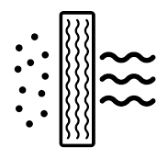




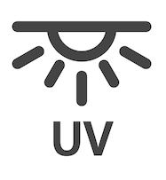



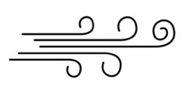
Can HVAC System Design and Operation Prevent COVID-19 Airborne Transmission?
Filtration (MERV 13 min)
HVAC Coil Cleaning using enzymes
Maintain normal thermal comfort conditions
Increased OA for Ventilation
Flushing Sequence
Operate standalone air cleaners
Operate Ultraviolet Germicidal Irradiation
Continuous Run of toilet’s Exhaust system
Operate Economizers
Increase room air motion

Slide 7
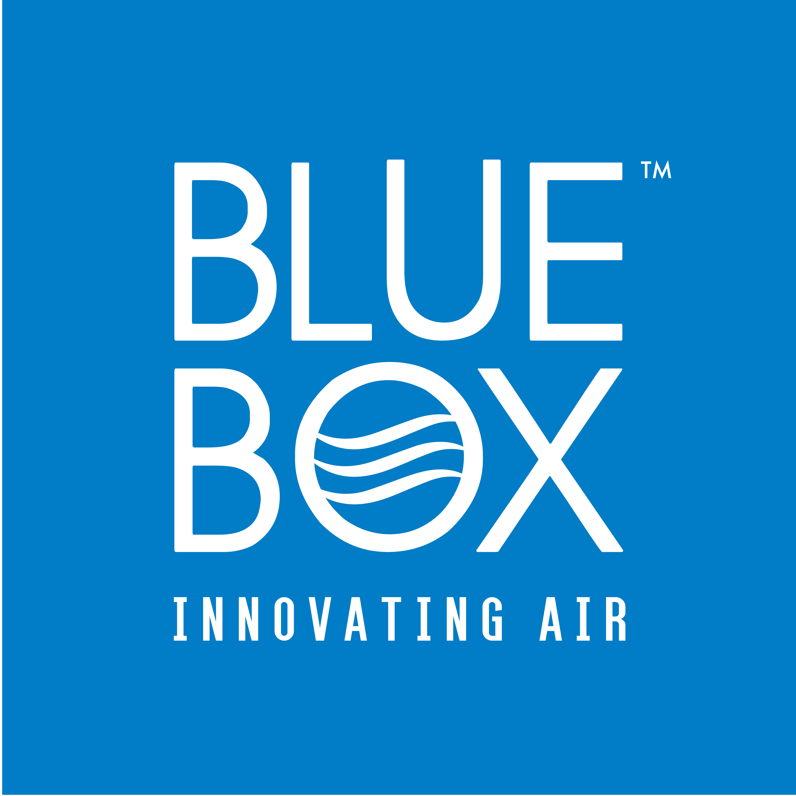
Recommendations by order of effectiveness, first and operating cost
1) Source Control
2) Source Removal
3) Dilution

Slide 8
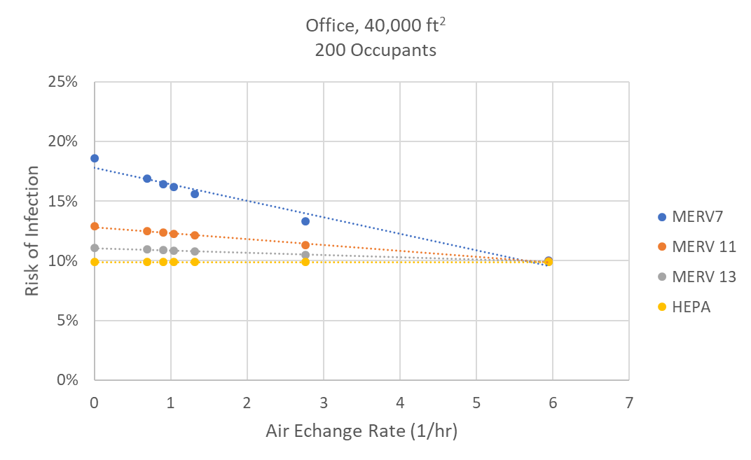
Trade-off Between Filtration and Ventilation
Wells Riley Risk infection Model
OA + PM Filtration | Risk (%) | Relative First Cost ($) | Relative Annual Cost ($)
Min OA + MERV 7 | 14.38% | $ - | $-
Min OA+ MERV 13 | 9.40% | $324 | $1,295
100 % OA | 8.51% | $906,275 | $189,751

Slide 9
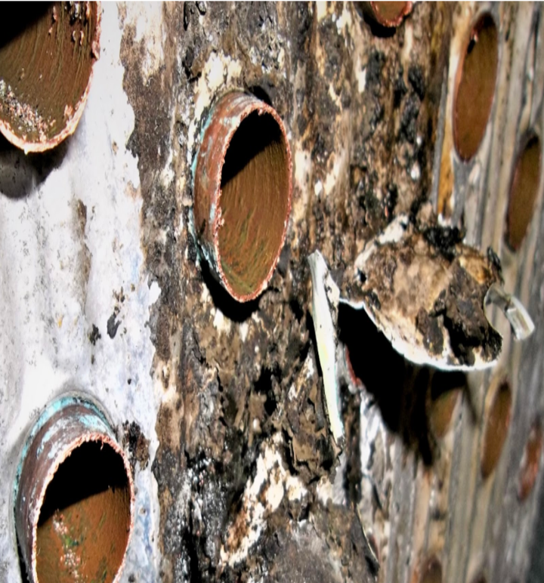
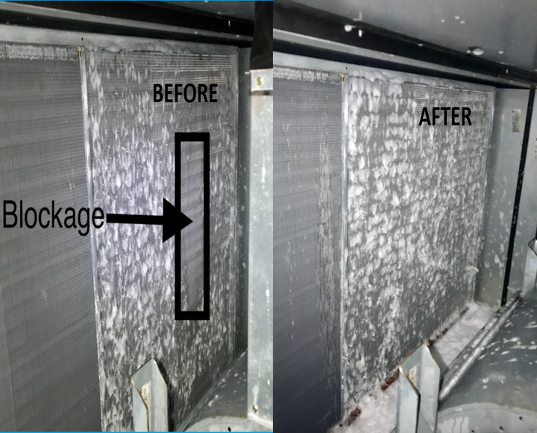
Coil Cleaning
Goals:
Remove biofilms deep within the coil
Not to re-aerosolize any particles that may be on the surface
→ Traditional coil cleaning (pressure and steam washing) and UV does not establish the above.
“A substantial evidence exists that coils can disseminate contaminants into the indoor air. ”

Slide 10
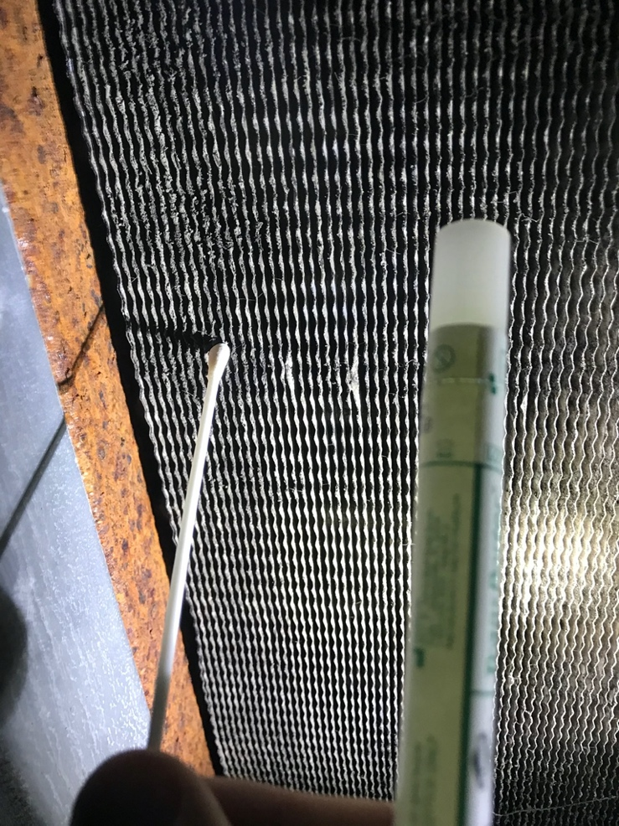
COVID-19 Testing
Swab Test
Air Sample Test
Pump

Slide 11

What is Ultraviolet Light?
Electromagnetic Spectrum
X-rays
Ultraviolet
Visible Light
Infrared
Vacuum-
UV
-C
UV-B
UV
-A
UV
260
100
200
280
315
400
780
Cell Inactivation
of Microorganisms
Wavelength (nm)
Increasing Wavelength
Increasing Energy

Slide 12
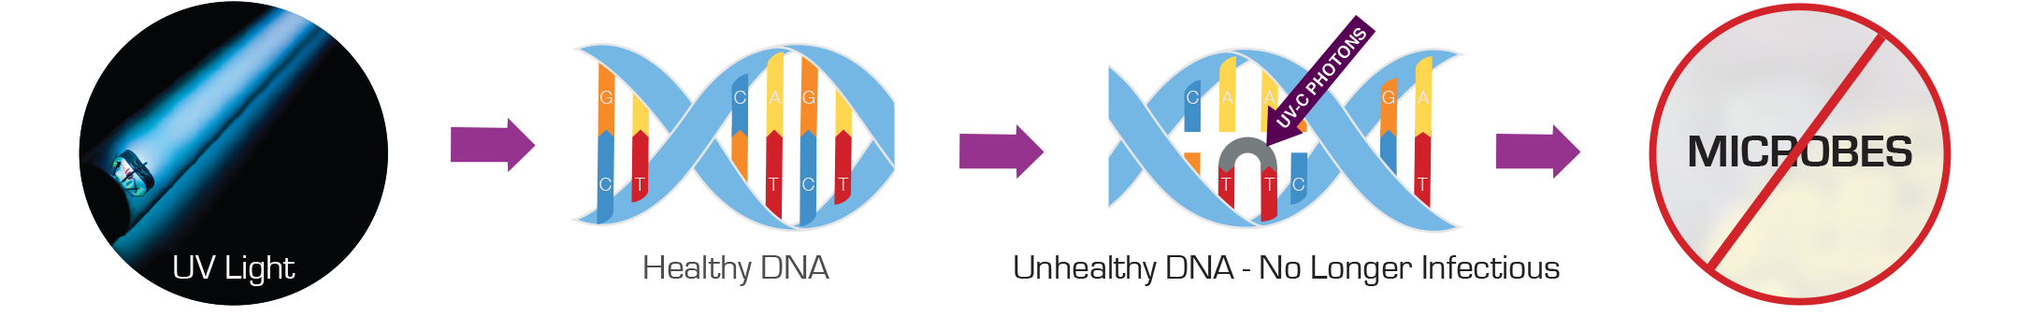
Ultraviolet Germicidal Irradiation
How UV Disinfects
UV-C energy alters the DNA of microorganisms preventing them from reproducing and causing them to become non-pathogenic, or incapable of causing disease.
The 254nm Energy Damages the DNA of the Pathogens

Slide 13
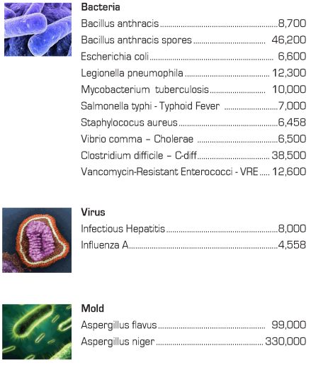
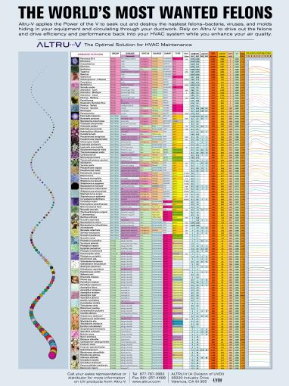
Correct Application of UVC Dose

Slide 14
UVC Applications in Buildings
Cooling Coil Disinfection
Air Stream Disinfection
Surface Room Disinfection

Slide 15
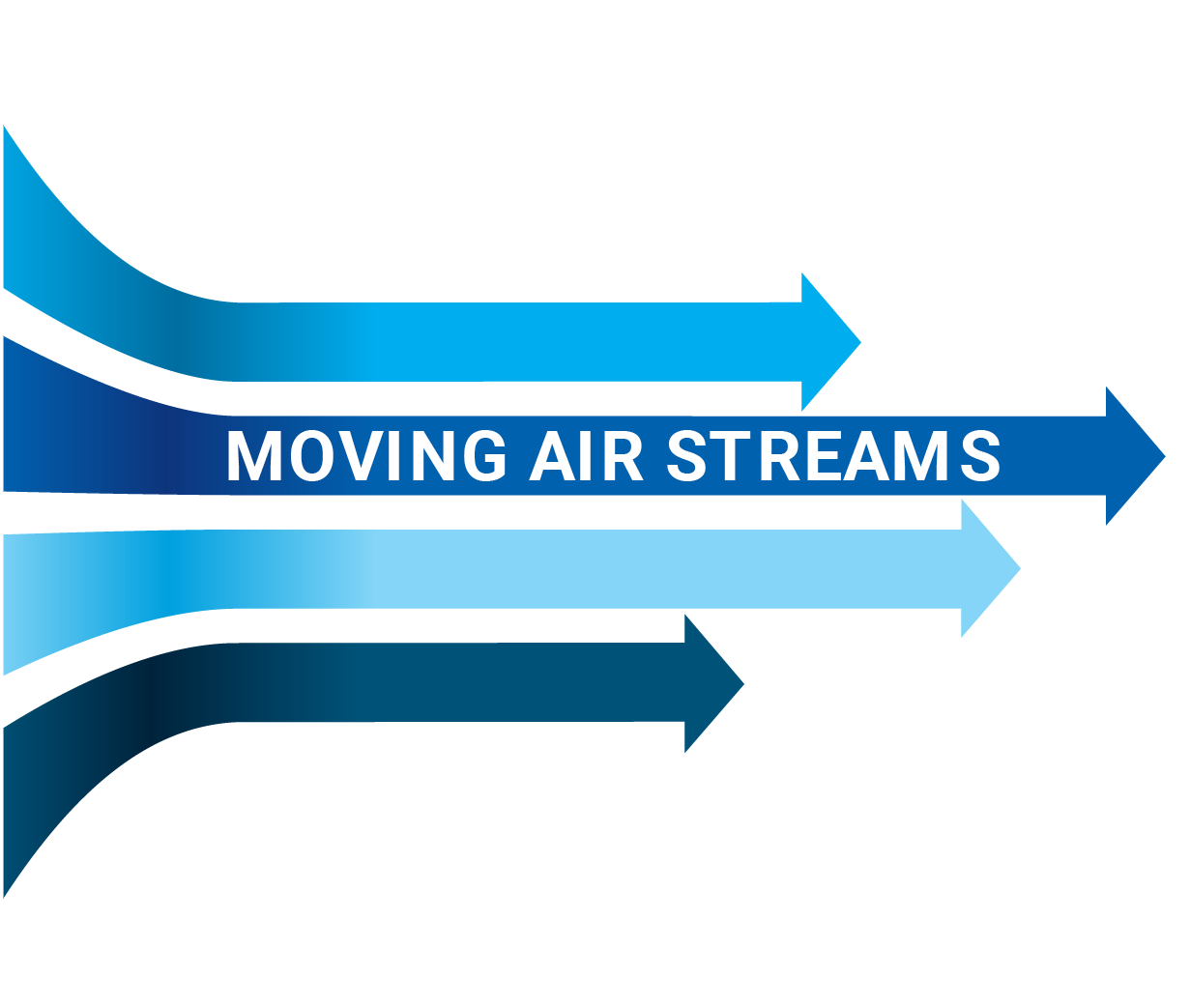
UVGI Air Stream Disinfection
“Kill on the Fly”
COMMON AIRBORNE MICROORGANISMS
CORONAVIRUS, INFLUENZA , SARS, HIN1, MERS-CoV
TUBERCULOSIS
MEASLES
ASPERGILLUS MOLD SPORES
LEGIONELLA

Slide 16
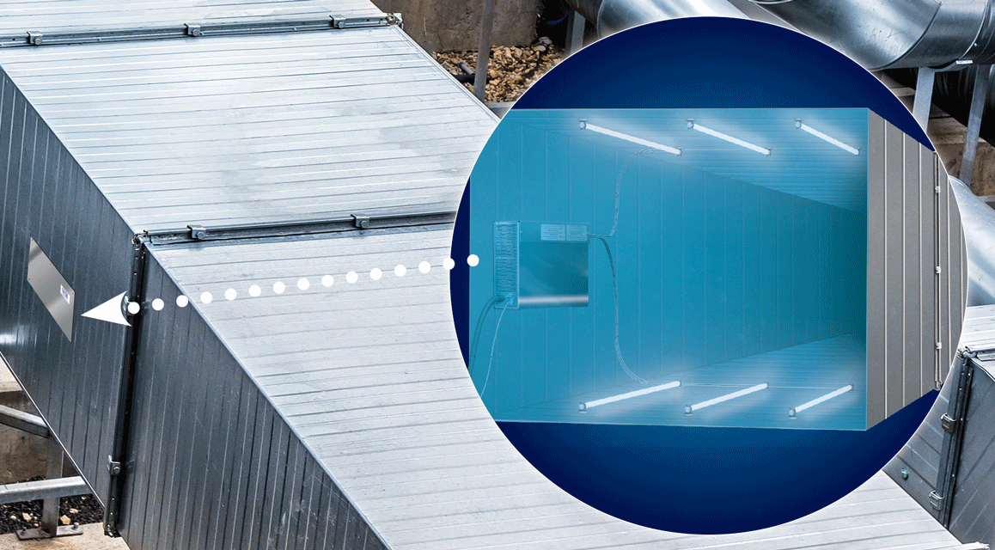
UVGI Air Disinfection
AHU Mounted
Duct Mounted

Slide 17
Key Takeaway – Air Disinfection
Dose = Intensity Time
x
Air Stream Disinfection is HIGH intensity light
Fractions of a second to “kill” the microbe
  Traveling 500fpm with a “kill” zone of 2 feet is 0.24009 seconds
Air Stream Disinfection can clean a coil if next to the cooling coil

Slide 18
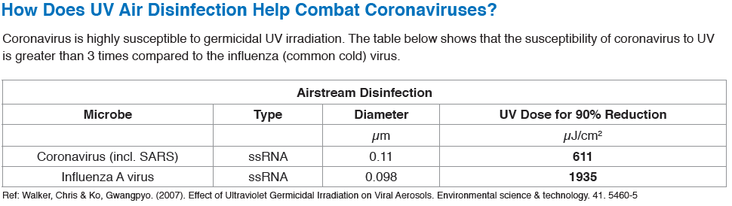
Coronavirus Preventative Measures
Greater than 99% single pass reduction of Coronavirus when Airstream disinfection sized for 90% single pass reduction of Influenza A

Slide 19
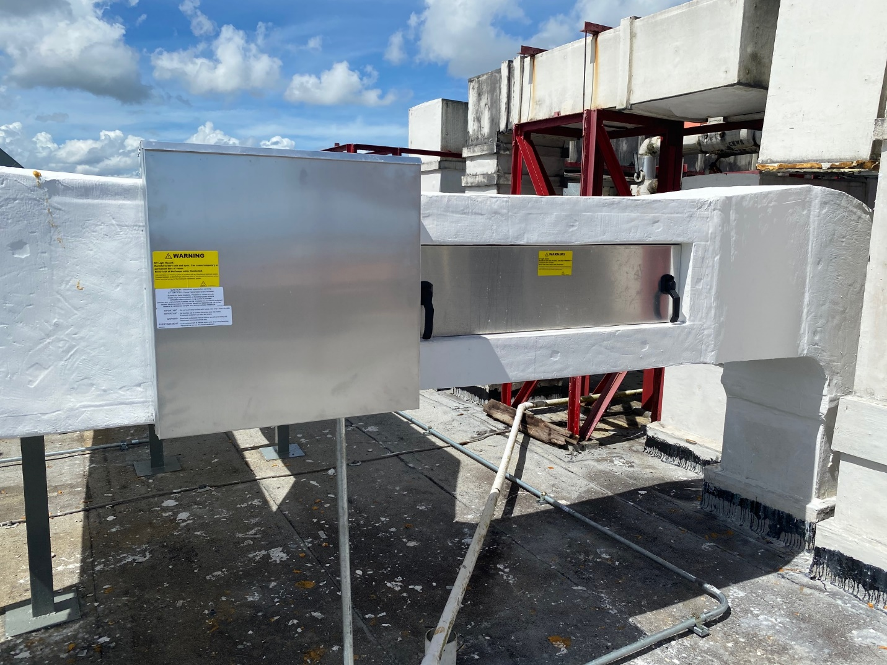
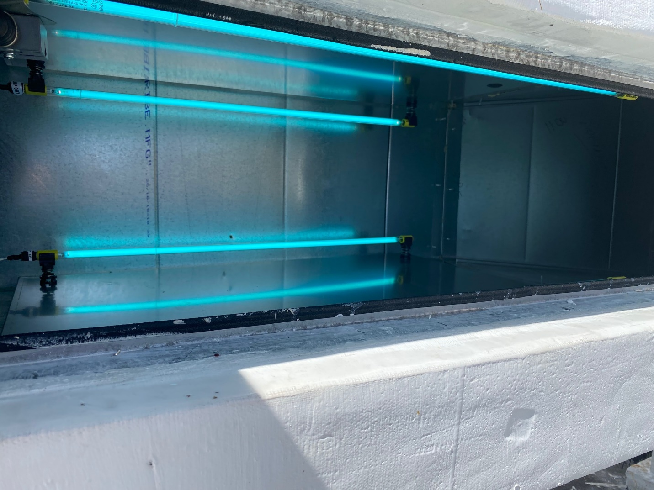
UV Air Stream Disinfection
Example Duct Installation

Slide 20
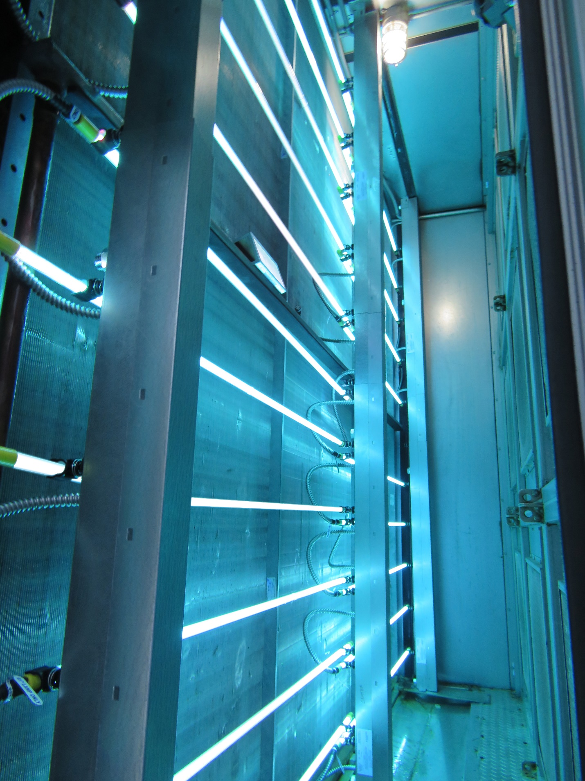
UV Coil + Air Stream Disinfection Example AHU Installation

Slide 21
UVGI Upper Air Room Disinfection
UVC Fixtures installed at a height above 7 ft
Baffles/louvers direct UVC outwards and upwards preventing occupant UVC exposure
Good room circulation allows UVC light to disinfect air as it moves upwards
Courtesy: Dr. Richard Vincent Mt. Sinai School of Medicine, NY

Slide 22
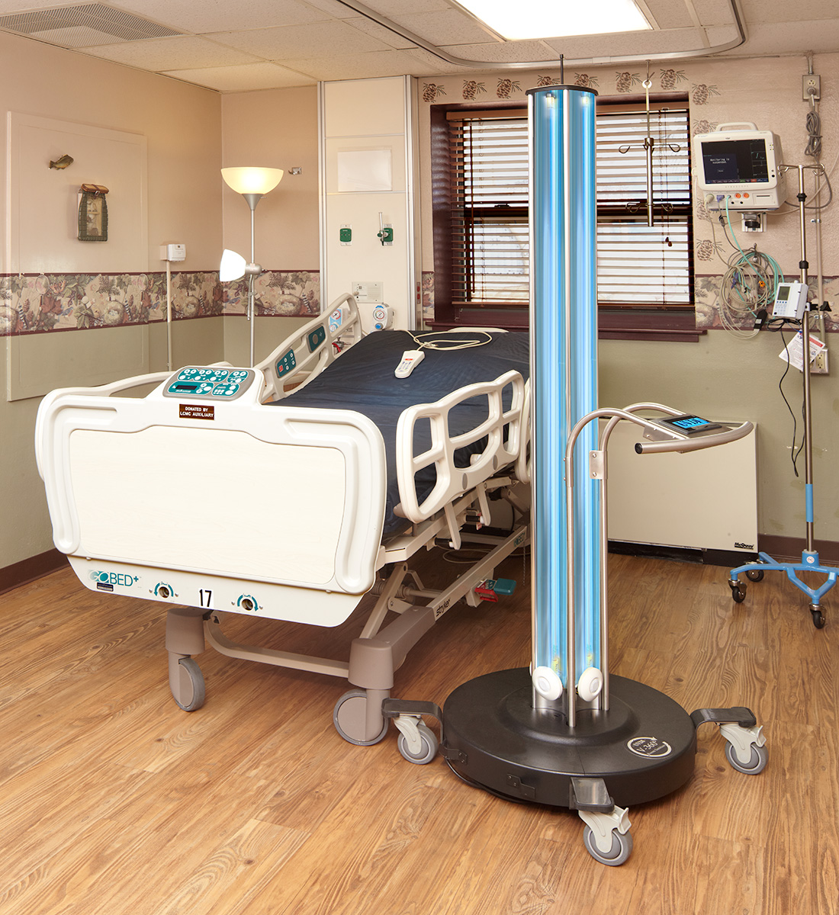
UVGI Whole Room Surface Disinfection
Coronavirus droplets can travel and deposit on surfaces in a room
Studies indicate coronavirus and other pathogens can survive on surfaces for days and weeks
UVC proven to be very effective in disinfecting surfaces to high levels of disinfection

Slide 23
Audience
Q & A
Notes:
Is the vision to go back to pre-COVID?

Slide 24
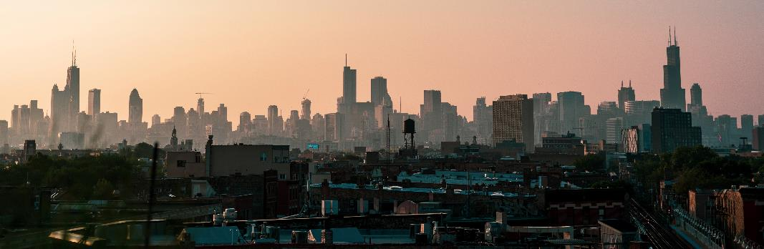
FM + COVID-19 Series #17
How technology and automation can improve O & M in your critical facilities
Wednesday, August 19th
10:00 A.M. CDT
https://covid-19webinar.ifma.org

Slide 25
Coronavirus Resource Center
ifma.org/coronavirus
IFMA.org

