Slide 1


IFMA Foundation Pandemic Manual, Part 1
Leading the Way from Crisis to Safety
FM & COVID -19 Webinar Series #9

Slide 2


Coronavirus
Resource Center
ifma.org/coronavirus
IFMA.org

Slide 3
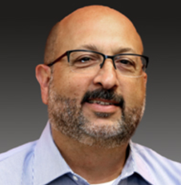


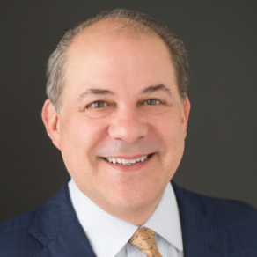
Joe Archie (Moderator)
Chair, IFMA Foundation
Director, Campus Operations, Loyola Law School
Dr. Steven Goldman
Senior Lecturer, MIT Crisis Management Courses
President, Steve Goldman & Associates
Jenny Yeung
Chair, IFMA Asian Advisory Board
Tony Piucci
1st Vice Chair IFMA Foundation
SVP, ABM Industries
IFMA FOUNDATION PANDEMIC MANUAL, Part 1 Leading the Way from Crisis to Safety

Slide 4

Topics :
Crisis Management
COVID-19 Issues
IFMA Foundation Pandemic Manual
Case Studies
Additional Resources

Slide 5




5
THANK YOU SPONSORS
PLATINUM SPONSOR
GOLD SPONSORS
BRONZE SPONSORS
IFMA Public Sector Council
IFMA San Fernando Valley Chapter
IFMA Health Care Council
IFMA Hospitality Council
CEES-Advisors

Slide 6

Crisis Management, Briefly

Slide 7

Reality Check!
When it Comes to a Crisis:
You have no option but to participate
How you handle it can make or break you
There are no hard and fast rules. Common sense should prevail.
You must be prepared
Communication is generally the toughest part of any crisis

Slide 8
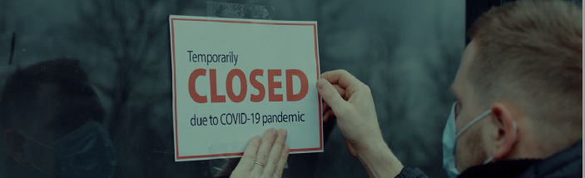
Basic Crisis Management Philosophy
Normal ‘day-to-day’ company operations are not suited to managing a crisis.
During a crisis:
Company resources must focus on the crisis
Crisis management organization must be established
Did you set up and exercise Pandemic Response Team . . . ?

Slide 9

Work From Home – Preliminary Research
Preliminary research results for an upcoming paper:
60 companies responding so far
On average, 95% of their staff are working from home
Manufacturing organizations reported WFH rate between 5% and 30%
Key result / trend:
The organizations who planned and exercised WFH had:
Many fewer problems and a much faster startup of the process
Better communications and coordination overall
. . . than those who did not.

Slide 10
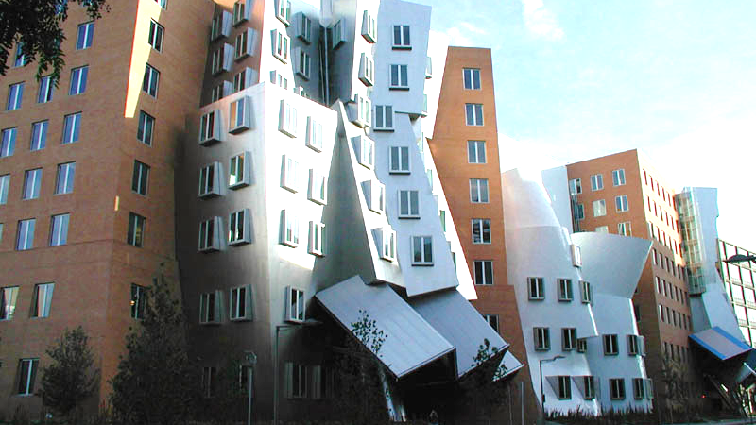
3 Pillars Needed to Build an Organization
PEOPLE FACILITIES CONNECTIVITY

Slide 11
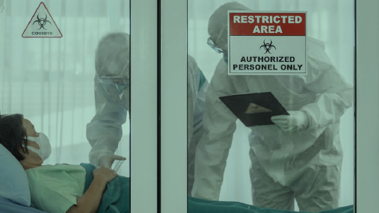
Some COVID-19 Issues

Slide 12
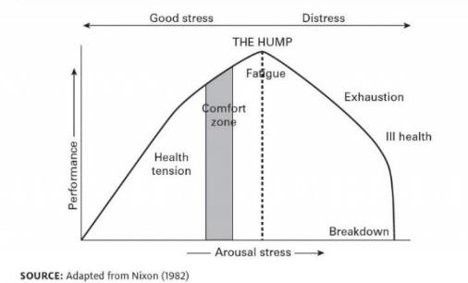
Care for Your People!
Have services available to support your employees, including counseling and other types of support
Monitor staff health
Understand employees may face medium- and long-term issues:
  Personal
  Family
  Financial
Communicate! Listen!
Do not overwork people!
The Human Function Curve

Slide 13
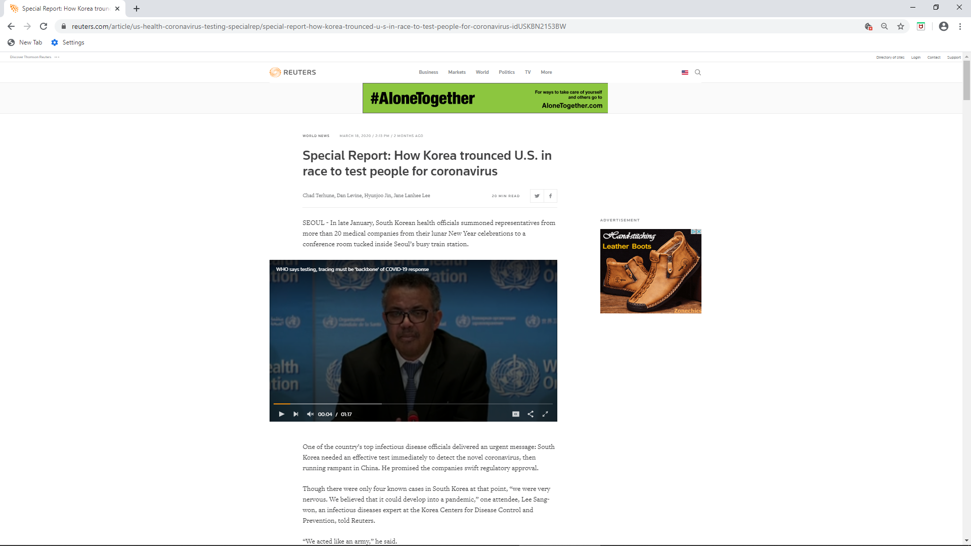
U.S. fell dangerously behind – who?

Slide 14
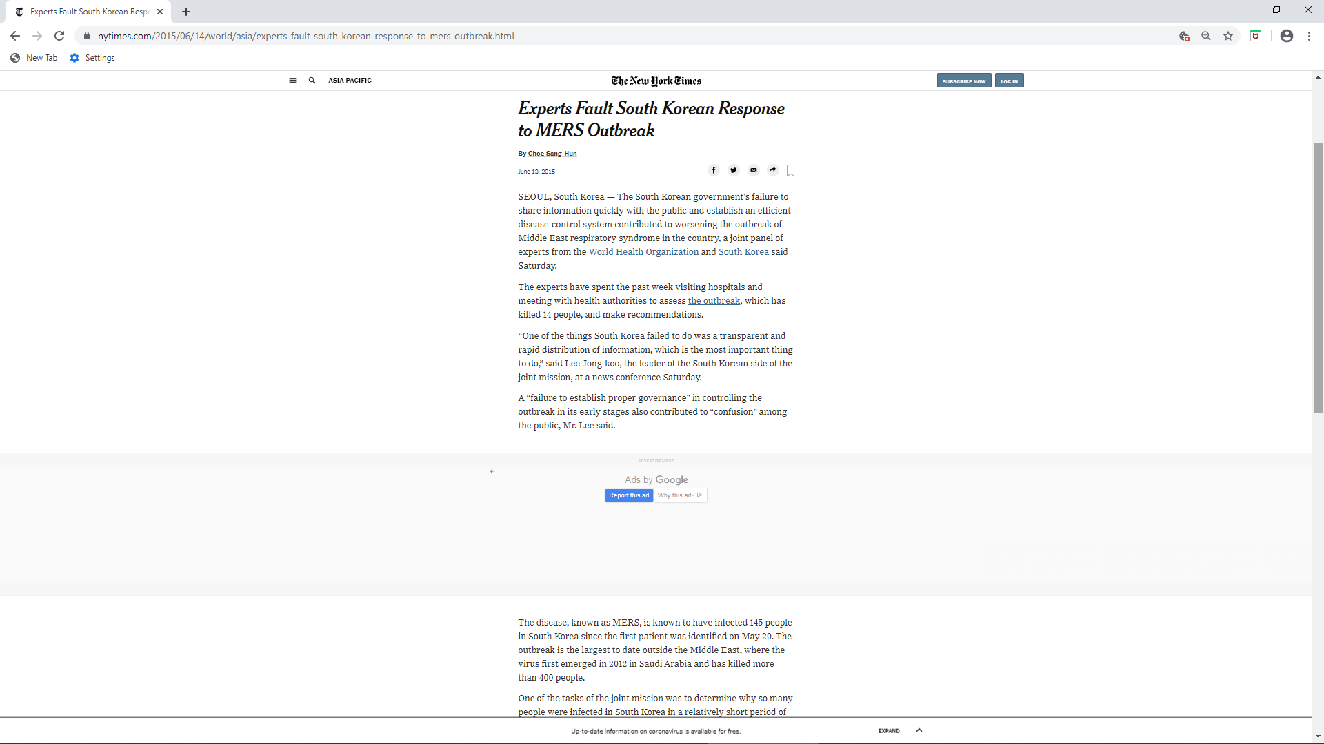
Who fell dangerously behind?
June 12, 2015

Slide 15
Innumeracy
Base data source: https://coronavirus.jhu.edu/data/mortality May 12, 2020; 11:46 PM
Country | Confirmed Cases | Deaths | Case-Fatality | Deaths/100k pop.
United States | 1,369,376 | 82,356 | 6.0% | 25.17
United Kingdom | 227,741 | 32,769 | 14.4% | 49.28
Italy | 221,216 | 30,911 | 14.0% | 51.15
France | 178,349 | 26,994 | 15.1% | 40.30
Spain | 228,030 | 26,920 | 11.8% | 57.62
Brazil | 178,214 | 12,461 | 7.0% | 5.95
Belgium | 53,779 | 8,761 | 16.3% | 76.70
Germany | 173,171 | 7,738 | 4.5% | 9.33
Netherlands | 43,183 | 5,529 | 12.8% | 32.09
Canada | 72,419 | 5,300 | 7.3% | 14.30
China | 84,018 | 4,637 | 5.5% | 0.33
Mexico | 38,324 | 3,926 | 10.2% | 3.11
Sweden | 27,272 | 3,313 | 12.1% | 32.53
India | 74,292 | 2,415 | 3.3% | 0.18
Russia | 232,243 | 2,116 | 0.9% | 1.46
Switzerland | 30,380 | 1,867 | 6.1% | 21.92
Ireland | 23,242 | 1,488 | 6.4% | 30.66
Portugal | 27,913 | 1,163 | 4.2% | 11.31
Philippines | 11,350 | 751 | 6.6% | 0.70
Japan | 15,968 | 657 | 4.1% | 0.52
Denmark | 10,789 | 527 | 4.9% | 9.09

Slide 16
Innumeracy
Base data source: https://coronavirus.jhu.edu/data/mortality May 12, 2020; 11:46 PM
Country | Confirmed Cases | Deaths | Case-Fatality | Deaths/100k pop.
Belgium | 53,779 | 8,761 | 16.3% | 76.70
Spain | 228,030 | 26,920 | 11.8% | 57.62
Italy | 221,216 | 30,911 | 14.0% | 51.15
United Kingdom | 227,741 | 32,769 | 14.4% | 49.28
France | 178,349 | 26,994 | 15.1% | 40.30
Sweden | 27,272 | 3,313 | 12.1% | 32.53
Netherlands | 43,183 | 5,529 | 12.8% | 32.09
Ireland | 23,242 | 1,488 | 6.4% | 30.66
United States | 1,369,376 | 82,356 | 6.0% | 25.17
Switzerland | 30,380 | 1,867 | 6.1% | 21.92
Canada | 72,419 | 5,300 | 7.3% | 14.30
Portugal | 27,913 | 1,163 | 4.2% | 11.31
Germany | 173,171 | 7,738 | 4.5% | 9.33
Denmark | 10,789 | 527 | 4.9% | 9.09
Brazil | 178,214 | 12,461 | 7.0% | 5.95
Mexico | 38,324 | 3,926 | 10.2% | 3.11
Russia | 232,243 | 2,116 | 0.9% | 1.46
Philippines | 11,350 | 751 | 6.6% | 0.70
Japan | 15,968 | 657 | 4.1% | 0.52
China | 84,018 | 4,637 | 5.5% | 0.33
India | 74,292 | 2,415 | 3.3% | 0.18

Slide 17
Innumeracy
Base data source: https://coronavirus.jhu.edu/data/mortality May 12, 2020; 11:46 PM
Country | Population (Millions) | Area (M Sq Mi) | Number of Infections | Number of Deaths | Deaths/M pop/M sq mi
Singapore | 5 | 0.000278 | 25,346 | 21 | 15,108
Switzerland | 8 | 0.016 | 30,413 | 1,564 | 12,219
Italy | 60 | 0.116 | 222,104 | 31,106 | 4,469
United Kingdom | 66 | 0.093 | 229,705 | 22,186 | 3,615
Spain | 47 | 0.195 | 228,691 | 27,104 | 2,957
France | 67 | 0.248 | 140,227 | 26,991 | 1,624
Germany | 83 | 0.138 | 173,274 | 7,755 | 677
Turkey | 82 | 0.302 | 141,475 | 3,894 | 157
South Korea | 51 | 0.038 | 10,962 | 259 | 134
Iran | 82 | 0.636 | 112,725 | 6,783 | 130
United States | 332 | 3.797 | 1,406,722 | 83,514 | 66
Mexico | 128 | 0.761 | 38,324 | 3,926 | 40
Canada | 37 | 3.855 | 71,486 | 5,209 | 37
Taiwan | 24 | 0.014 | 440 | 7 | 21
Brazil | 209 | 3.288 | 178,883 | 12,484 | 18
Iraq | 38 | 0.169 | 2,913 | 112 | 17
Russia | 141 | 6.6 | 242,271 | 2,212 | 2
Australia | 25 | 2.97 | 6,980 | 98 | 1
China | 1,394 | 3.705 | 82,919 | 4,633 | 1

Slide 18

IFMA Foundation Pandemic Manual
Introduction
COVID-19 Information
Potential Pandemic Impacts on Facilities
FM Pandemic Risk Factors and Control Options
Pandemic Planning/Preparation
Pandemic Response
Pandemic Recovery
Appendices ➔
You can download the manual (free) at https://foundation.ifma.org/news/publications/

Slide 19
IFMA Foundation Pandemic Manual
Appendices
Pandemic Resources
Glossary of Terms
Optimizing Remote Work Programs
Coordinated Outbreak Management Systematics
COVID-19 Case Studies
  Building Management
  Facilities Services
  Facilities Services Provider
  Higher Education Student Accommodation
  Hotel
  Information Technology
  International Financial Institute
  Museum
  Real Estate Services I
  Real Estate Services II
  University
  Singapore and China
https://foundation.ifma.org/news/publications/

Slide 20


Source: https://twitter.com/kyork20/status/571788686574149632

Slide 21
Case Studies
Jenny Yeung
Chair, IFMA Asian Advisory Board
Tony Piucci
1st Vice Chair, IFMA Foundation
SVP, ABM Industries

Slide 22
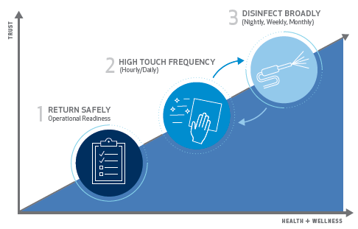
ABM EnhancedClean Program
Three-step approach that delivers healthy spaces with a certified disinfection process backed by experts.
KEY DIFFERENTIATORS:
Certified Processes Backed
by Experts
Hospital Grade Disinfectants & Specialized Equipment
Innovative Solutions including Evidence Based Testing
Notes:
Let’s quickly review the 3-Steps of enhanced cleaning:
1. Pre-opening/reentry phase starts with all-important planning for building and occupant health and safety. Building occupants will likely return in groups or phases, with the facility ramping up to full occupancy over time. Pre-opening/reentry requires facility managers to play a key role in fostering occupant confidence. The most significant component of this phase is performing comprehensive disinfection services, designed to create a healthier environment in order to curb transmission.
Important components for success are:
Labor levels and readiness: Facility managers and their suppliers must be ready to properly train and deploy team members specifically versed in disinfection protocols. There will likely be a need to hire new team members to meet increased demand.
Supply chain security and incorporating new technology (such as that which creates a touchless environment): Planning for the necessary supplies (both type and quantity) is a crucial part of properly executing re-opening protocols. Adapting current methods and incorporating new infection control technology and best practices will also play a vital role.
Accounting for increased service levels and cost: Managing expectations of cost will be key to success. A higher level of service equals more hours equals higher costs.
2. Daily disinfection - Maintaining pathogen control measures that you charted out in phase one will be critical. As occupant confidence begins to return, your pathogen control, occupant health, and preventative maintenance measures must be repeated hourly, daily, or at other appropriate intervals appropriate to your facility use. The hallmarks of this ongoing program are Improved frequency, visibility, and efficacy of cleaning through increased staff and scope.
3. Periodic broader disinfection - (disinfection on a broader scale) becomes necessary when the pandemic has passed or is largely under control. Pathogen control measures must still be practiced, and the new measures employed during phases one and two will likely become a permanent part of daily life. Phase three will entail adding new technologies, which ABM has tested or will test and then pilot at client sites before incorporating them as standard components of our holistic cleaning program.
When we boil it down, what makes a holistic reentry program work is…
Protocols and recommendations driven by a network of experts
Specialized Training on new SOP’s and specific disinfection services
A uniform national infrastructure & availability of labor
Supply Chain Purchasing Power and
Best In Class Equipment and innovations in infection control

Slide 23
The Right Approach at the Right Time
 | Suggested Frequency | Methods Employed | Team Members Deployed | Potential Supplies and Equipment
Step 1: Return Safely Build trust that it’s safe to return to your space. | Intervals based on timing of reentry | Reentry site assessment(s) Plan return to work strategy Facility checklists New workforce protocols (i.e. social distancing procedures, health screening, PPE requirements) Reentry disinfection service using EPA-registered disinfectants | Certified disinfection specialists | Touchless fixtures, dispensers & door openers Centralized trash receptacles Sensor technologies Hand-sanitizing stations (based on availability) Disinfecting wipes for occupants (based on availability)
Step 2: High Touch Frequency Instill confidence that a recurring cleaning and disinfection program is in place | Intervals range from hourly to daily to help curb the spread of pathogens | Site specific SOW for each facility type based on occupancy levels Increased frequency of disinfection of all high touch point areas in facility | Certified disinfection specialists | Occupant Reentry Communication Kits EPA-registered disinfectants Proper PPE Microfiber program
Step 3: Disinfect Broadly A broader disinfection process to help safeguard your full facility beyond high touch point cleaning. Occupants feel secure their environment is reset to even higher standards | Intervals range from nightly to quarterly based on business needs | Full building / large area disinfection using electrostatic spraying with stronger disinfectants | Certified disinfection specialists | Electrostatic sprayers Hospital grade disinfectants with faster kill time and broader pathogen spectrum Continued product testing: Testing and validation UV devices and UVC lighting Antimicrobial and environmental coating solutions Robotic disinfection
Notes:
Pause here for questions.
Every building is unique, with a need for consistent preventative practices and routine disinfection to assure health and wellness for its occupants.
ABM EnhancedClean™ helps you meet the challenge of reentry and reinforced facility services with disinfection technologies for building health and wellness.

Slide 24

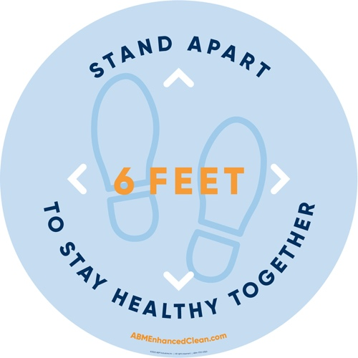



Occupant Reentry Communications
Restroom
Mirror Clings
Entryway Easel Signs
Break Area Tent Cards & Floor Clings
Desk Drops

Slide 25
Questions & Answers

Slide 26

Other Resources

Slide 27
MIT Crisis Management & Business Continuity Course
Virtual Live!
July 21 – 23, 2020
and
July 28 – 30, 2020
http://shortprograms.mit.edu/cm

Slide 28




WE EDUC ATE
WE INVEST
WE C ONNECT
https://foundation.ifma.org/

Slide 29

FM + COVID-19 SERIES #10
Pandemic Essentials Part 2:
The Road to Recovery
Wednesday 27 May 10:00 am (central time)
IFMA.org

Slide 30
Coronavirus
Resource Center
ifma.org/coronavirus
IFMA.org

