Slide 2
Coronavirus Resource Center
ifma.org/coronavirus
IFMA.org

Slide 8
METHODOLOGY

Slide 9
METHODOLOGY: REAL-TIME DELPHI
Obtains a spectrum of diverse external expert perspectives on key questions and assumptions to develop an objective, consensus view of the future in highly uncertain times
Via an online platform, the real-time Delphi facilitates dialogue between geographically separated experts to identify:
Consensus views
Divergent opinions
Notes:
Purpose:
Real-time Delphi study obtains a spectrum of diverse external expert perspectives on key questions and assumptions to develop an objective, consensus view of the future in highly uncertain times. It is a method designed for strategic foresight when quantitative forecasting methods fail.
It is a structured foresight method that enables organizations to deal with complex topics with a high degree of uncertainty. The real-time Delphi facilitates dialogue between geographically separated experts to​ exploit collective intelligence​.
Outcome:
Curated insights from the industry’s leading experts on NWOW post COVID-19 pandemic.
Sponsors would receive raw data so that they can track how discussions and consensus views emerged.

Slide 10
METHODOLOGY: REAL-TIME DELPHI
Curated views of industry-leading, subject matter experts on the key challenges facing the industry
Aids in decision-making
Enables you to orientate on potential opportunities and risks using experts’ assessments.
Identify consensus views
Explore dissenting opinions
Notes:
Purpose:
Real-time Delphi study obtains a spectrum of diverse external expert perspectives on key questions and assumptions to develop an objective, consensus view of the future in highly uncertain times. It is a method designed for strategic foresight when quantitative forecasting methods fail.
It is a structured foresight method that enables organizations to deal with complex topics with a high degree of uncertainty. The real-time Delphi facilitates dialogue between geographically separated experts to​ exploit collective intelligence​.
Outcome:
Curated insights from the industry’s leading experts on NWOW post COVID-19 pandemic.
Sponsors would receive raw data so that they can track how discussions and consensus views emerged.

Slide 11
SIGNIFCIANT SME DEBATE
248 or 38% participated in the survey, and 155 or 23% completed the survey.
Participation among 248 respondents
 | Total | Average
Visits & Revisits | 837 | 3 Per SME
Comments | 2,494 | 100* Per question
Revisions | 1,486 | 62* Per question
* Note: Average of comments based on average of 25 questions and revision based on average of 24 questions. Figures have been rounded to whole numbers. The difference is due to types of questions asked

Slide 12
The online debate ran from 2 July 2020 – 4 August 2020

Slide 13
PLATFORM: RESPONDENT VIEW (EXAMPLE)
Question
In the post-pandemic workplace, technologies to remotely sense the health condition of people in the workplace (e.g. remote temperature and heart rate sensors) will become standard in offices.
Strongly disagree
Disagree
Neutral
Agree
Strongly agree
Reason / explanation
Question
In the post-pandemic workplace, technologies to remotely sense the health condition of people in the workplace (e.g. remote temperature and heart rate sensors) will become standard in offices.
Strongly disagree
Disagree
Neutral
Agree
Strongly agree
Reason / explanation
Respondent A can check consensus, check response stats, see other respondents’ comments, and rate other participant answers. They can also change their answer if they want
1) Respondent A provides answer
Respondent A enter their rationale for their answer
My reason
Consensus
Stats
Comments
Consensus
Stats
Comments
Since the virus will be with us for a few years, organizations and employees will want the means to ensure those who are sick do not risk the health and wellbeing of people in the workplace.
Strongly Disagree
Laws, company policies, and workers’ concern for privacy will limit the application of such technologies – regardless of the impact of the Covid19 crisis.
Back
Unimportant
Important
Irrelevant
Relevant

Slide 14
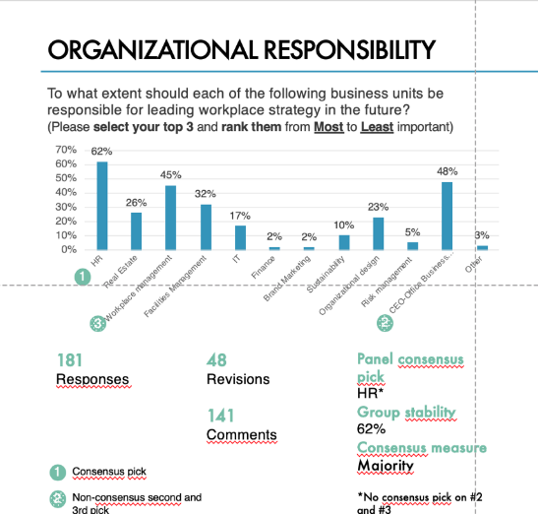
CONSENSUS MEASURES
A
SME consensus is measured in two different ways, depending on the question type.
If the question response categories followed a Likert scale, the platform calculates the consensus measure using the arithmetic mean.
In the case of non-Likert scales, the platform calculates the consensus measure using he response that received the majority of SME responses.
The consensus threshold is set at 55%. Thus, the group stability measure, whether coefficient of variance or percentage function, needs to exceed 55% to achieve a "consensus" ranking.
Group stability is the strength of the consensus measure.
For Likert scale questions, the platform measures group stability using the coefficient of variation.
For non-Likert scale questions, the platform measures group stability using a percentage function.
B
A
B
A

Slide 15
PARTICIPANT DEMOGRAPHICS

Slide 16
PARTICIPANT DEMOGRAPHY*
AGE
GENDER
Prefers not to say
56 %
1 %
43 %
GEOGRAPHIC DISTRIBUTION
EDUCATION
57%
29%
7%
2%
1%
2%
* Note: Figures may not add to 100% due to rounding
Notes:
660 were invited to participate
248 or 38% participated in the survey, and 155 or 23%
completed the survey.
A vital element of the real-time Delphi is the makeup and the collaboration of the SME panel. The following section outlines the demographic composition of the SME panel. The subsequent three pages provide in-depth statistics describing the SME panel as well as examples of the organizations they represent.
Age: Given the focus on SME's, the survey methodology focuses on participants with 10+ years of work experience. As a result, 33% of respondents are 41-50 years old, and 30% are 51-60 years old.
Gender: The SME panel skews male (56%) over female (43%). The remaining 1% preferred not to say.
Regional composition: The panel composition is predominately North American (57%) and European (29%), though panelists from Asia (7%), Oceania (2%), Africa (2%), and Latin America (1%) are also represented
Educational background: 63% of respondents had a Master's Degree or more.
Professional background: IFMA's Communities of Practices attempted to create an SME panel with diverse professional experiences consisting of academics, advisors, internal support functions, and external support functions (e.g., service providers). While there were representatives from all the aforementioned professional backgrounds, consultants provided the majority of the SME panel, followed by persons working in internal functions.
Discipline/area of practice: IFMA's Communities of Practices invited participants from diverse fields of practice, including Workplace Strategy, Architecture, Design, Business Management, Change Management, Human Resources, Facility Management, Corporate Real Estate, Technology, Sustainability, Wellbeing, etc. 31% of the SME panel work in workplace strategy followed by 30% that worked within the Facility Management and Corporate Real Estate space.

Slide 17
PARTICIPANT DEMOGRAPHY*
PROFESSION
DISCIPLINE
* Note: Figures may not add to 100% due to rounding
Notes:
660 were invited to participate
248 or 38% participated in the survey, and 155 or 23%
completed the survey.
A vital element of the real-time Delphi is the makeup and the collaboration of the SME panel. The following section outlines the demographic composition of the SME panel. The subsequent three pages provide in-depth statistics describing the SME panel as well as examples of the organizations they represent.
Age: Given the focus on SME's, the survey methodology focuses on participants with 10+ years of work experience. As a result, 33% of respondents are 41-50 years old, and 30% are 51-60 years old.
Gender: The SME panel skews male (56%) over female (43%). The remaining 1% preferred not to say.
Regional composition: The panel composition is predominately North American (57%) and European (29%), though panelists from Asia (7%), Oceania (2%), Africa (2%), and Latin America (1%) are also represented
Educational background: 63% of respondents had a Master's Degree or more.
Professional background: IFMA's Communities of Practices attempted to create an SME panel with diverse professional experiences consisting of academics, advisors, internal support functions, and external support functions (e.g., service providers). While there were representatives from all the aforementioned professional backgrounds, consultants provided the majority of the SME panel, followed by persons working in internal functions.
Discipline/area of practice: IFMA's Communities of Practices invited participants from diverse fields of practice, including Workplace Strategy, Architecture, Design, Business Management, Change Management, Human Resources, Facility Management, Corporate Real Estate, Technology, Sustainability, Wellbeing, etc. 31% of the SME panel work in workplace strategy followed by 30% that worked within the Facility Management and Corporate Real Estate space.

Slide 18
EXAMPLE OF INSTITUTIONS RESPRESENTED

Slide 19
THEMATIC SECTIONS & KEY FINDINGS

Slide 20
THEMATIC SECTIONS – COVERED IN THE REAL-TIME DELPHI
Workplace strategy
7 questions
Employee well-being & benefits
4 questions
Technology development
5 questions
Organization & productivity
3 questions
Sustainable development goals
3 questions
Facilities in demand
2 questions

Slide 21
INITIAL KEY FINDINGS – WORKPLACE STRATEGY
Remote work
81% expect >26% to work more than 50% remotely
People @ the Office
Need social interactions & work requirements
Well-being challenges
Stress, isolation, concerns of infectious diseases, and insecurity
Workplace strategy
HR sets the strategy,
but does FM own the experience?
FM Responsibilities
Deeper alignment with HR, healthy work environment, ensuring workplace experience

Slide 22
REMOTE WORK
Before the COVID-19, a small portion of the global workforce worked at home half-time or more. In your opinion, what percentage of people will conduct at least half of their work remotely post-COVID-19?
Consensus is set at 55%. No consensus, but 81% believe >26% will work remotely
175
Responses
29
Revisions
110
Comments
Panel consensus pick
No consensus
Group stability
52%
Consensus measure
Majority
Consensus

Slide 23
REMOTE WORK – SME INSIGHTS
26 – 50 %
58 Comments
“We will see more people working remotely but most likely they will work remotely 1-2 days per week. Therefore, the overall percentage of workforce working remotely more than half time will still be limited.”
51 – 75%
26 comments
”In organizations where WFH has proven a success, a dynamic work model will allow for most people to conduct their work from any location allowing folks to work outside of the office at a higher frequency that pre-COVID 19.”
11– 25 %
18 comments
”Having read and listened to lots of research results lately it is clear to that on an average person wants to work an extra day from home compared to pre-COVID-19.”

Slide 24
PEOPLE AT THE OFFICE
Given that we can work from anywhere, why will people come to the office in a post-COVID-19 world? (Please select your top 3 and rank them from Most to Least important)
3
1
3
2
176
Responses
30
Revisions
110
Comments
Panel consensus pick
Need social interactions
Group stability
59%
Consensus measure
Majority
Consensus
1
Consensus pick
2
Non-consensus 3rd pick

Slide 25
PEOPLE AT THE OFFICE – SME INSIGHTS
“Social interactions, in-person teaming, will be beneficial given the environment & community are "safe”. Ultimately some confidential work absolutely must be produced in a high secured environment (physical space as well as technology).”
NEED SOCIAL INTERACTIONS
63 Comments
“I keep wondering about the mechanical engineers and such - what the heck are they doing these last few months. Yes, you can design a lot of stuff on the tube but you've got to build some things and unless you too have a 3D printer sitting beside you, or better yet a fleet of them build lots of parts, how are you really going to get your work done?.”
NEED TO ACCESS UNIQUE FACILITIES
54 Comments

Slide 26
PEOPLE AT THE OFFICE – SME INSIGHTS
”The office will only be for interpersonal activities that don't work anywhere else. So training, customer interaction, mentoring, etc. can all take place elsewhere, and for those who can't work from home, co-working places are an option. But high-level interactions are best in person - nothing can replace that experience. And project teams always work best when everyone first meets in person.”
NEED TO ADDRESS COMPLEX INTERACTIONS
37 comments
“Vermont has 40,000 households without access to effective broadband infrastructure to support remote working and education. That's not counting households that can't afford it. Altogether about 25% or more of Vermonters likely do not have access to broadband. This will continue for years to come. Our state hasn't set up the systems yet to completely figure out remote working processes and procedures.”
CANNOT WORK FROM HOME
42 comments

Slide 27
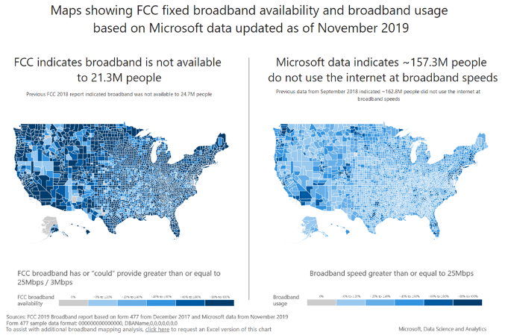
REMEMBER THE DIGITAL DIVIDE
Although digital access is improving through satellite-based internet and mobile broadband (4G and 5G), the digital divide will remain an issue that will impact people’s abilities to work remotely.
In the United States, more than 6% of the population (21 million people) have no high-speed connection. In Australia, the figure is 13%.¹
Globally, only just over half of households (55%) have an internet connection, according to UNESCO. In the developed world, 87% are connected compared with 47% in developing nations, and just 19% in the least developed countries.¹
Data from Microsoft shows that some 157.3 million people in the U.S. do not use the internet at broadband speeds. ²
Image source: Microsoft, 2020
¹ WEF, 2020
² Microsoft, 2020c

Slide 28
WELL-BEING CHALLENGES
In your opinion, what are the most significant health and well-being challenges facing workers following the COVID-19 pandemic? (Please select your top 3 and rank them from Most to Least important)
2
3
1
4
169
Responses
41
Revisions
95
Comments
Panel consensus pick
Stress and mental health issues, including burnout
Group stability
67%
Consensus measure
Majority
Consensus
1
Consensus pick
3
Non-consensus pick

Slide 29
WELL-BEING CHALLENGES– SME INSIGHTS
“We continue to be confronted with a continuous ratcheting up of pressure on performance and outcomes. This can get out of control and lay unsustainable pressure on individuals. In these conditions mental pressure builds and these lead to a range of other illnesses leading ultimately to poorer performance.”
STRESS & MENTAL HEALTH ISSUES
74 comments*
“Isolation can cause all sorts of mental health issues, for some people work is their only place of social interaction and we need to be mindful of that.”
SOCIAL & PROFESSIONAL ISOLATION
58 Comments
* As this question asks for top-3, comments are multipled by 3

Slide 30
WELL-BEING CHALLENGES– SME INSIGHTS
”…The primary concern, therefore, will be worrying about getting COVID (or other future infectious diseases), the ongoing rise of healthcare costs.
CONCERNS OVER INFECTIOUS DISEASE
43 Comments
“In South Africa, the numbers are over 10 000 a day. The economic outlook of the country and jobs is dire. Salary cuts, fear of the illness and burnout from trying to work at home and keep businesses going has been immense.”
INSECURITY (ECONOMIC, FOOD, HOUSING)
45 Comments
* As this question asks for top-3, comments are multipled by 3

Slide 31
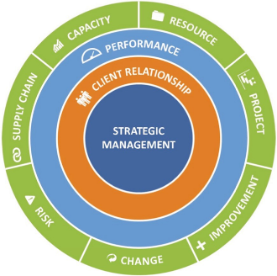
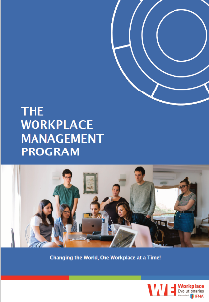
WHAT DOES THIS MEAN?
Workplace Strategy is “the intentional, strategic alignment of the workplace to the business goals, vision, and culture of an organization ”. It requires an integrated, multi-disciplined approach.
Workplace Management Program from IFMA
Workplace management is a dynamic, emerging discipline that designs and delivers an organization’s unique workplace experience, aligning it to strategic drivers and business goals. It coordinates all the disciplines and infrastructure needed to deliver an integrated experience in a powerful, economic and effective way, every day
FM
IT
Risk
CRE
HR
Security
Design
Source: Kate North and Workplace Evolutionaries, (2020)

Slide 32
WHAT DOES THIS MEAN FOR WORKPLACE STRATEGY
FM
IT
Workplace strategy is “the intentional, strategic alignment of the workplace to the business goals, vision, and culture or an organization ”
Risk
CRE
HR
Security
Design
Source: Kate North and Workplace Evolutionaries, (2020)

Slide 33
WORKPLACE STRATEGY - ORGANIZATIONAL RESPONSIBILITY
To what extent should each of the following business units be responsible for leading workplace strategy in the future? (Please select your top 3 and rank them from Most to Least important)
1
3
4
2
Consensus
181
Responses
48
Revisions
141
Comments
Panel consensus pick
HR*
Group stability
62%
Consensus measure
Majority
*No consensus pick on #2 and #3
1
Consensus pick
2
Non-consensus

Slide 34
ORGANIZATIONAL RESPONSIBILITY – SME INSIGHTS
“HR is responsible for the workforce (culture, talent mix, programs supporting the workforce - compensation/benefits/policies). It is responsible for the technical foundation/framework supporting the workforce's ability to do the work, communicate, and collaborate.
HR
100 Comments
“I believe that corporate leadership (CEO/business lines) must buy in to the workplace strategy and lead the company in adopting whatever it may be. In terms of leading the creation of workplace strategy, that should come from supporting functions who understand how people work and how space and tools support them…”
CEO OFFICE
72 Comments

Slide 35
ORGANIZATIONAL RESPONSIBILITY – SME INSIGHTS
“…Workplace strategy has been and should continue to be managed by a cross functional team consisting of representatives from RE/Facilities (workplace strategy), IT, HR and business unit management.”
WORKPLACE MANAGEMENT
65 comments
“The strategy on workplace should come from the discipline which has the best overview over current and future use of existing workplaces. This is in my opinion the FM department. Cooperation with HR and IT to make the strategy work”
FACILITY MANAGEMENT
47 Comments

Slide 36
FACILITY MANAGER RESPONSIBILITIES
What importance will be placed on the following facility management responsibilities post-COVID-19?
(Please select your top 3 and rank them from Most to Least)
1
2
4
3
177
Responses
34
Revisions
106
Comments
Panel consensus pick
Deeper alignment with HR, IT, …
Group stability
62%
Consensus measure
Majority
Consensus
1
Consensus pick
3
Non-consensus 3rd pick

Slide 37
FACILITY MANAGER RESPONSIBILITIES – SME INSIGHTS
“There already should be greater alignment than there is with HR, IT, etc. - but post-COVID there has to be. Workplace strategy is all-encompassing and to my mind that includes the workplace experience and work from home aspects.”
DEEPER ALIGNMENT WITH HR
73 Comments
”Healthy buildings will prove the office can work efficiently. It will encourage people to get back to the office. It will prevent evacuating spaces as we have been forced to currently.”
HEALTHY BUILDING
42 Comments

Slide 38
FACILITY MANGER RESPONSIBILITIES – SME INSIGHTS
“Workplace experience has become paramount in recruiting and employee retention efforts. Having a holistic strategy that incorporates other aspects of the employee experience will be critical to maintain the workplace strategies that are proposed for the physical space.”
OWNING THE WORKPLACE EXPERIENCE
49 comments
”….By emphasizing business outcomes, human capital values and other results never usually considered to be part of the domain of FM we will establish a better balance of solutions, more accountability and it will require upskilling of FM professionals who will need to get seriously outside their current comfort zones.”
DEPLOYMENT OF A WORKPLACE STRATEGY
32 Comments

Slide 39
INITIAL KEY FINDINGS – WORKPLACE STRATEGY
Remote work
81% expect >26% to work more than 50% remotely
People @ the Office
Need social interactions & work requirements
Well-being challenges
Stress, isolation, concerns of infectious diseases, and insecurity
Workplace strategy
HR sets the strategy,
but does FM own the experience?
FM Responsibilities
Deeper alignment with HR, healthy work environment, ensuring workplace experience

Slide 40
THEMATIC SECTIONS – COVERED IN THE REAL-TIME DELPHI
Workplace strategy
7 questions
Employee well-being & benefits
4 questions
Technology development
5 questions
Organization & productivity
3 questions
Sustainable development goals
3 questions
Facilities in demand
2 questions

Slide 41
EXPERTS' ASSESSMENT: THE WORKPLACE POST-COVID-19
Report Available 28 September 2020
Sponsored by:
Prepared by:
Nordic Foresight

Slide 43
Coronavirus Resource Center
ifma.org/coronavirus
IFMA.org

Slide 44
STAY TUNED FOR FUTURE WEBINARS DISCUSSING
Employee well-being & benefits
Technology development
Organization & productivity
Sustainable development goals
Facilities in demand

