Slide 1
FM + COVID-19 Series #10
Pandemic Essentials Part 2:
The Road to Recovery
IFMA.org

Slide 2
Coronavirus Resource Center
ifma.org/coronavirus
IFMA.org

Slide 3
Joe Archie
-Chair, IFMA Foundation
-Director, Campus Operations, Loyola Law School
Dr. Steven Goldman
-Senior Lecturer, MIT Crisis Management Courses
-President, Steve Goldman & Associates
Jenny Yeung
Chair, IFMA Asian Advisory Board
Cathy Campbell, CHESP, CMIP
National Director, Service Delivery
ABM Industries Health Care Division
PANDEMIC ESSENTIALS PART 2
The Road to Recovery

Slide 4
5
THANK YOU SPONSORS
PLATINUM SPONSOR
GOLD SPONSORS
BRONZE SPONSORS
IFMA Public Sector Council
IFMA San Fernando Valley Chapter
IFMA Health Care Council IFMA Hospitality Council
CEES-Advisors

Slide 5
Today’s Topics
Road to Recovery
Re-Entry Considerations
Lessons from Asia
Enhanced Cleaning & Peace of Mind

Slide 6
Road to Recovery

Slide 7
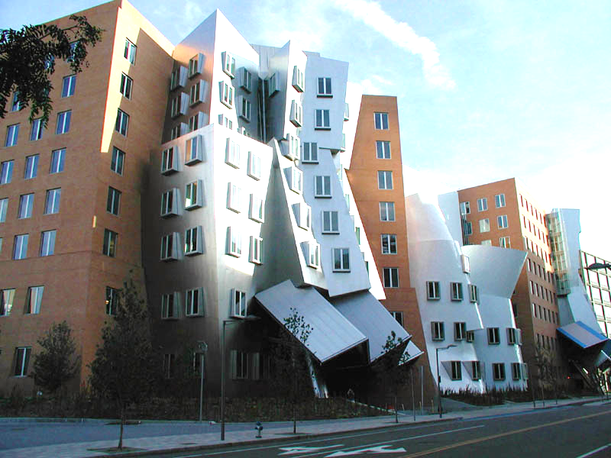
The Three Pillars on which one recovers an organization
People
Facilities
Connectivity

Slide 8
Recovery
Start planning NOW!
Building or Office Reopening Considerations / HR Issues
Dependencies – order of restoration / re-entry
Individual Department Recovery Actions
Graded Department / Employee Re-entry
Employee Health Monitoring
Safety and Security – People and facilities
Social distancing policies / considerations – meetings, “water cooler” gatherings, break rooms
Operations supply chain / distribution chain restarted and balanced
Supplies restocked and distributed
Mail Services restarted
Delayed / Stopped Capital or IT / Construction / Maintenance Projects

Slide 9
Six Readiness Essentials
Primary focus areas applicable to nearly every real estate owner and occupier across the globe:
Prepare the Building: cleaning plans, pre-return inspections, HVAC & Mechanicals checks
Prepare the Workforce: mitigating anxiety, policies for deciding who returns, employee communications
Control Access: protocols for safety and health checks, building reception, shipping and receiving, elevators, visitor policies
Create a Social Distancing Plan: decreasing density, schedule management, office traffic patterns
Reduce Touch Points and Increase Cleaning: open doors, clean desk policy, food plan, cleaning common areas
Communicate for Confidence: recognize the fear in returning, communicate transparently, listen and survey regularly
Source: https://www.cushmanwakefield.com/en/insights/covid-19/recovery-readiness-a-how-to-guide-for-reopening-your-workplace

Slide 10
Re-entry Considerations
Government
Overall re-entry strategy
Relax shelter-in-place orders
Restore public transportation
Open public areas
Relax business shutdowns
Landlord
Occupier
Building capacity/entry restrictions
Building entry policies/ security
Employee testing
Systems cleaned/cleared
Common area social distancing
Cleaning protocols
Supplies restored
Amenities modifications
Services restored (e.g. mail, cleaning)
Signs posted
Selective re-opening
Full re-opening
Office/area capacity/entry restrictions
Office entry/use policies
Social distancing/floorplan
Employee testing
Cleaning protocols
Amenities modifications
Supplies restored
Signs posted
Policies restored/modified
Selective re-entry
New operations tested/approved
Full re-entry/re-opening
RE-ENTRY
Ultimate decision maker on re-entry
Must be confident in health and safety
Family concerns allayed
Individual

Slide 11
Issues to Consider / Monitor
National and local re-opening guidance
Phased re-opening (phases and gates)
Facility disinfection
Employee testing and monitoring
Social distancing
Continual cleaning / disinfection
Communications! Speak and listen!

Slide 12
Mask Confusion?
Local government has lifted the facemask requirement. As staff and contractors report back to work, you notice the following in various areas and departments:
Why could this be a problem?

Slide 13
Preparing for the Next One
To prepare for the next one,
we need to learn and improve from the current one.
Post-Event Review and Action Plan
Conduct in-incident reviews (now!)
Conduct a post-incident critique
Gather all relevant documents and files
Conduct individual interviews
Develop and issue the Post-pandemic Action Plan
Update plans, procedures, facilities, supplies, etc.
Prepare for the next one!

Slide 14
Pandemic Response Action Plan Template
Ref # | Observation/ Item/Challenge | Comment/ Recommendation/ Resolution | Responsible Department / Person | Completion Due Date | Status
1 | (Item 1) | (Recommendation 1) | Legal / D. Havey | November 30 | Underway/on schedule
2 | (Item 2) | (Recommendation 2) | Facilities / D. Eder | October 31 | Not started
3 | (Item 3) | (Recommendation 3) | HR / B. Cianci | October 31 | Completed October 8
4 | {Others}

Slide 15
Case Studies
Jenny Yeung
Chair, IFMA Asian Advisory Board

Slide 16
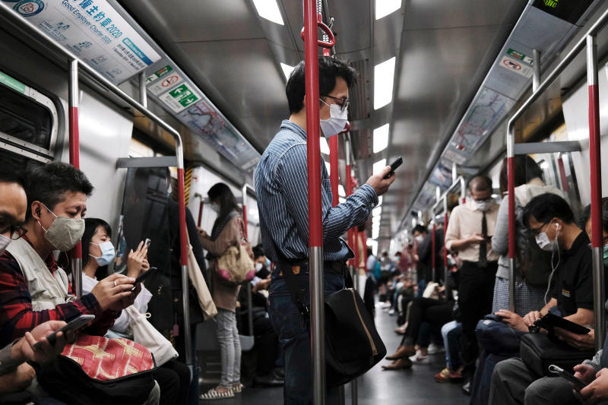
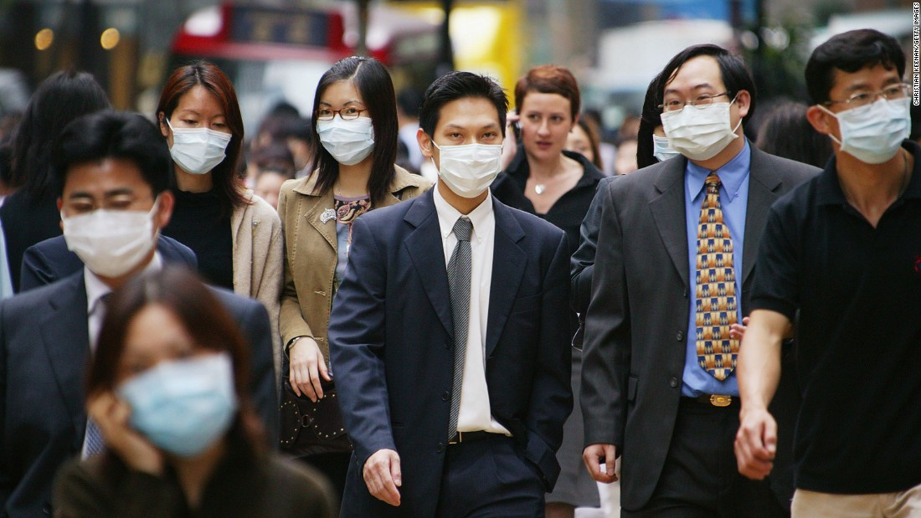
FM + COVID-19 SERIES
LIVE UNDER COVID-19

Slide 17
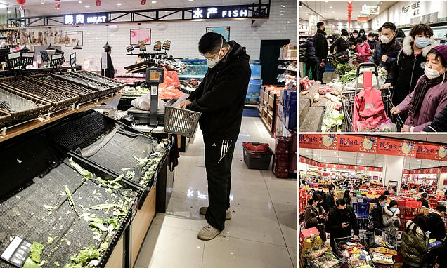
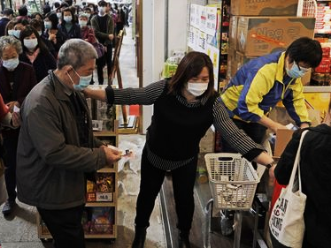
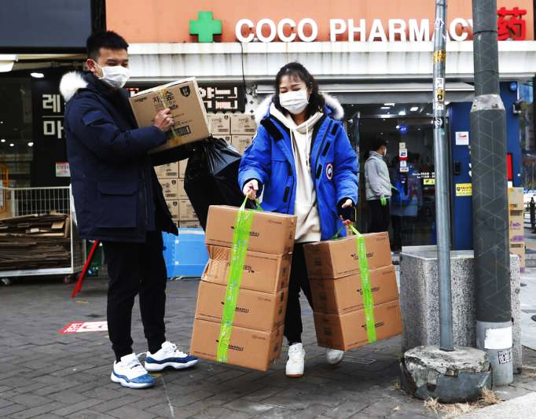
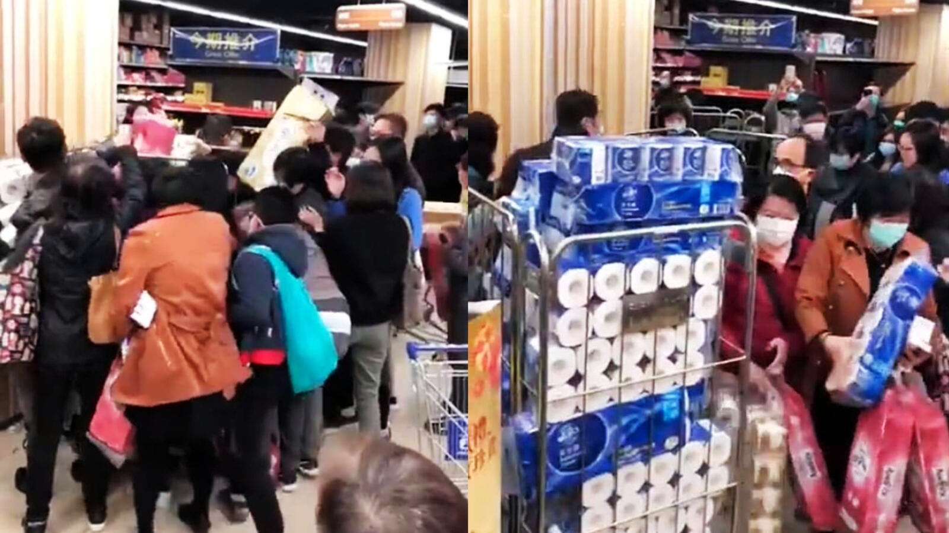
FM + COVID-19 SERIES
SUPPLY CHAIN

Slide 18
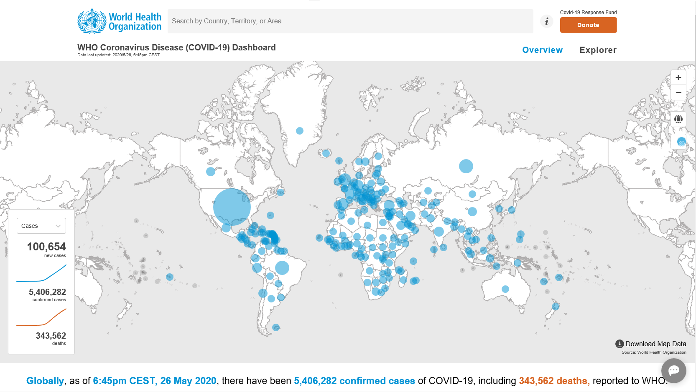
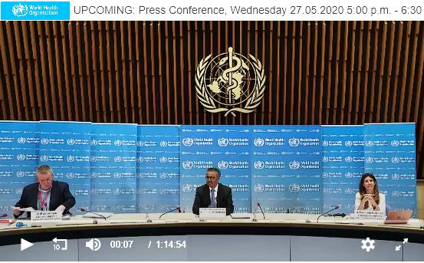
FM + COVID-19 SERIES
COMMUNICATIONS

Slide 19
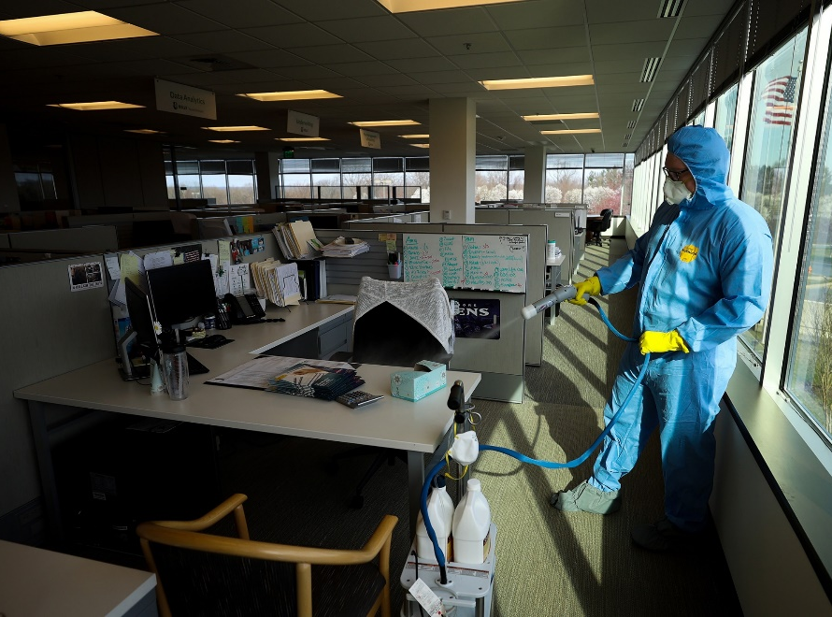
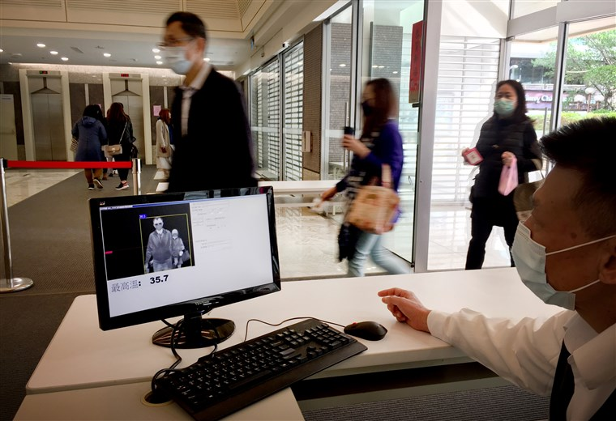
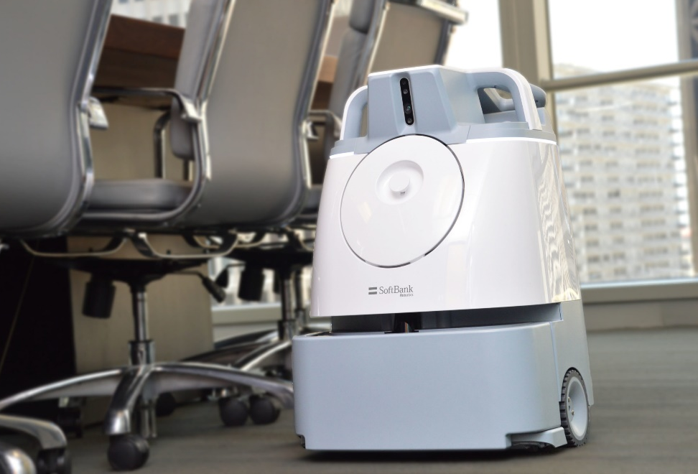
FM + COVID-19 SERIES
RETURN TO SITE

Slide 20
FM + COVID-19 SERIES
PHYSICAL DISTANCING

Slide 21
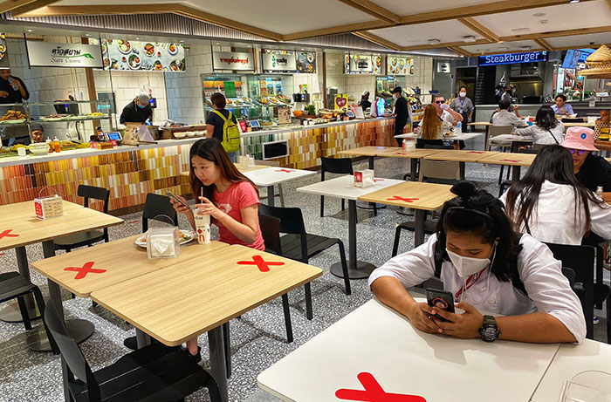
FM + COVID-19 SERIES
HIGH PERFORMANCE
WORKPLACE

Slide 22
Case Studies
Cathy Campbell, CHESP, CMIP
National Director, Service Delivery
ABM Industries Health Care Division

Slide 23
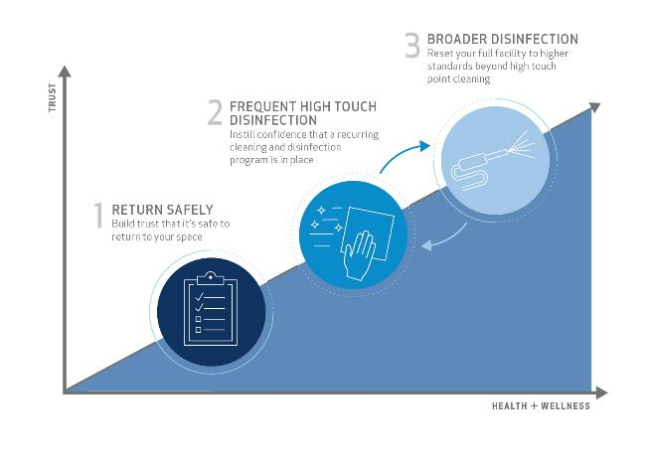
Reentry Cleaning Program
A three-step approach that delivers healthy spaces
Key Considerations for Successful Reentry
Peace of mind
Demonstrated prevention
Certified disinfection
Notes:
As your facilities return to normal occupancy levels, providing peace of mind is vital.
There is a heightened sense of scrutiny for demonstrating that you are doing your part to provide clean, healthy, and safe environments.
Through enhanced cleaning, you can be uniquely positioned to help prevent the spread of pathogens using a certified disinfection process and training program backed by experts.
When we boil it down, what makes a holistic reentry program work is…
Protocols and recommendations driven by a network of experts
Specialized Training on new SOP’s and specific disinfection services
A uniform national infrastructure & availability of labor
Supply Chain Purchasing Power and
Best In Class Equipment and innovations in infection control

Slide 24
Step 1: Return Safely
ASSESS
ESTABLISH
IMPLEMENT
ENHANCE
Pre-opening site assessment(s) using reentry checklists to inform return to work strategy
Workforce protocols (i.e. PPE & social distancing procedures)
Implement preventive products strategy
One-time enhanced clean
Potential Supplies & Equipment
No touch fixtures, dispensers and door openers
Centralized trash receptacles
Sensor technologies
Hand sanitizing stations
Disinfecting wipes for occupants
EPA-registered disinfectants qualified for use against SARS-CoV2
Notes:
The first step starts with planning and preparing for building and occupant health and safety. Perform a site assessment that includes the following:
A thorough walkthrough using facility reentry checklists to identify high touch points where frequent disinfection is needed and perform a checkup of your entire facility
Identify the most effective locations to add hand sanitizing stations or disinfecting wipes
Evaluate opportunities to reduce high touch points by replacing manual fixtures/dispensers with touchless products
Recommend the incorporated centralized trash collection to support social distancing practices
Finally, a comprehensive disinfection service should be performed by certified disinfection specialists to prepare your space for reentry.

Slide 25
Step 2: Frequent High Touch Disinfection
FREQUENCY
SCOPE
HIGH TOUCH
CONFIDENCE
Intervals range from hourly to daily
Site specific SOW for each facility based on occupancy levels
Cleaning and disinfection of all high touch point areas in facility
Instill confidence that a recurring cleaning and disinfection program is in place
Potential Supplies & Equipment
Occupant communication kits
Proper PPE
Microfiber program
EPA-registered disinfectants qualified for use against SARS-CoV2

Slide 26
Step 3: Broader Disinfection
FREQUENCY
STRONGER
TESTING
SAFEGUARD
Intervals range from nightly to quarterly
Large area disinfection with stronger disinfectants
Continued product testing: UV devices and UVC lighting; testing & validation
Help safeguard your full facility beyond high touch point cleaning. Occupants feel secure their environment is reset to even higher standards.
Potential Supplies & Equipment
Electrostatic sprayers
Hospital grade EPA-registered disinfectants qualified for use against SARS-CoV2 with faster kill time and broader pathogen spectrum

Slide 27
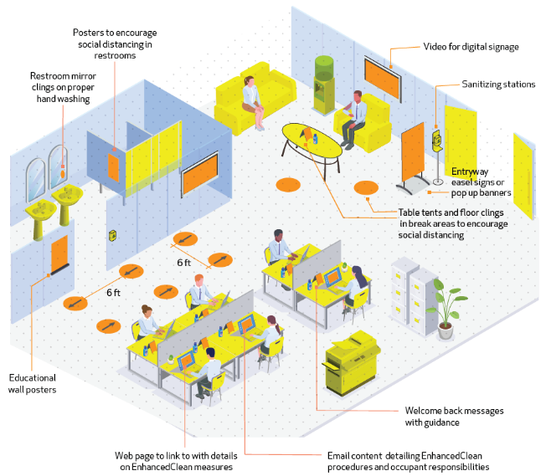
What peace of mind looks like

Slide 28
Q & A

Slide 29
MIT Crisis Management & Business Continuity Course
http://shortprograms.mit.edu/cm
Crisis Management & Business Continuity
July 21 – 23, 2020 and July 28 – 30, 2020

Slide 30
IFMA Pandemic Manual
Introduction
COVID-19 Information
Potential Pandemic Impacts on Facilities
FM Pandemic Risk Factors and Control Options
Pandemic Planning/Preparation
Pandemic Response
Pandemic Recovery
Appendices: Resources, Glossary, and Case Studies
You can download the manual (free) at https://foundation.ifma.org/news/publications/

Slide 31
WE EDUC ATE
WE INVEST
WE C ONNECT
https://foundation.ifma.org/

Slide 32
Coronavirus Resource Center
ifma.org/coronavirus
IFMA.org

