Slide 1
FM + COVID-19 Series #12
Re-entry into the Workplace: How to enter, manage visitors and communicate changes
IFMA.org

Slide 2
Coronavirus Resource Center
ifma.org/coronavirus
IFMA.org

Slide 3
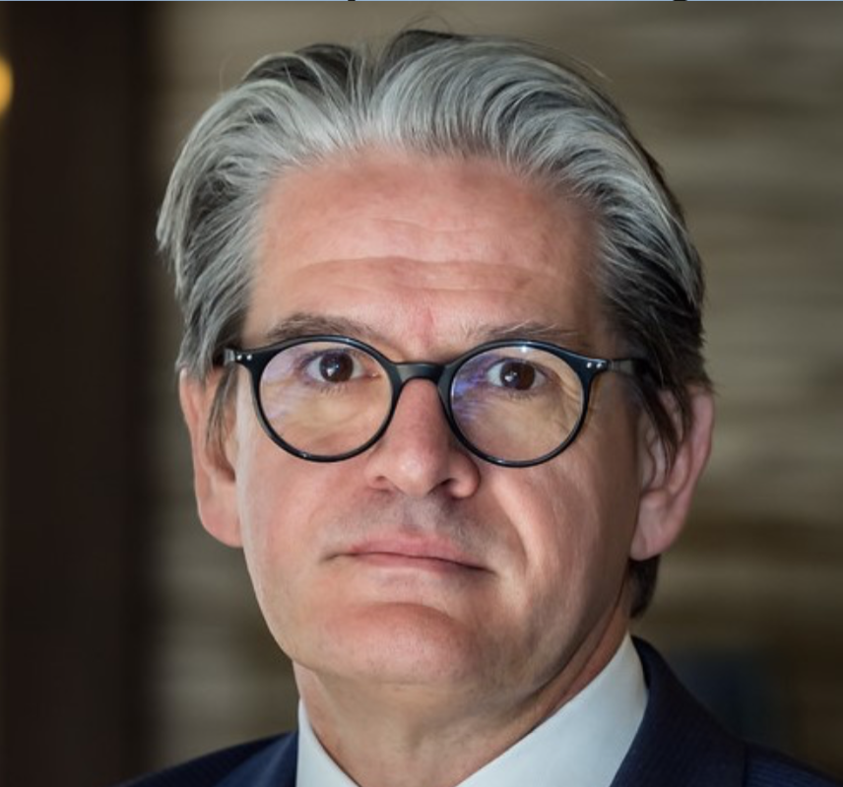
Peter Ankerstjerne
Global Facility Management & Employee Services Lead, JLL
Federico Garcia Parra
Head of Global Strategic Accounts, OTIS
Amy Michel
AI Applications Solutions Manager, IBM
Jos Duchamps
Managing Director, PROCOS Group
Re-entry into the Workplace: How to enter, manage visitors and communicate changes

Slide 4
5

Slide 5
Today’s Topics
Building re-entry and logistics
Managing risks and returning with confidence
Optimizing the physical work environment

Slide 6
OTIS

Slide 7
Moving together: Day one and beyond
WE CAN LEARN FROM EACH OTHER
SHELTER IN PLACE
RE-ENTRY
NEW NORMAL
Countries are arriving to their “new normal” at different times. We can, and should, learn from these experiences around the world as we develop what works the best for all of us.
© 2020 OTIS ELEVATOR COMPANY. ALL RIGHTS RESERVED.
Notes:
As the world moves through this different countries are at different stages. We can learn from each other.

Slide 8
Navigating the transition
CHANGING AND EVOLVING EXPECTATIONS AROUND…
Physical Distancing & Behavior
Virtual & Remote Work
Limiting Physical Contact
…are driving us to look for new solutions for the movement of people.
Purification & Hygiene
© 2020 OTIS ELEVATOR COMPANY. ALL RIGHTS RESERVED.
Notes:
As a global company we've had the opportunity to observe and work with customers on some of the challenges they face as stay at home orders are lifted and they transition to a "new normal".
Questions we are hearing from customers:
How do we ensure social distancing as employees and customers move about the facility?
What needs to be cleaned, how, and how often?
How does this affect our occupancy rate?
How do we manage lobbies, entrance way and other areas where people congregate?
How do we reassure employees, tenants and customers that we're doing everything we can to help ensure their health and well being?

Slide 9
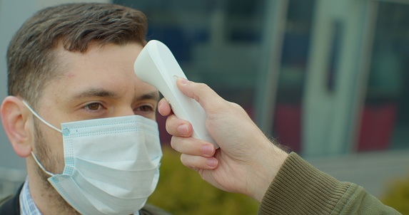
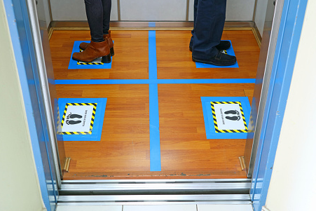
Learnings from around the globe
We've seen many interesting ideas developed that experts have recommended will help smooth the transition.
1
Stagger passenger arrival / departure times
2
Temperature checkpoints
3
Social distancing floor markers
4
Limit occupancy
5
Sanitizer Stations
© 2020 OTIS ELEVATOR COMPANY. ALL RIGHTS RESERVED.

Slide 10
Advancing technology for today and tomorrow
As we navigate these unprecedented times, Otis continues to innovate solutions for our customers and passengers.
PASSENGER COMMUNICATIONS
PROMOTING SOCIAL DISTANCING
PURIFYING PRODUCTS
TOUCHLESS SOLUTIONS
REMOTE MONITORING & INTERVENTION SERVICES

Slide 11
IBM

Slide 12
Plan for the journey back to the office. Manage risk and return with confidence.
Monitor and manage occupancy and employee workplace utilization
Organize spaces and provide workplace services to ensure occupant safety
Ensure readiness across your facilities by adhering to new protocols and processes

Slide 13
Consider how to create a safe and efficient workplace to ensure occupant well-being
Monitor Occupancy to support new capacity policies
Create space plans for social distancing
Enable more reservable spaces to book in advance
Workplace services for employees where and when they need them
Manage new Facilities cleaning and maintenance projects
Monitor inventory by location for critical supplies
IBM TRIRIGA / © 2020 IBM Corporation

Slide 14
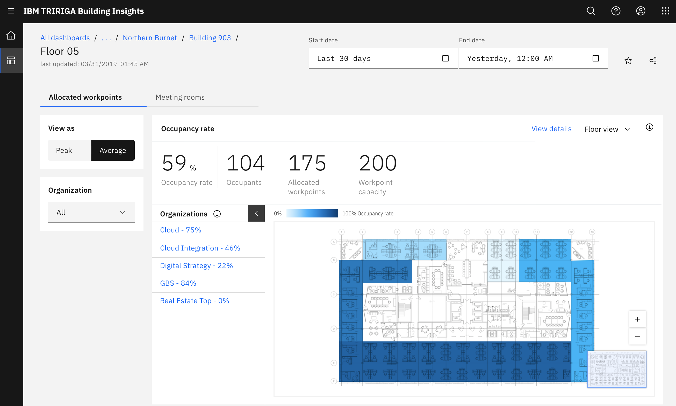
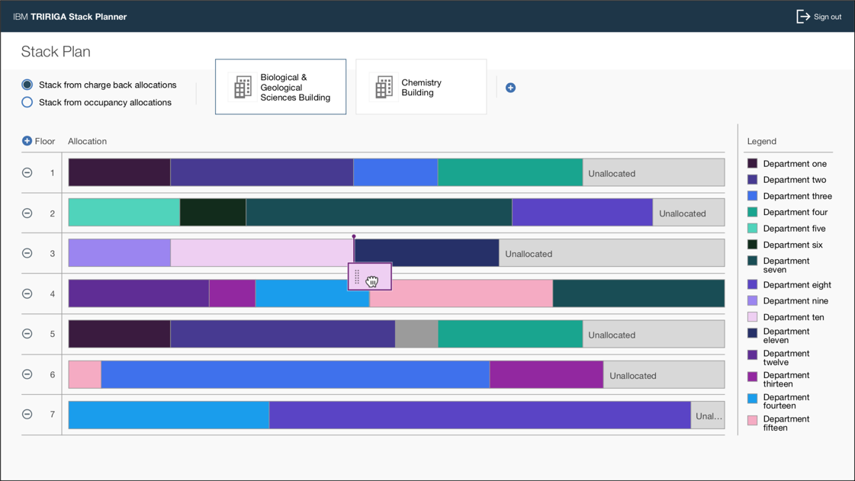
Map out how to enable scalable site occupancy monitoring
Who is using your buildings, and how?
Monitor occupancy by organization, understanding utilization of space to new capacity requirements
Understand occupancy distribution by site, adapting learning from teams that have returned to the workplace
Use of data in other FM processes (e.g. Janitorial, Food services)
Right-sized real estate costs

Slide 15
Use facilities project management to prepare facilities readiness for the return
Enterprises will need to consistently complete a series of projects to return to the workplace:
Install high efficiency air filters, hand sanitizing stations, no touch trash cans, barriers between desks or workstations, etc.
Provide access to Personal Protective Equipment
Increase air ventilation rates in the work environment
Install new signage
Reconfigure spaces for social distancing protocols
Enhancements to Maintenance & Operations routine tasks:
New maintenance, cleaning and disinfecting protocols
Many other readiness and business resilience initiatives
Source: OSHA 3990-03 2020 Guidance on Preparing Workplaces for COVID-19
https://www.osha.gov/Publications/OSHA3990.pdf

Slide 16
What you do now will help you prepare for the next emergency with ongoing business continuity planning
People
Critical roles and backups, visitor management, technology assessment for remote working, risk ranking, critical to business continuity
Emergency Types
Natural disasters, pandemics, power outages, physical security threats, etc.
Locations
Impacted facilities, secondary/contingency facilities, off-site options and alternatives
Assets
Location and availability, criticality and backup options, inventory management of key equipment
IBM TRIRIGA / © 2020 IBM Corporation

Slide 17
PROCOS GROUP

Slide 18
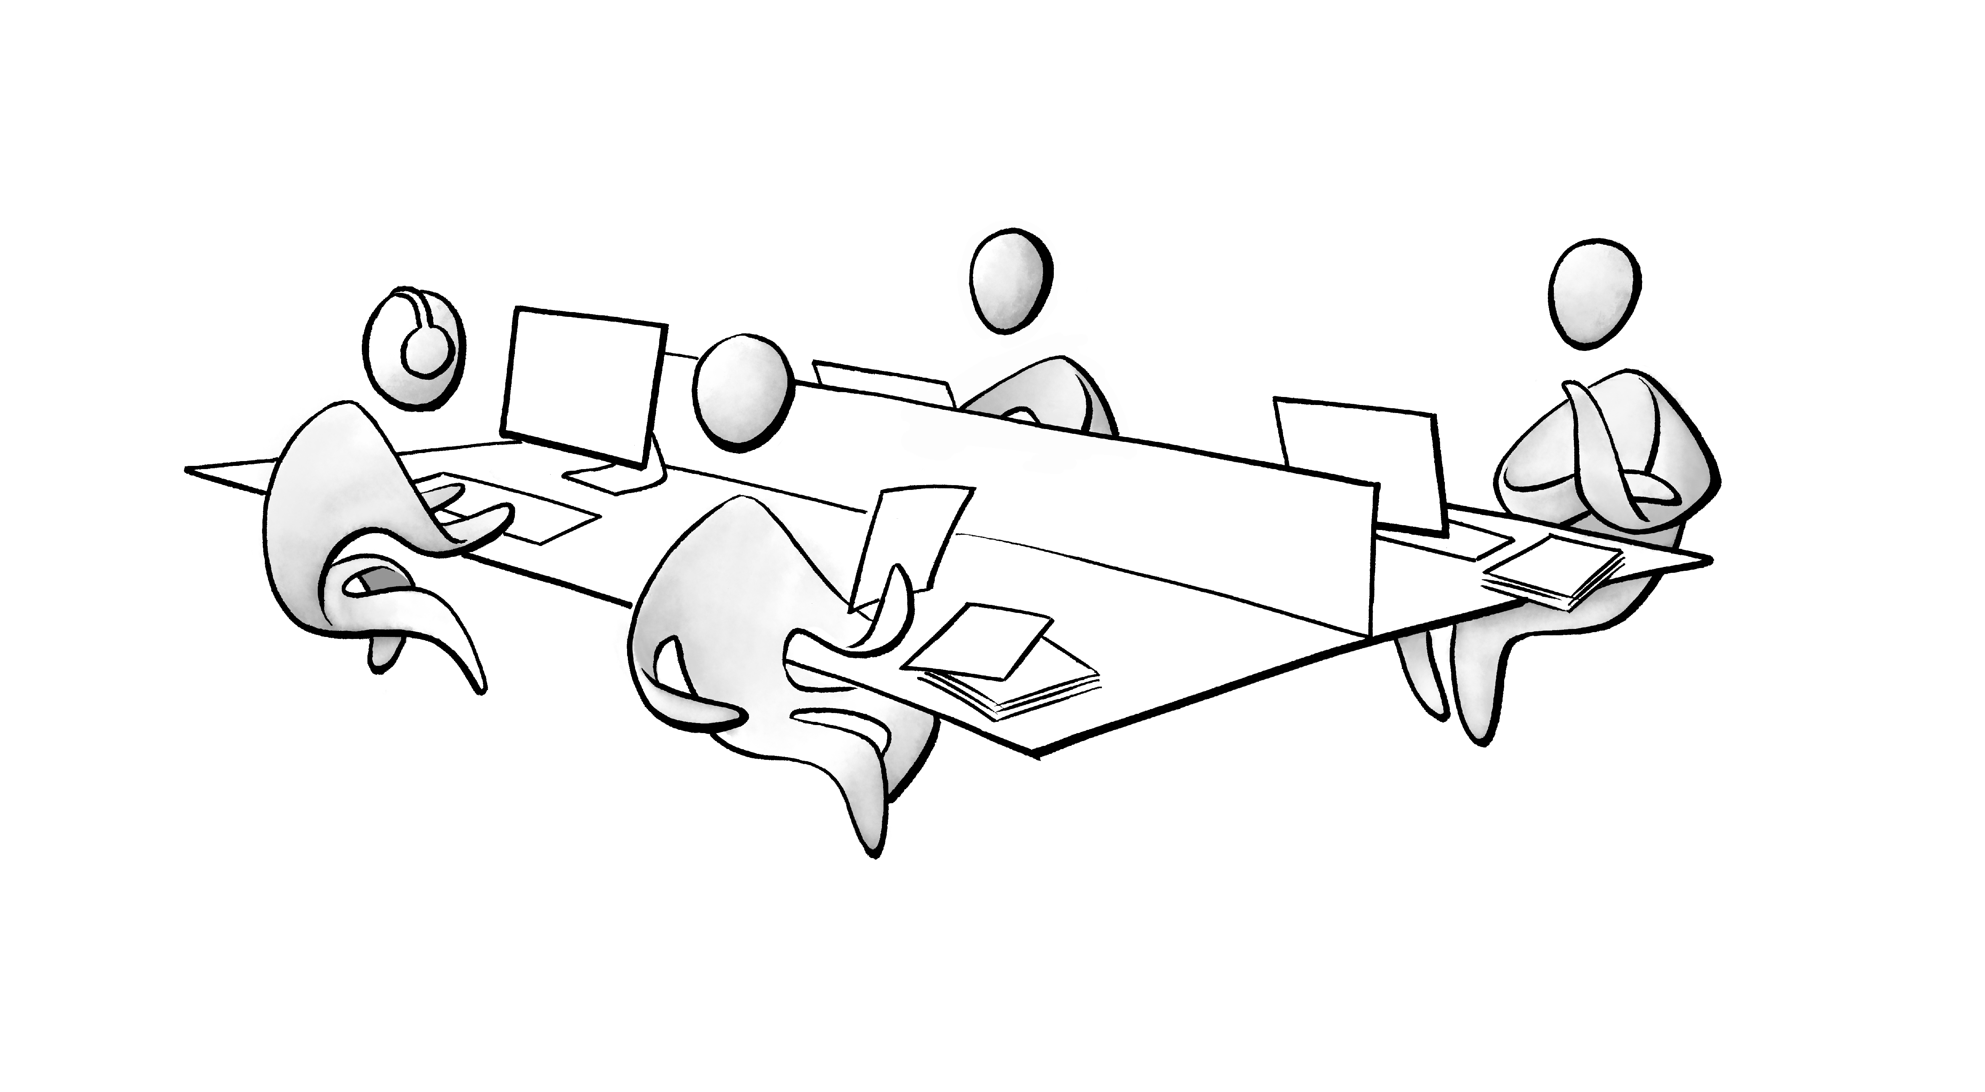
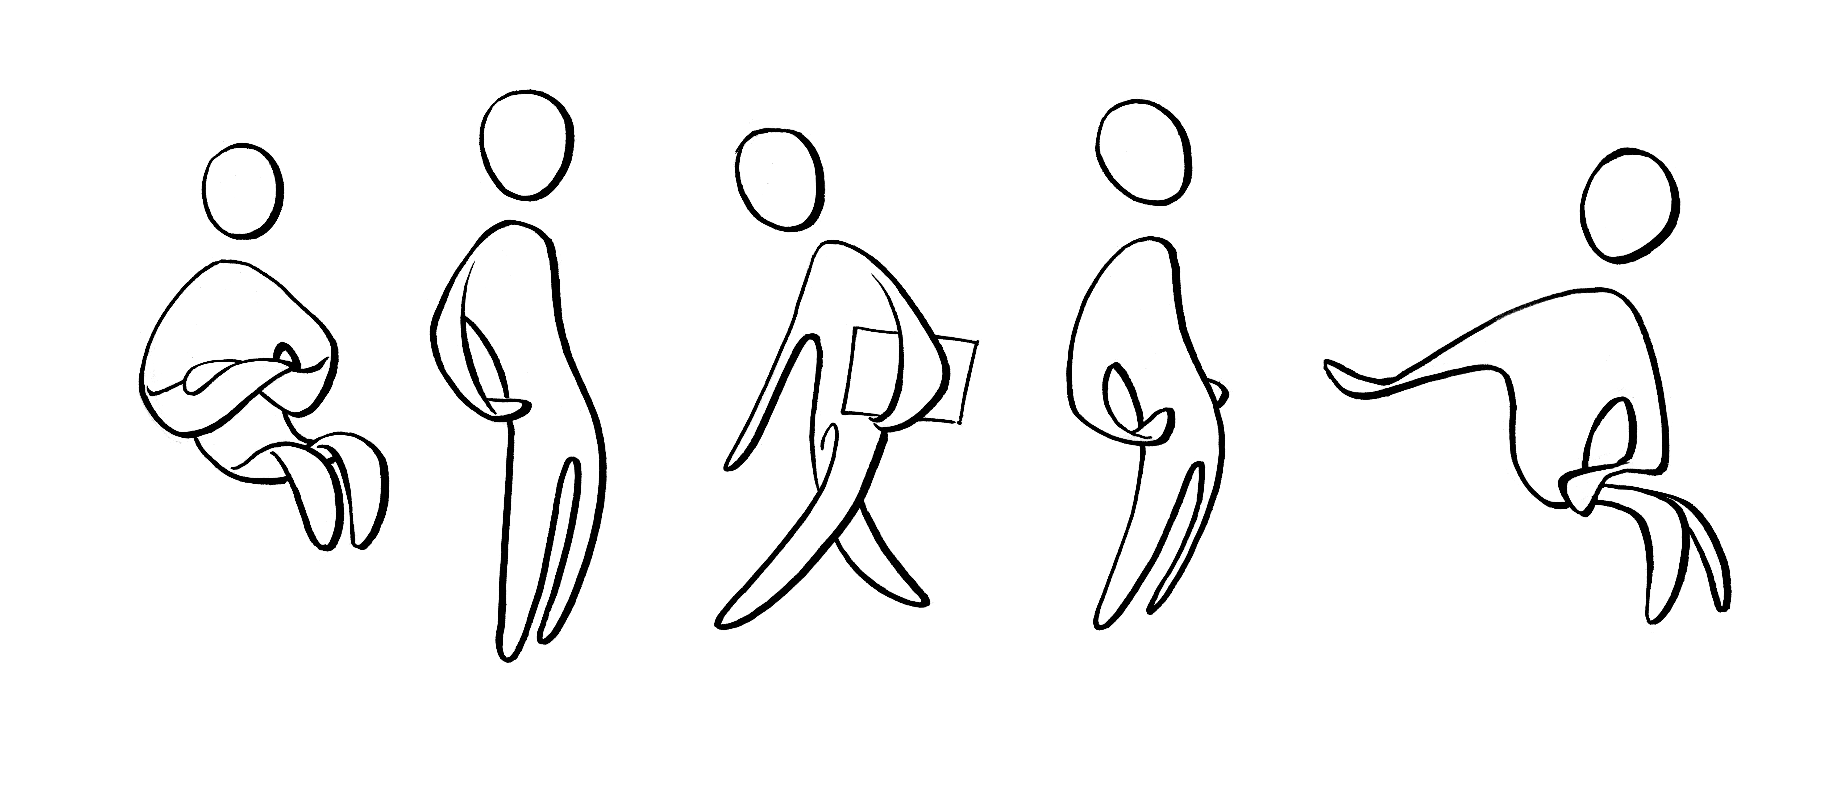
FM Processes
Physical working environment
Technology
People
Lockdown
Re-entry
New normal

Slide 19
Closing the loop for a safe re-entry
after COVID-19
Plan
Reserve
Clean
Track
Closing the loop

Slide 20
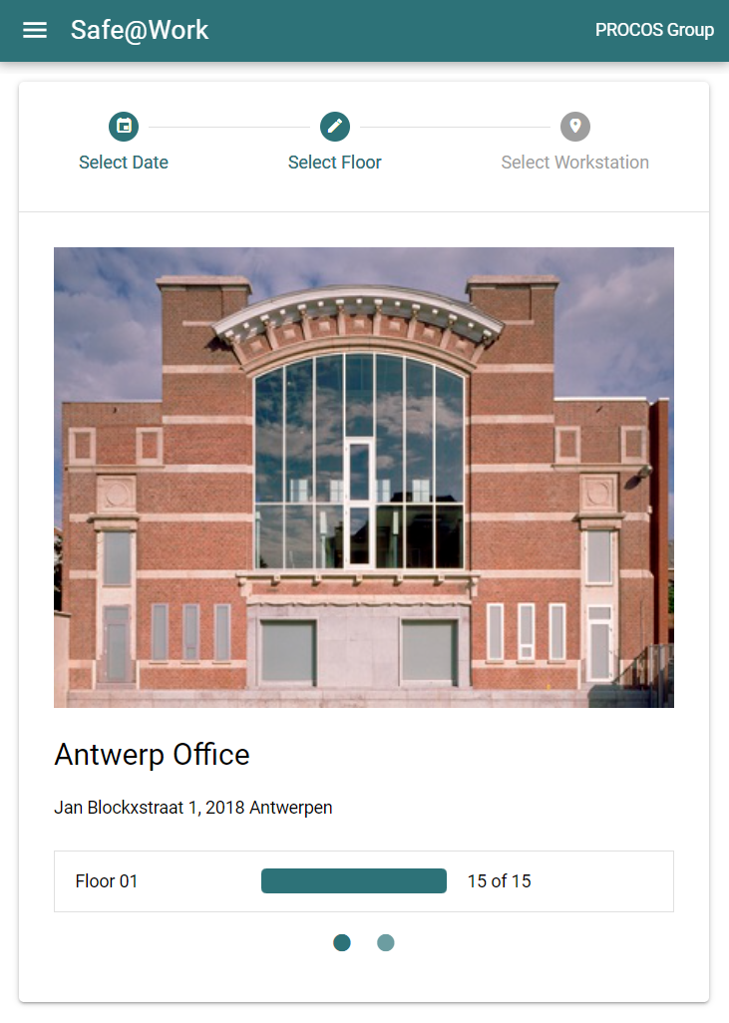
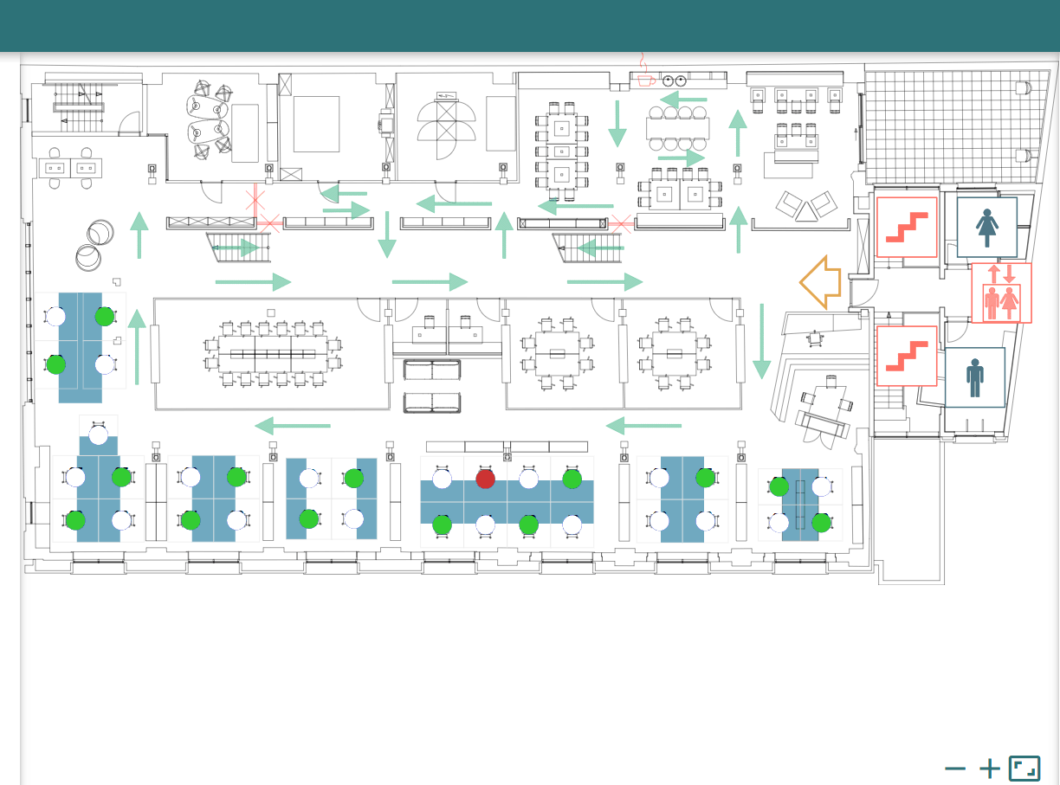
Plan the re-entry
Floorplans
Workstations
Circulation lines
Personal Disctance
Buildings

Slide 21
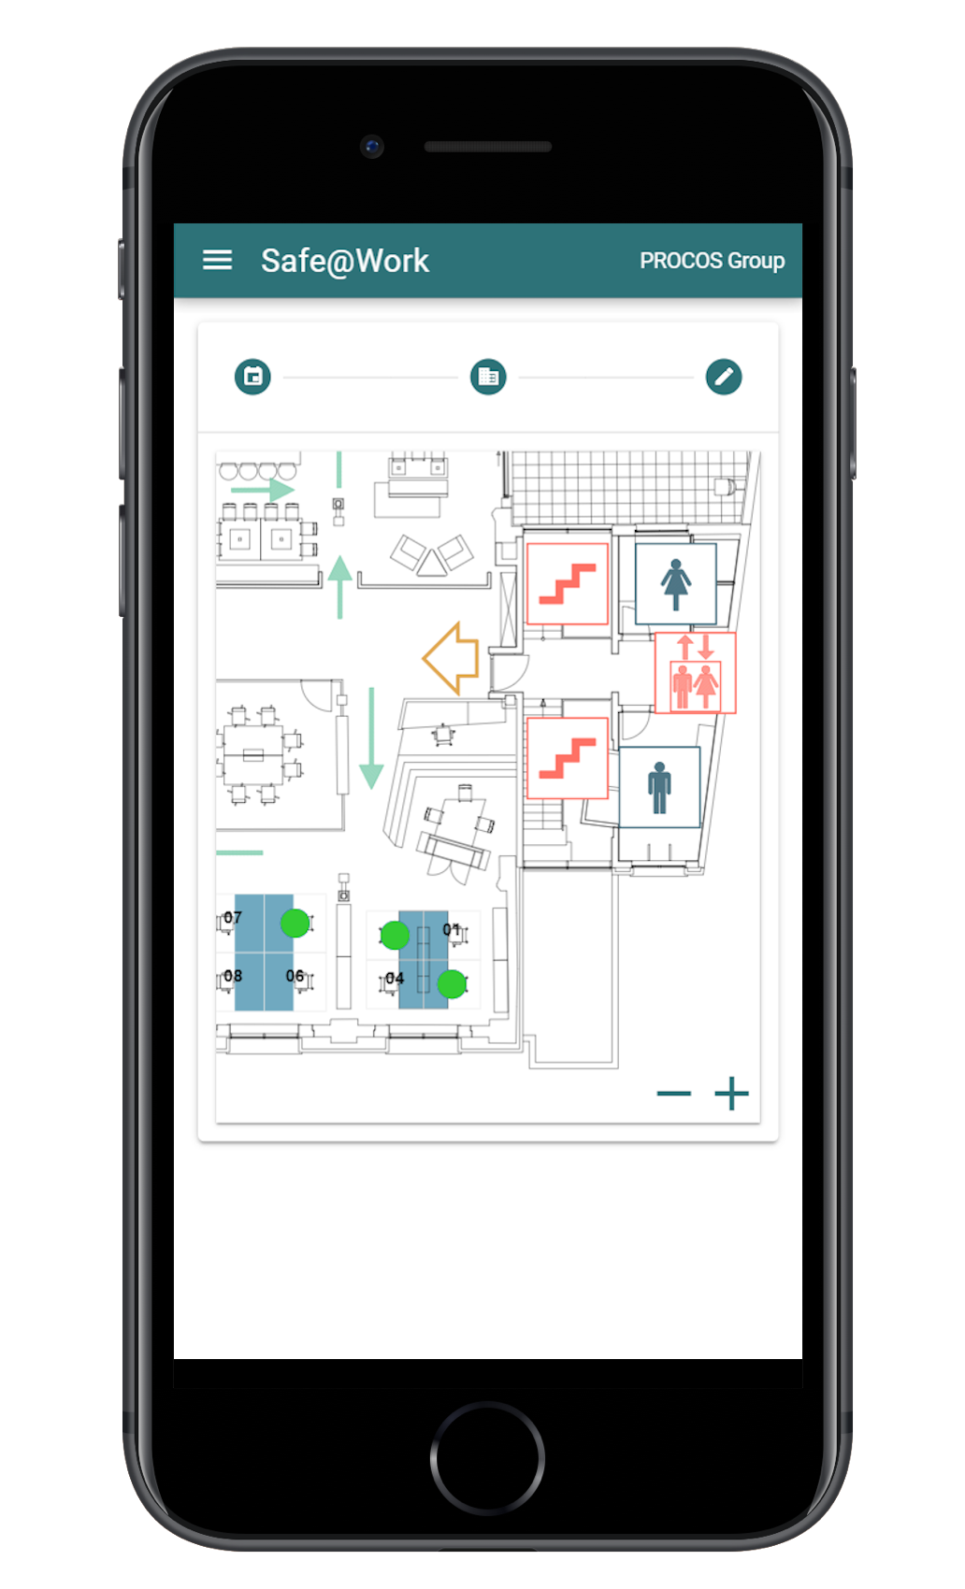
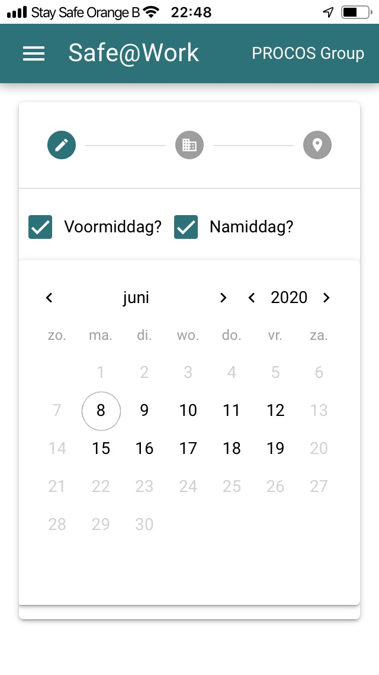
Reserve a safe workstation
Timing
Inform and communicatie with teams, groups, employees

Slide 22
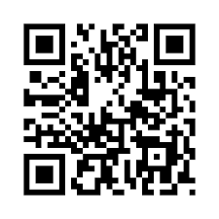
Clean the used workstations
Clean only the workstations that were occupied
Manage the cleaning team
Guarantee safe check out of the workstation

Slide 23
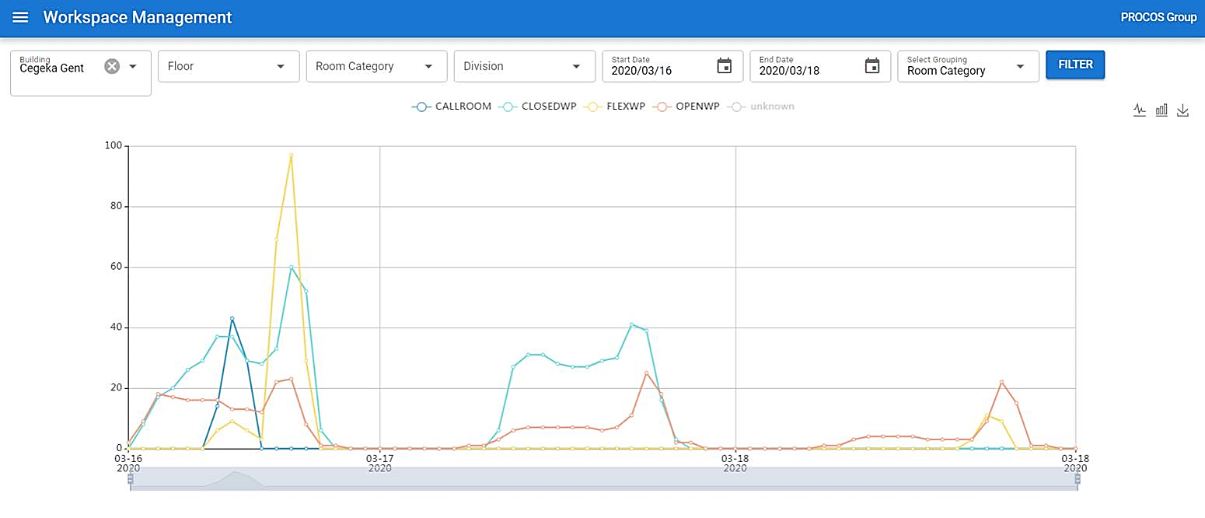
Track & close the loop
Track occupation by employee
Act when needed
Make analysis
Improve

Slide 24
Audience Q & A

Slide 25
FM + COVID-19 Series #13
Day One Ready:
A walkthrough of the first day returning to the workplace
Wednesday, June 17th
10:00 A.M. CDT
https://covid-19webinar.ifma.org/

Slide 26
Coronavirus Resource Center
ifma.org/coronavirus
IFMA.org

