Slide 1
REMOTE BUILDING OPERATIONS
Wednesday Webinar FM + COVID-19 Series #4

Slide 2
REMOTE BUILDING OPERATIONS
Erik Jaspers
Global Product Strategy & Innovation
Planon International
Email: erik.jaspers@planonsoftware.com
LinkedIn: linkedin.com/in/erikjaspers/
Jonas Fluri
Director Global Portfolio & Strategy Building Performance & Sustainability
Siemens Smart Infrastructure
Email: jonas.fluri@siemens.com
LinkedIn: linkedin.com/in/jonas-fluri-5ba16a2/
Ravichandra Kshirsaga
Commercial VP,
Digital Building Services
Schneider Electric
Email: ravichandra.kshirsagar@se.com
LinkedIn: linkedin.com/in/ravichandra/
Kaynam Hedayat
VP Product Management
EcoStruxture Building
Schneider Electric
Email: Kaynam.Hedayat@se.com
LinkedIn: linkedin.com/in/kaynamhedayat/

Slide 3
Topics :
Why Remote Building Operations now?
Views on the topic by Siemens
Views on the topic by Schneider Electric
Questions and conversation
Takeaways

Slide 4
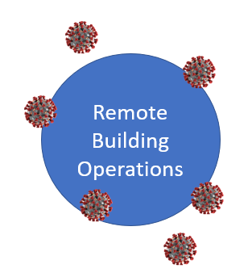
Why this topic today?
Do remote operations tools not provide brilliant ‘social distancing’ properties?
What would its contribution be to
high-demand environments?
When we abandoned our buildings, how did we leave them behind in terms of operation mode?

Slide 5
Why this topic today?
Safety
Technology
Sustainability
People & Economics
Notes:
Resilience is a keyword to mention here. In what ways are organizations more resilient in future when they install remote building operations? Why?

Slide 6
Remote Building Operations

Slide 7
Remote Building Operations at Siemens Main Use Cases
Main Use Cases
A
Remote Clarification & Configuration
Check performance
Change setpoints, schedules
Remote Commissioning
Perform commissioning
Run overall system checks
Remote Optimization and Predictive Maintenance
Identify and correct energy and operational issues
Provide maintenance recommendations
Remote Operation Centers
In more than 35 countries
Building Automation, Energy, Fire Safety & Security
Supported by regional digital service centers centralized regional
Domain experts and data scientists
B
C

Slide 8
Remote Building Operations at Siemens Examples
Customers impacted by COVID19
Hospital General Universitario de Toledo, Spain
University Properties of Finland Ltd, © SYK
Set to Unoccupied Remotely
Various customer’s buildings were unoccupied and wasted energy when staff left for home office regime
Proactively monitored and asked customers to change mode by remote operations
Remote Commissioning
Hospital with 800 beds and 25 surgery rooms
Planned opening was for July, it opened mid March 2020
Remote commissioning of HVAC, video and access control in 3 days!
Predictive Maintenance
Data analytics based proactive maintenance approach based on maintenance and HVAC data
Reduced significantly exposure of on-site staff for preventive maintenance/inspections

Slide 9
The journey towards smarter buildings Smart self-adapting building
202?
Smart building
Self-adaptive
2020
2010
Smart building
Automated building
+ Fully integrated management
stations and remote connectivity
+ Automated remote analytics
+ Building twin
+ All buildings are connected (hopefully)
+ More intelligent and more automated
+ Integrated with IT (CMMS, IWMS, ERP)
+ Simulation and artificial intelligence based on building twin

Slide 10
Digital Building Services
Address Crisis with Analytics driven approach
Subtitle

Slide 11
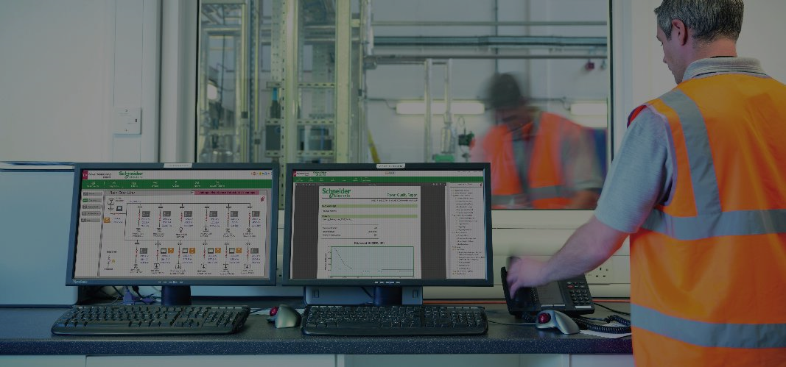
| Efficiency challenges
25–45%
Energy wasted by HVAC systems⁽¹⁾
20–40%
unscheduled maintenance instances⁽²⁾
40%
of service workforce
will retire by 2020⁽³⁾
Sources:
⁽¹⁾ Saving Building Energy through Advanced Control Strategies
⁽²⁾ Schneider Building Advisor engineering team estimates
⁽³⁾ TSIA Global Research
Confidential Property of Schneider Electric |
Page 11
Notes:
Now consider this: 75 percent of a building’s life cycle costs are in maintenance and operations. By being proactive versus reactive about maintenance using analytics and deep insights, we can significantly increase a building’s overall efficiency.
Up to 45 percent of the energy used by HVAC systems is wasted due to faults; and as much as 40 percent of workspace is not used.
If you're a building owner or facility manager, those numbers will keep you up at night, won’t they?
SOURCES:
25-45% energy wasted by HVAC systems: Saving Building Energy through Advanced Control Strategies
20-40% unscheduled maintenance instances: Building Advisor team
30-40% workspace not utilized: JLL-occupancy-planning-benchmarking-report-2017

Slide 12
| Crisis challenges, starting with Safety…
€
X2 to X5 Demand
in critical facilities,
with reduced onsite staff
Limited Budgets
Cost control in current scenario
Efficient and Reliable
Operations: Uptime, Energy savings
Confidential Property of Schneider Electric |
Page 12
Notes:
Now consider this: 75 percent of a building’s life cycle costs are in maintenance and operations. By being proactive versus reactive about maintenance using analytics and deep insights, we can significantly increase a building’s overall efficiency.
Up to 45 percent of the energy used by HVAC systems is wasted due to faults; and as much as 40 percent of workspace is not used.
If you're a building owner or facility manager, those numbers will keep you up at night, won’t they?
SOURCES:
25-45% energy wasted by HVAC systems: Saving Building Energy through Advanced Control Strategies
20-40% unscheduled maintenance instances: Building Advisor team
30-40% workspace not utilized: JLL-occupancy-planning-benchmarking-report-2017

Slide 13
Enable Remote Operations with a system that provides key insights into building operations by constantly monitoring and detecting faults
~29% decrease
in unscheduled maintenance Condition-based maintenance approach
Remote 24/7 : Commissioning, Maintenance, Improvement
+
~70% Operations
performed remotely
Automated diagnostics and fault detection
A system to enable your “Crisis resilience”
Building Advisor: Cloud-based with action + savings dashboards
Up to 20% energy
cost reduction Continuous commissioning of building equipment
Notes:
Now consider this: 75 percent of a building’s life cycle costs are in maintenance and operations. By being proactive versus reactive about maintenance using analytics and deep insights, we can significantly increase a building’s overall efficiency.
Up to 45 percent of the energy used by HVAC systems is wasted due to faults; and as much as 40 percent of workspace is not used.
If you're a building owner or facility manager, those numbers will keep you up at night, won’t they?
SOURCES:
25-45% energy wasted by HVAC systems: Saving Building Energy through Advanced Control Strategies
20-40% unscheduled maintenance instances: Building Advisor team
30-40% workspace not utilized: JLL-occupancy-planning-benchmarking-report-2017

Slide 14
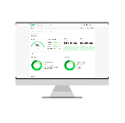
With EcoStruxure platform, we have enabled remote analytics driven services for our customers globally
SpaceLogic IoT enabled Controllers
EcoStruxure
Building Operations
EcoStruxure
Building Advisor
430K+
30M+
104B+
Connected Assets Under Management
Square Meters
Data Points Analyzed per year
Notes:
$15+ M in calculable avoidable energy cost across 140,000 equipment
12% of Air Handling Units with major anomalies worth $3.5M+ energy savings
- incorrect sequence of operations, close damper to avoid smoke intake – in turn affecting Economizer
- simultaneous heating and cooling
- faulty sensors leading to excessive and erratic heating in frost coil
- too low discharge temperature of AHU – needed excessive heating in VAV
27,630 (36%) zone units stuck heating valves & 17,126 (?%) stuck dampers affecting comfort

Slide 15
Remote Services
| Customer Cases
Healthcare
Datacenter
Life sciences
Commercial office
17-floor tower
Hospitals UK
Condition Based Maintenance services
Remote Alarm Monitoring services for Critical Assets
Remote Control Strategy for change of use
Global Colo provider
70+ Sites
NAM, EMEA, APJ
24/7 365
Remote Support Services &
Remote Maintenance with Software upgrades
Global biopharmaceutical company
4 countries - 86 Sites
Condition Based Maintenance and optimization services
$1.2M annual energy savings realized out of $1.9M identified
Condition Based Maintenance and recommissioning
$75k
annual energy savings
$50k
annual incentive from the utility provider
Confidential Property of Schneider Electric |
Page 15
Notes:
So as you saw in the video, our EcoStruxure solution is delivering lots of value to Boston Scientific:
Up to $40,000 energy savings annually …
Energy-related faults are down 51 percent …
And they cut fault-related costs by 40 percent.
Boston Scientific is just one of many success stories that we are part of. We’re working with organizations around the world to help them get their facilities to run more efficiently. Another example highlights a research lab that had leaky cooling coil valves. By finding those leaks and being able to remedy them, the company is saving over $60,000 a year.
Sources:
Various Case Studies of Building Advisor

Slide 16
Building Advisor: 6 Modules to drive Remote, data-driven decisions to efficiently manage operations, while reducing costs
1
Monitor and identify EBO system performance and issues across portfolio
BMS Health
2
Monitor BMS Alarms – Real time with Notification and critical Alarms filtering to drive actions
Smart Alarm
3
Analyze Equipment Performance, Fault Detection and Diagnostics to action avoidable costs
Asset Health
4
Monitor, compare and identify top energy consumers vs baseline objectives set
Energy Health
5
Quickly create, share, track tasks with recommended fixes for SLA compliance
Task Manager
6
Comprehensive reports: a complete picture with KPIs to engage Executives as well as actions with operational teams
Value Reports
Notes:
Now consider this: 75 percent of a building’s life cycle costs are in maintenance and operations. By being proactive versus reactive about maintenance using analytics and deep insights, we can significantly increase a building’s overall efficiency.
Up to 45 percent of the energy used by HVAC systems is wasted due to faults; and as much as 40 percent of workspace is not used.
If you're a building owner or facility manager, those numbers will keep you up at night, won’t they?
SOURCES:
25-45% energy wasted by HVAC systems: Saving Building Energy through Advanced Control Strategies
20-40% unscheduled maintenance instances: Building Advisor team
30-40% workspace not utilized: JLL-occupancy-planning-benchmarking-report-2017

Slide 17
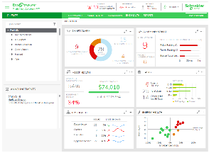
Building Advisor provides key insights into building operations by constantly monitoring systems and identifying faults to proactively address inefficiencies
Typically 29% decrease in unscheduled maintenance Condition-based maintenance approach
Cloud-based
Single pane of glass with secure access
Intuitive dashboard
Building portfolio visualization
6
Typically 33% fewer occupant complaints
Automated diagnostics and fault detection
2
3
5
1
4
Up to 20% energy cost reduction Continuous commissioning of your building equipment
Building Advisor Portal

Slide 18
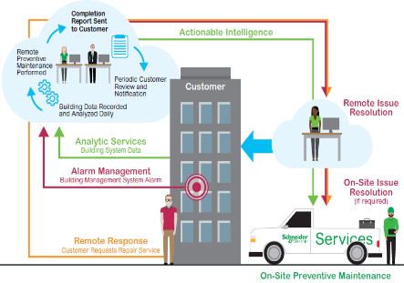
Building Advisor
Delivery Model overview for Annual Services Plans (Plus, Prime, Ultra, Managed Software)
Delivery to customers
Connected Services Hubs
Delivery to customers
Monitoring
Real-time alarms, fault & operating conditions
Analytics
BMS and HVAC equipment data, fault & operating conditions, alarm data
Remote Support
Troubleshooting, Maintenance
Reports
Intelligent site check reports, Dashboards
Field Services Technician
Onsite Resolution
Troubleshooting, Maintenance

Slide 19
Digital Building Services Offer
Direct Services enhanced by Building Advisor
BMS Services offer based on On-Site, Remote and Advanced Analytics delivered by Building Advisor
 |  | Plus | Prime | Ultra | Managed Software
Monitor | Remote Connection & Troubleshooting | ● | ● | ●
 | BMS Health (EBO >2.0) | ● | ● | ●
 | Smart Alarm for (EBO, Vista, Continuum) | o | ● | ● | o
 | Asset Health (BMS Agnostic) |  | ● | ● | ●
 | Energy Health (BMS Agnostic)** |  | o | ● | o
Maintain | Preventative Maintenance - System Based on Remote, BMS Health, Smart alarm | ● | ● | ●
 | Preventative Maintenance - Asset Time savings based on Asset Health & Energy Health |  | ● | ●
 | Condition Based Maintenance Savings based on BMS & Asset health |  |  | ●
 | Task Manager Assign actions based on Asset Health |  | ● | ● | ●
Improve | Remote System Optimization | ● | ● | ●
 | Onsite Preventative Maintenance |  | ●
 | Onsite Condition Based Maintenance |  |  | ●
Report | Value Report Based on BA modules, options offered | ● | ● | ● | ●
Building Advisor Modules
** Q3 2020
O – Optional modules

Slide 20
Questions & conversation
Notes:
Poll questions.
What type of infrastructure are you managing (multiple choices possible)?
Critical (hospital / production)
Non-critical (office)
How are you today managing your infrastructure
Local / on-site
Remote
Combination of a) and b)
Is your operational load fundamentally changing under the Covid-19 situation?
Business as usual
Much higher activity levels
Much lower activity levels
What is holding you back on adopting remote management tools (multiple choices possible)?
Cyber security concerns
Lack of knowledge about it
Cost concerns
Competences of staff to work with it
Other considerations (please state them)

Slide 21
Takeaways

Slide 22
WEDNESDAY WEBINAR SERIES #5
Return to Work
Wednesday 29 April 11:00 am (EDT) / 5:00 pm (CET)
IFMA.org

Slide 23
Tickets:
https://worldworkplaceeurope.ifma.org/

Slide 24
Coronavirus Preparedness Resource Center
ifma.org/coronavirus
IFMA.org

