Slide 1
WPS Team

Slide 2
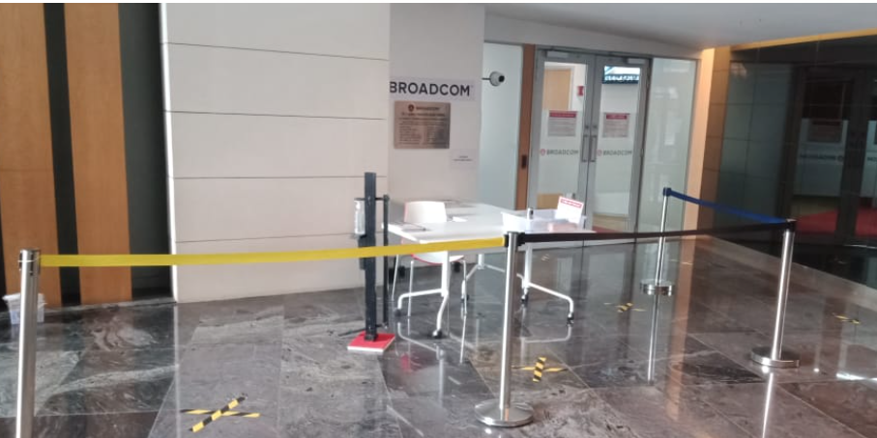
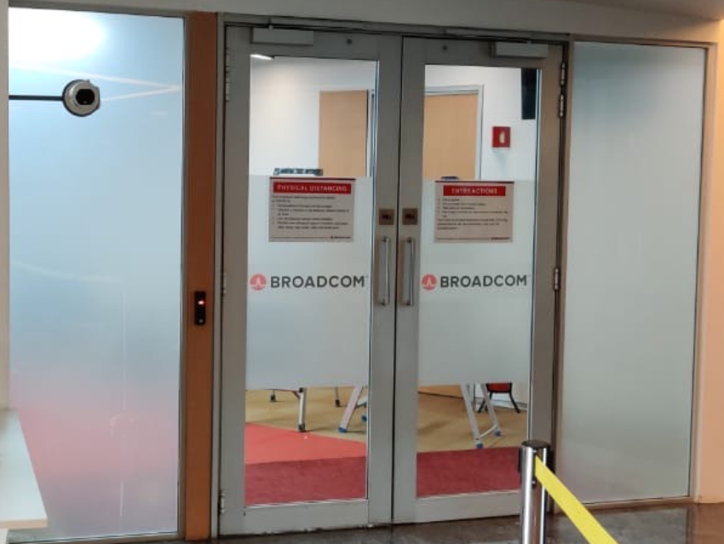
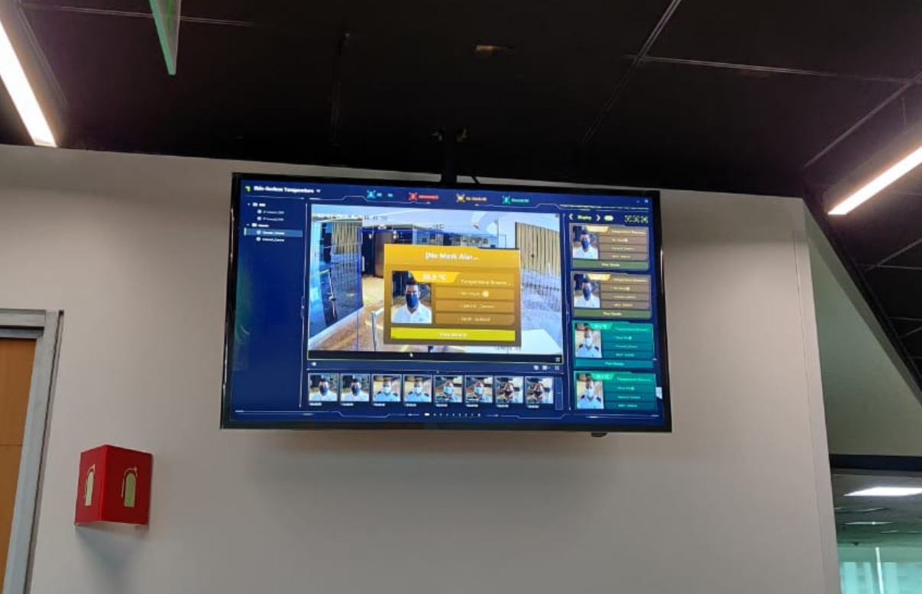
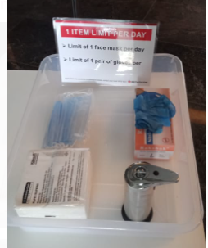
Entry Process
Temperature screening of people entering the office.
Thermal Screening Monitor has been placed at Reception which will be monitored 24X7.
With built-in audio module , Temperature Screening Thermographic camera triggers alarm immediately if high temperature person pass by.
Maintain safe distance during the screening.
Isolation room created at every floor for people showing symptoms for further check & action.
Declaration provided by HR to be filled in by employees.
A set of mask, Sterile hand glove placed for employees at entrance.
Wall mounted touch free sanitizer dispenser placed outside & inside of every access door for Employees to sanitize hands
Entry Passage with social distancing demarcation
Thermal Camera Placed on retractable wall mounted stand
Dashboard view , system announcement is clearly audible wrt to normal /abnormal temperatures & in case mask not worn
Entry Kit for Employees with masks / gloves , declaration.

Slide 3
Important Guidelines To Employees
WELCOME
All employees are advised to wear face masks at office.
Request you to please visit the ground floor Broadcom main entry on daily basis for body temperature check.
While you visit the office the first day, request you to please collect the declaration form from Ground floor Broadcom main entrance and take it along with you at your desk. Please fill in duly and submit the same at Broadcom Reception.
Employees can collect masks and gloves for their personal use from the main entrance.
Employees are advised to maintain social distancing at – Workplace, Cafeteria, Lifts, Restrooms, Reception/Security Entrance, Pantries, Mailroom, Reprographics and Parking.
Employees are advised to wash hands with soap and water at least for 20 seconds frequently.
Employees are advised to dispose used hand gloves, tissues in designated biohazardous Bin only placed at washroom passage area.
Employees are advised to consume home carried food at their Work Stations to avoid congestion in the cafeteria.
Digital transactions are encouraged in cafeteria by EON for takeaway food.
Avoid overcrowding at Pantry, Restroom and Lifts.
Use videoconferencing for meeting when possible.
Office Air Conditioning has been set up as per ASHRAE & WHO guidelines.
Air conditioning temperature is set up in the range 24 Degree to 30 Degree, maintaining relative Humidity & 24X7 Fresh Air supply at both Office space and washroom area.
Indoor Air Quality check frequency increased to Monthly to ensure the quality of Air.
Please follow process of notifying your respective mangers , HRBP and WPS team in case of any COVID symptoms.
And Comply with COVID-19_Mitigation_Policy
Kindly download Aarogya Setu App on mobile phones, as per the guidance from Government of INDIA.
No Visitors are allowed.
All the facility related issues to be reported through CBRE portal only.

Slide 4
Plan & Process For Soft Service Operation
The frequency of disinfectant cleaning (Restrooms, Meeting rooms, Common areas, Lifts, Receptions, & All high touch points’ areas) has been increased.
Alcohol based sanitizers kept near all touch points and entry points to the building.
Mist disinfectant fumigation (VIREX II 256) through professional services has been carried out on all floors .
Frequency of pest control increased.
Covid-19 awareness posters received from Broadcom, for hand cleaning from WHO & CDC placed at all places for employee’s information.
Daily Deep cleaning in work station, labs & common areas.

Slide 5
Frequency of cleaning
Additional Cleaning Kits have been placed on the floor in case if any employees wish to ascertain sanitization or need to clean the desk after meals, he /she can use the cleaning kits.
Alcohol wipes are placed in all the cleaning kits which can be used by employees to sanitize their laptops / mobile phones, or can be used while opening doors or using lift buttons to avoid touch at any surface.

Slide 6
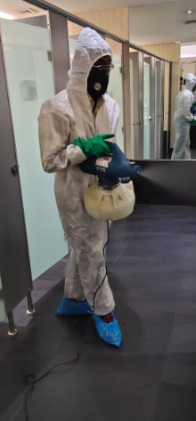
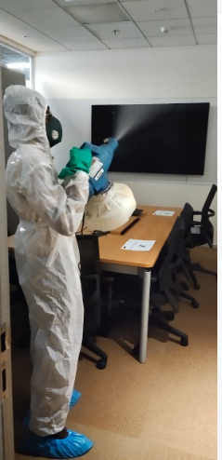
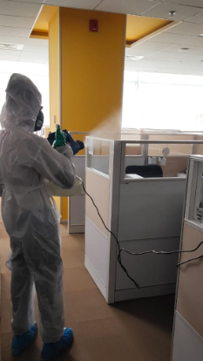
Sanitization Process
Sanitization norms are in place.
Virus control measures like special Mist fumigation and spot cleaning undertaken.

Slide 7
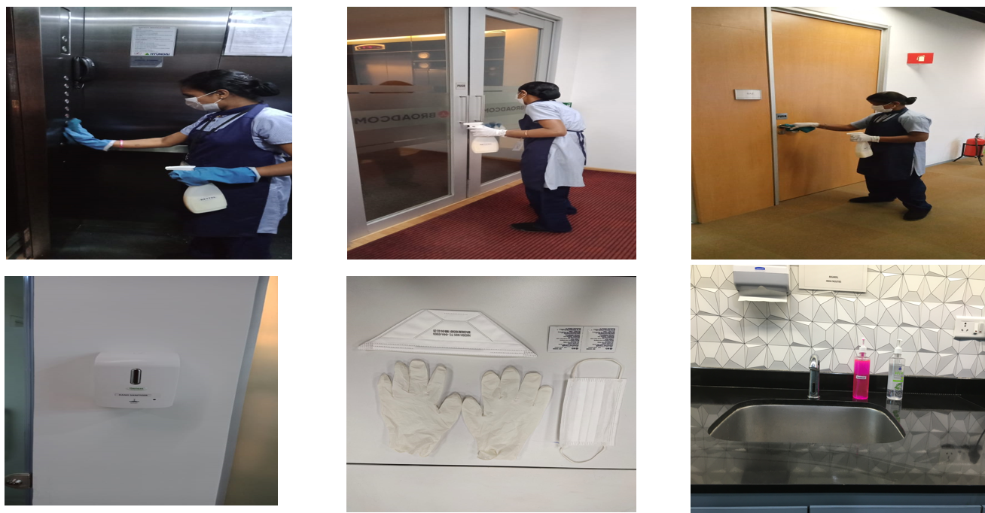
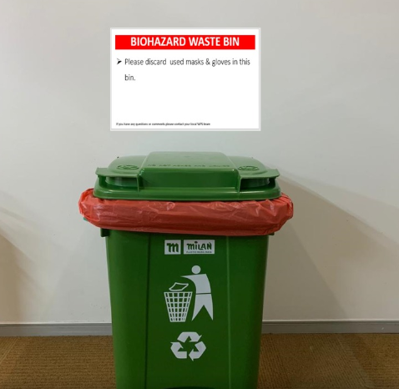
Sanitization Process
Sanitization norms are in place. PPE in stock and in use.
Virus control measures like special Mist fumigation vendor PO raised, servicing will be scheduled before sight opening.
BioHazard Waste Bins placed on All floors.

Slide 8
Social Distancing Demarcation & Posters
Reduced seating capacity to maintain social distancing in Conference rooms. Small Meeting rooms are closed for use.
Covid-19 awareness Posters are placed in all areas to guide employees.
Social distancing at Pantries & Copier rooms marked.
2 Wheeler Parking has has been marked in alternative parking slot. Vehicle not to be parked in CROSS symbol parking lot.

Slide 9
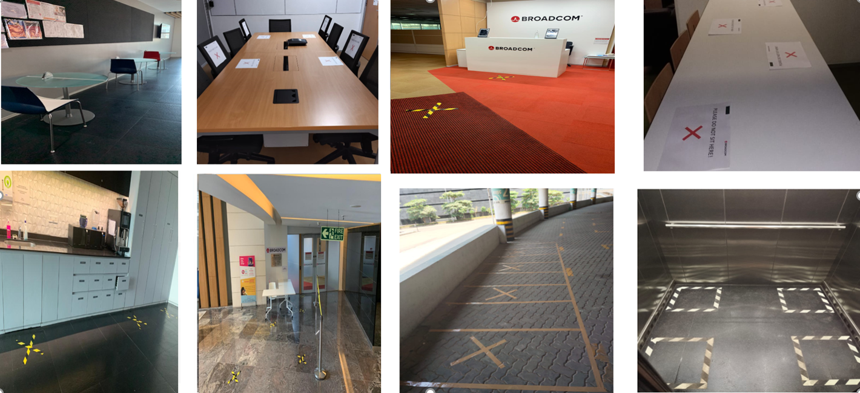
Social Distancing (SD)
Demarcation by tape carried out at meeting rooms, reception, cafeteria, lifts, restrooms, parking & common areas.

Slide 10
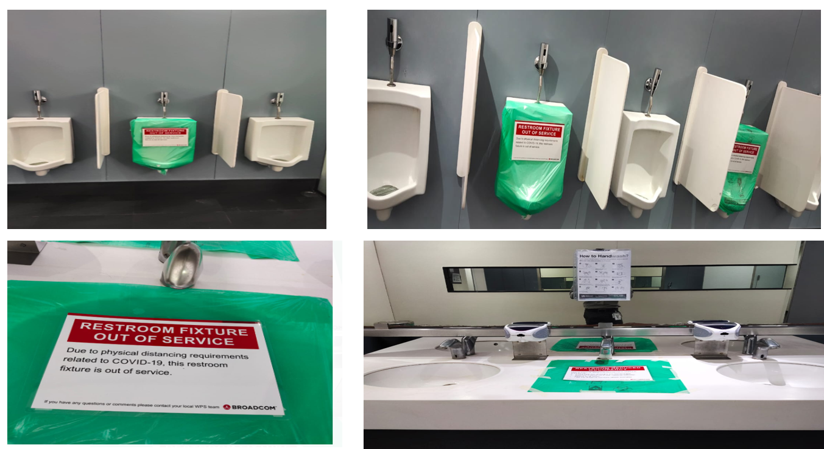
Social Distancing (SD) at washrooms

Slide 11
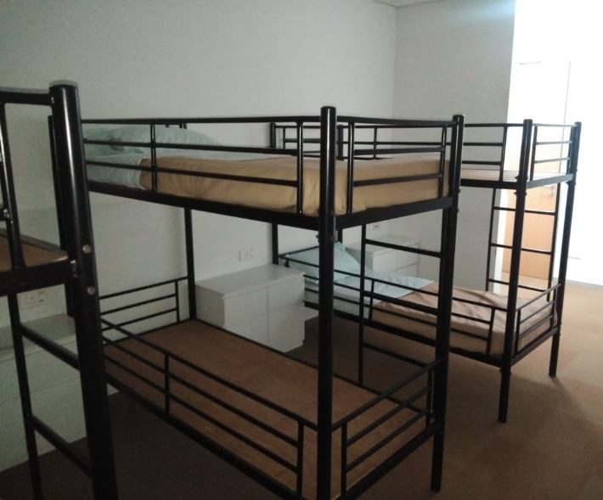
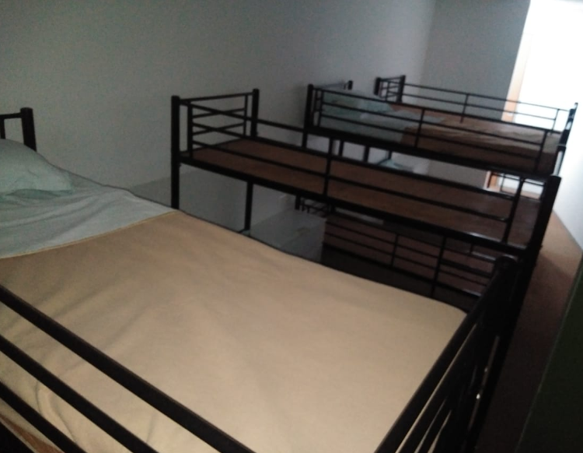
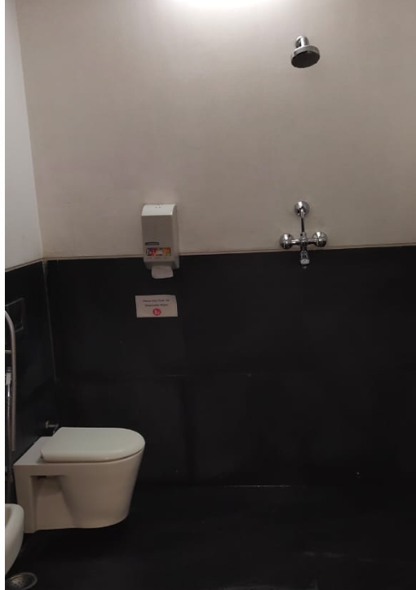
Dormitory is kept Closed currently!
Ladies (3 beds)& Gents(4 beds) Dormitory on 1st & 2nd floor respectively. Occupancy reduced to Half due to alternate Bedding facility provided considering safe distancing.
Note: Items provided
Beds (Mattress, Pillow Cover, Bed sheet & Blanket) .
Sanitizer .
Drinking Water Dispenser.
Shower Arrangements
Shower facility available Ladies (1st Floor) & Gents(2nd Floor)

Slide 12
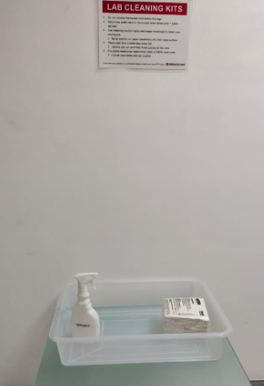
Practice Good Hygiene In Labs
Maintain social distancing inside labs.
Employees can access Alcohol based Wet tissues while entering to clean machineries & working station on their own.
Employees to sanitize hand while in & out with hand sanitizer kept on lab entrance.
A separate biohazardous container are placed near the labs at washroom passage to dispose tissues/gloves etc.

Slide 13
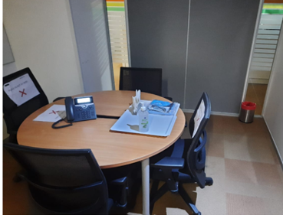
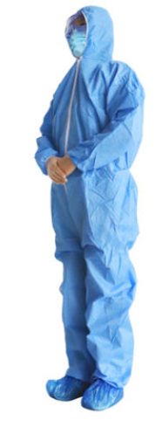
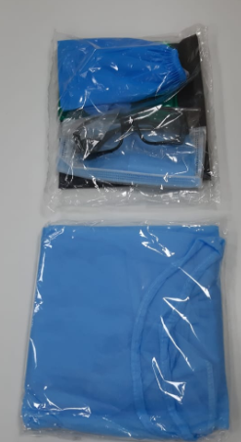
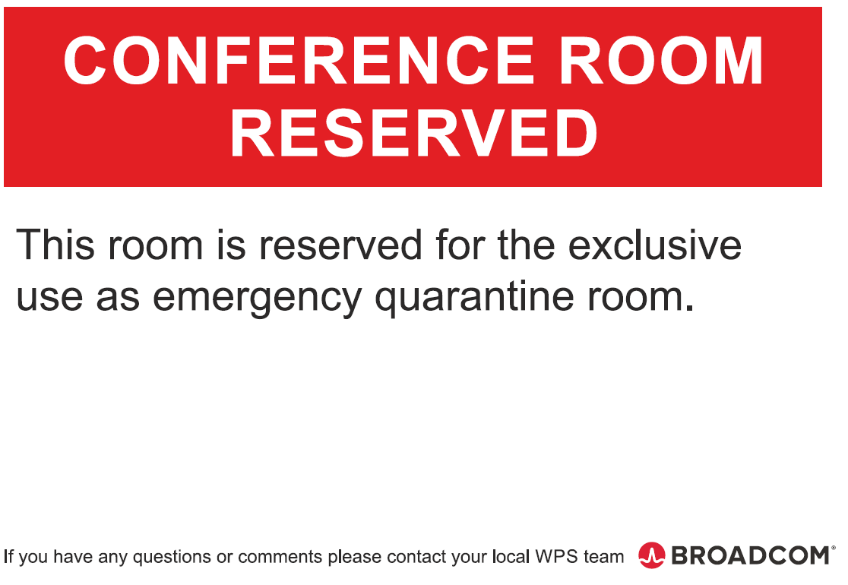
Emergency Isolation /Quarantine Room
For emergency and isolation, on individual floor the very first four seater meeting room earmarked.
For medical assistance during the COVID-19, we have engaged with the external hospital and have the paramedic staff and Ambulance made available for any emergency.
Hazmet Suits , Sanitizer , tissue, wet wipes and bio hazard waste bins placed in isolation room.
Hazmet suits also made available at Security control room
Post the COVID positive case or any suspicious case in premises ,office will be evacuated and sanitization and disinfection treatment will be carried out by external agency.
Basic First Aid Kits available at site.

Slide 14
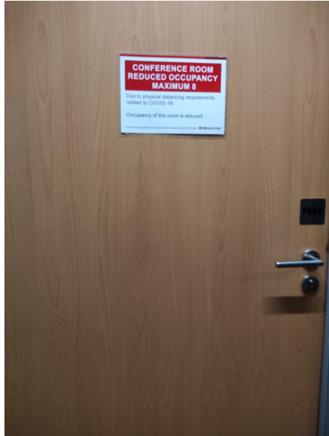
Seating Allocation
Seating allocation to be followed as proposed by WPS/Space planning team.
Meeting Room Protocol
Meeting room’s numbers are reduced to avoid over crowding.
On each floor one big Conference room is available for team meeting with reduced capacity, Other meeting rooms are locked/Unavailable.
Proper posters are placed against available & unavailable meeting rooms.
Please book only following available meeting rooms in calendar
GF –Maracus, Basoon, Celesta /1F- Clavichord / 2F- Ektara ,Bazooka ,Melodica / 3F-Zither / 4F-
Mridangam

Slide 15
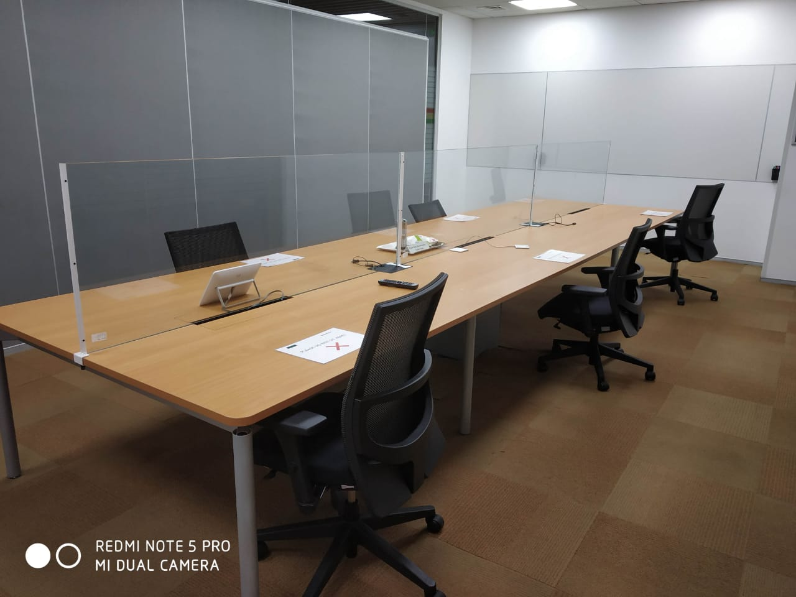
Glass Partition in Conference Room

Slide 16
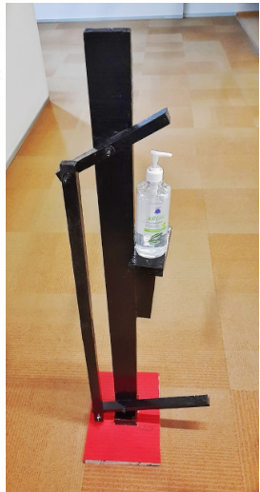
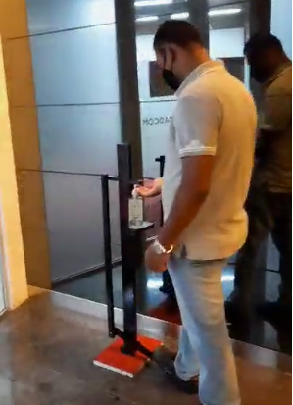
Technology Adopted for Touchless Operation
Pedal operated hand sanitizer dispenser made & will be placed at transport bay.
Sensor based hand sanitizer dispensers placed in floor entries, washroom doors and pantries

Slide 17
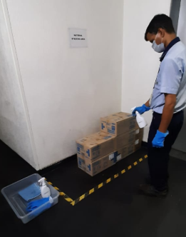
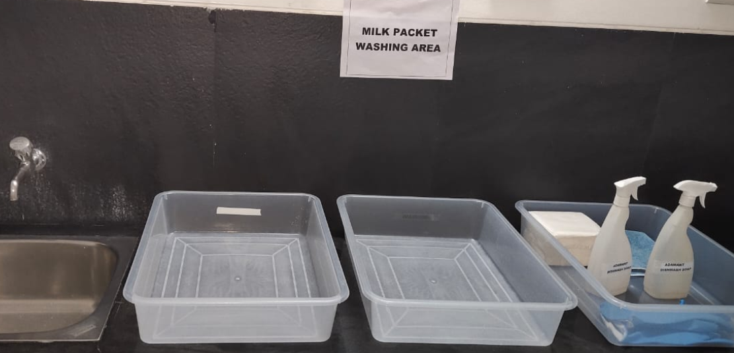
Material Receiving process during COVID
Material Receiving:
The material delivery person to be checked for body temperature. And have him sanitize his hands.
Material Lift lobby at Ground floor only to be used as material receiving dock.
All the material /boxes received to be sprayed with Chemical (Virex II 256) to be sprayed on all the sides of packaging.
All the material boxes to be shifted to designated store and kept untouched for minimum 3 days.
All the Snack Packets outer carton boxes to be sprayed by Virex II 256 . Material to be moved to designated store space and to be opened only after 3 days.
Milk Packets to be received and shifted to wet pantry at the material lobby and washed thoroughly with dish wash soap and then distributed to all the floors.

Slide 18
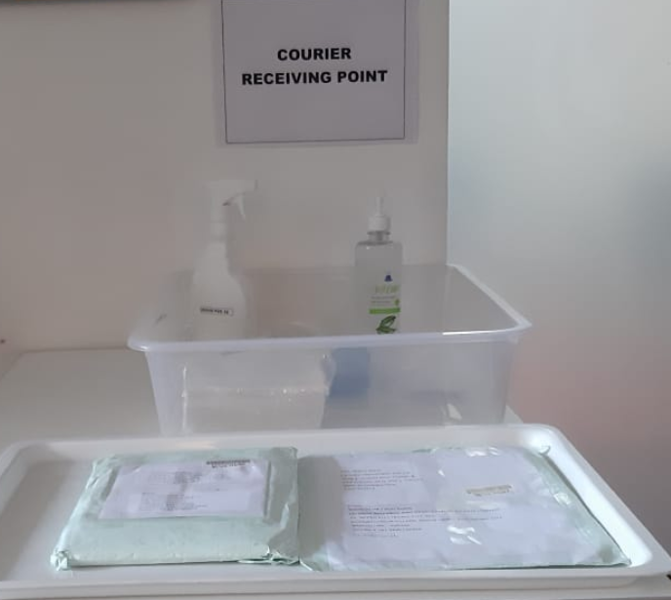
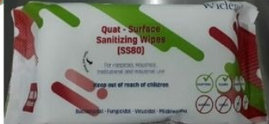
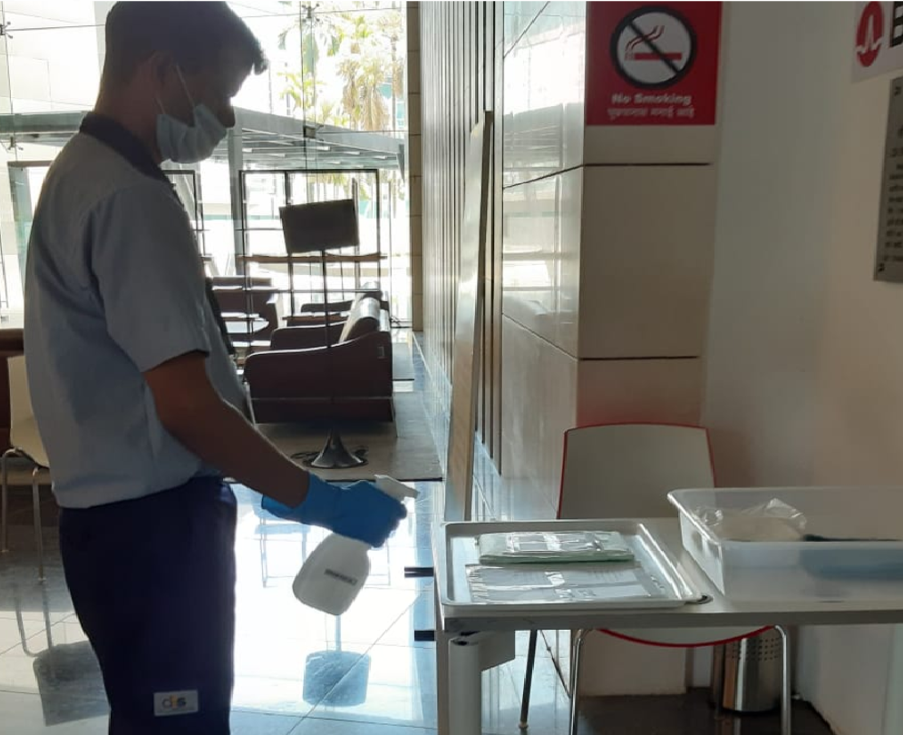
Courier Receiving process during COVID
Courier Inward:
The Courier delivery person to be checked for body temperature. And have him sanitize his hands. No entry to be provided inside the office premises.
Security counter at wing 2 Ground Floor main entrance only to be used for Courier delivery.
All the parcels /envelops to be kept at the courier tray.
All the Couriers parcels /Boxes received to be sprayed with Chemical (Virex II 256) to be sprayed on all the sides of packaging.
All the envelops received to be cleaned up with the help of sanitization wipes(Alcohol based).
Courier Outward:
The courier delivery person to be checked for body temperature. And have him sanitize his hands. No entry to be provided inside the office premises.
Security counter at wing 2 Ground Floor main entrance only to be used for Courier Dispatch.
All the parcels /envelops to be kept at the courier tray.
All the Couriers parcels /Boxes received to be sprayed with Chemical (Virex II 256) to be sprayed on all the sides of packaging.
All the envelops received to be cleaned up with the help of sanitization wipes(Alcohol based).
Parcels /envelops to be handed over to Courier personnel.

Slide 19
Resuming Utility Operation – Electrical, HVAC & Plumbing System
As per ISHRAE ( Indian Society of Heating Refrigerating and Air-conditioning Engineers) guidelines, we follow below safety measures in respective of HVAC operation :
Set Room Temperature between 24°C and 30°C. (In humid Climates set temperature closer to 24°C for de -humidification and in Dry Climates closer to or at 30°C )
Maintain relative humidity between 40% and 70%.
Fresh Air fan runs 24x7 operation.
Toilet exhaust fan runs 24x7 operation.
Air conditioning system filter & Fresh Air filter cleaning frequency increased from Quarterly to Monthly basis with the help of recommended chemical as per standard
Indoor Air quality checking frequency increased from Quarterly basis to monthly basis.

Slide 20
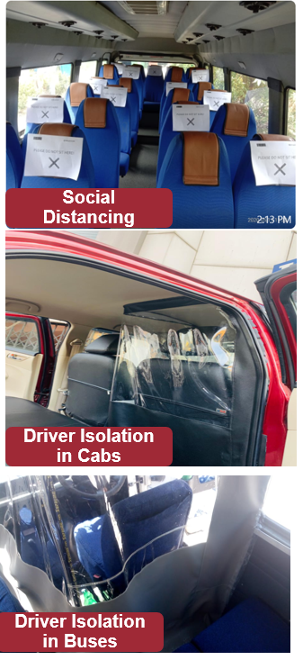
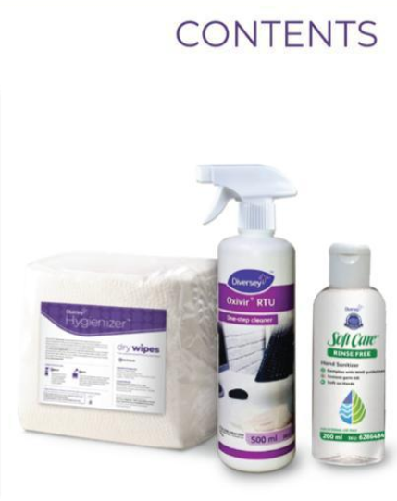
Transport Management readiness
Fogging in buses interiors and exteriors with Virex II 256 and leave the bus for 30minutes to dry on or before a day of Post lockdown, Ideally, will ensure on first day the vehicle deployment will be happened post fogging of the buses by the vendor at their end. Service providers are in line with our proposal
Spray & wipe on door handles, grab bars, glasses, seats etc., on daily basis in our Campus (Cabs: for Every Trip Completion, Buses: One time in a day)
Bus shuttle Driver window and adjacent windows are open to get in maximum fresh air for circulation.
Driver isolation cabins created in both Bus and Cabs.
Practicing Social Distance while in buses / Cabs for Employees
Drivers are briefed to maintain Social Distance while in Campus without fail
Placing Hand sanitizer in all buses / Cabs
Ensure Employees / Drivers use face masks at all the times
Temperature checks for Drivers and Supervisors every day before entering to premises
Daily compliance checks are updated with additional check points
Coordinating with Moveinsync vendor on automation of Transport Tool on Red Zones / Containment zones.
Cleaning Kits

Slide 21
THANK YOU

