Slide 1
The Experts’ Assessment
The Experts’ Assessment
Facilities in Demand — 2021 and the Return to the New Normal
EPISODE #4
27 JANUARY 2021

Slide 2
The Experts’ Assessment
MODERATOR & PANELISTS

Slide 3
Facilities in Demand – 2021 & the Return to the New Normal
SPONSORED BY:

Slide 4
TODAY’S TOPICS
Entered post-vaccine era
Facilities in demand
Impacts on facilities management
Strategy setting
Services offered
Budget priorities
Skills required
The Experts’ Assessment
EPISODE #4 | 27 JANUARY 2021

Slide 5
THE EXPERTS’ ASSESSMENT: THE WORKPLACE POST-COVID-19 STUDY
Helps you develop your
readiness and resilience
Synthesize findings from 6 key areas
Harvest insights from industry's leading experts
Assess current challenges and future priorities

Slide 6
METHODOLOGY: REAL-TIME DELPHI
Obtains a spectrum of diverse external expert perspectives on key questions and assumptions to develop an objective, consensus view of the future in highly uncertain times
Via an online platform, the real-time Delphi facilitates dialogue between geographically separated experts to identify:
Consensus views
Divergent opinions

Slide 7
METHODOLOGY: REAL-TIME DELPHI
Curated views of industry-leading, subject matter experts on the key challenges facing the industry
Aids in decision-making
Enables you to orientate on potential opportunities and risks using experts’ assessments.
Identify consensus views
Explore dissenting opinions

Slide 8
WITH THE INVALUABLE ASSISTANCE

Slide 9
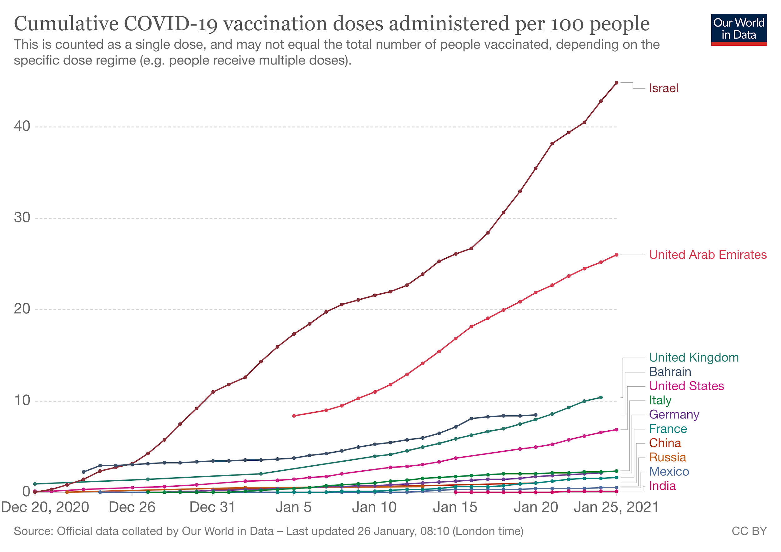
ENTERED POST-VACCINE ERA
1
Over 230+ vaccines are at various stages of development
2
3
70-90% of the population needs to be immunized to achieve herd immunity.
Sources: 1) WHO, Draft landscape of COVID-19 candidate vaccines, 26 January 2021. https://www.who.int/publications/m/item/draft-landscape-of-covid-19-candidate-vaccines and Coronavirus Vaccine Tracker and https://www.nytimes.com/interactive/2020/science/coronavirus-vaccine-tracker.html2) Our World in Data, Coronavirus (COVID-19) Vaccinations, 11 January 2021. https://ourworldindata.org/covid-vaccinations, Jonathan Allen, “Fauci says herd immunity could require nearly 90% to get coronavirus vaccine,” Reuters. 24 December 2020. https://www.reuters.com/article/health-coronavirus-usa/fauci-says-herd-immunity-could-require-nearly-90-to-get-coronavirus-vaccine-idUSL1N2J411V

Slide 10
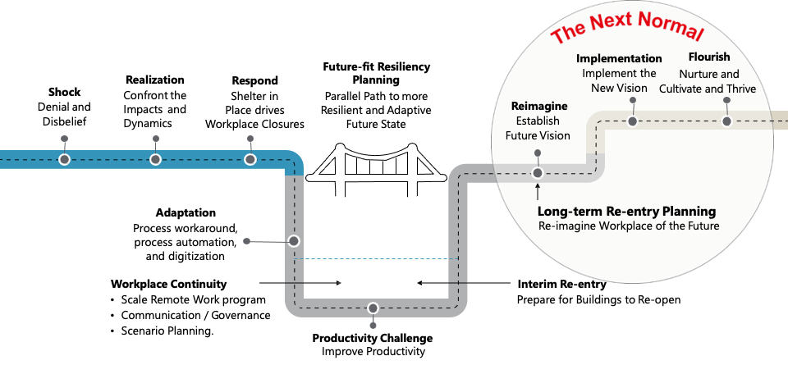
THE JOURNEY TO THE NEXT NORMAL
Sources: JLL, 2020

Slide 11
REMOTE WORK REVOLUTION
81% expect at least 26% of workers will work remotely most of the time

Slide 12
ACTIVITIES WITH HIGHEST POTENTIAL FOR REMOTE WORK
Updating knowledge and learning
Interacting with computers
Thinking creatively
Communicating with and guiding colleagues or clients
Processing, analyzing, and interpreting information
82-91
70-75
43-68
43-63
54-61
Communicating and establishing interpersonal relationships
Performing administrative and organizational activities
Training, teaching, coaching, and developing others
Monitoring processes, surroundings, or use of resources
Selling to or influencing others
29-57
39-52
6-47
34-46
24-41
Source: McKinsey Global Institute, “What’s next for remote work”, 23 November 2020

Slide 13
Facilities in Demand

Slide 14
ORGANIZATIONS IMPLEMENT NEW TYPES OF WORKING ENVIRONMENTS
63% believe organizations will make greater use of co-working sites, satellite offices or new type of spaces

Slide 15
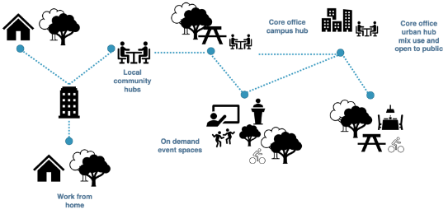
ORGANIZATIONS WILL HAVE TO INTEGRATE MANY ELEMENTS INTO THEIR HYBRID WORKING STRATEGIES
Different elements of hybrid working environments
Home services for remote workers
Working near home options
Collaborative headquarters or hubs
Event spaces
Technology platforms – integrating the above
Source: Cushman Wakefield, 2020
Source: Saunders and Rømer, 2021

Slide 16
DEMAND FOR REAL ESTATE SHIFTS
New Hybrid Solutions, Co-working, Class A
Class B
Class C

Slide 17
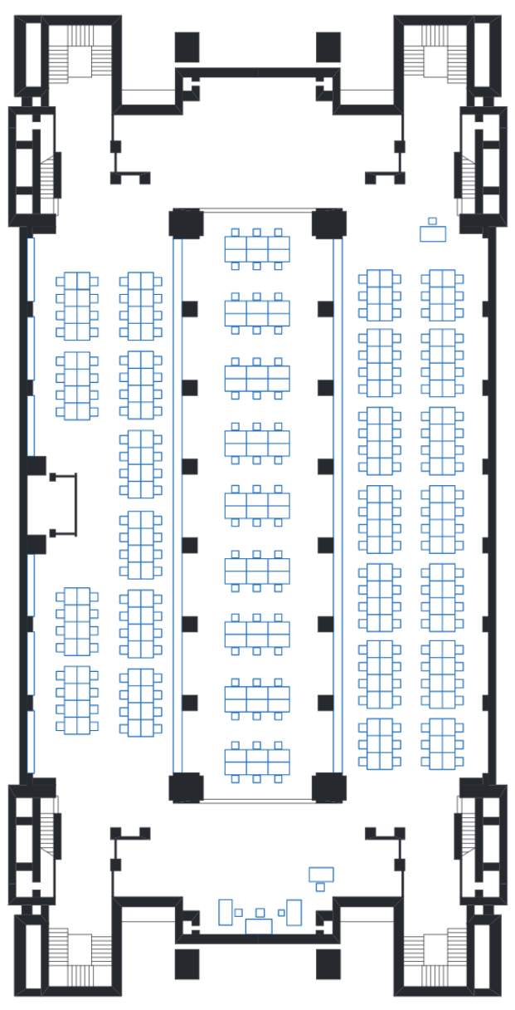
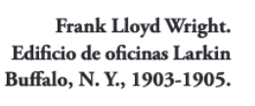
CBRE - The Office of the Future
It’s All About
Culture & Strategy
Workplace Strategy
Activity Based
Agile
Fluid
Portfolio Strategy
Club and Hub Concept
Club in City Centers
Hubs in Suburban Areas
Tech
Technology Enhanced
AI (5G)
Collaboration
Sustainability
Hosting
CMMS & BMS
Const. & Design
OP
Source: Luis Vina, The Future of the Workplace in a digital era (deck prepared for RE:Connect), 2021

Slide 18
HOK - The Workplace as an Ecosystem
Business advantages
Reduced city center footprint
Assess to a greater talent pool
Potential for more employees per sf/sm of real estate
More tailored real estate
Human advantages
Greater work-life balance
Reduced transportation time
Greater environmental variation
Better quality connections
Better quality of life
Source: Hub-Home-Spoke: HOK and Steelcase Explore the Future of Work

Slide 19
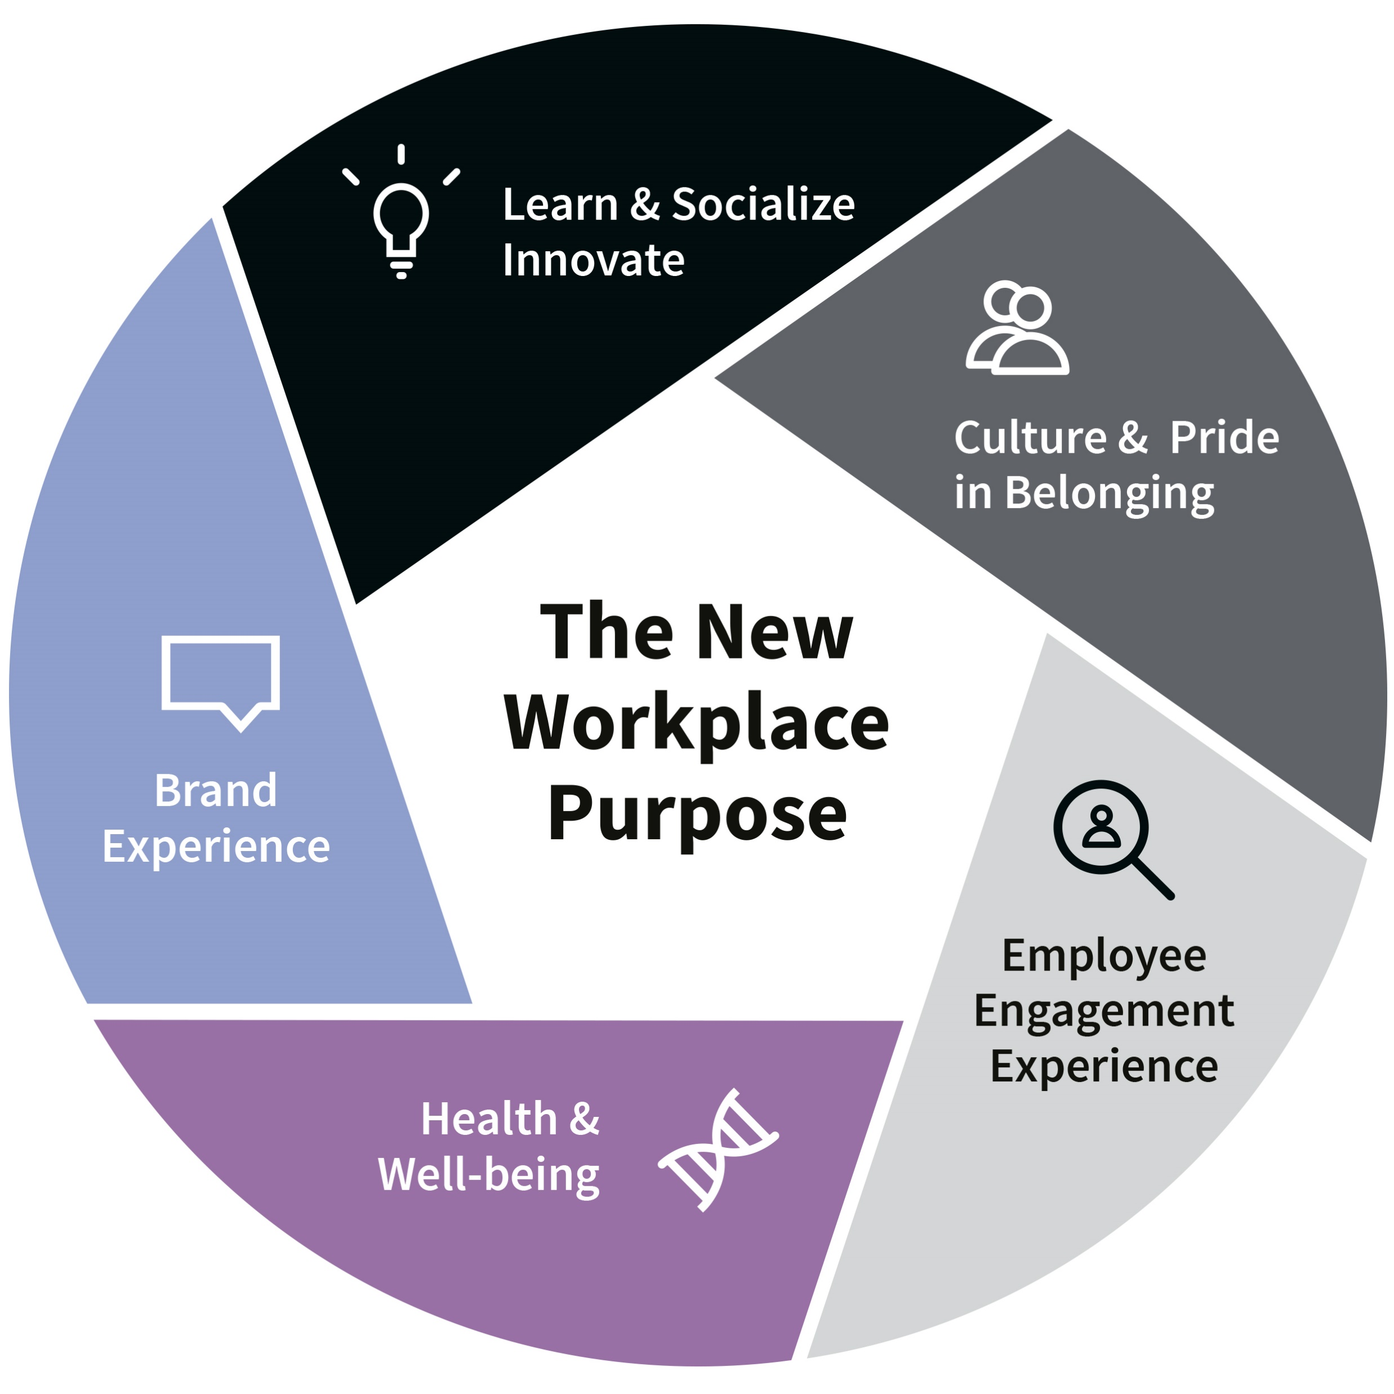
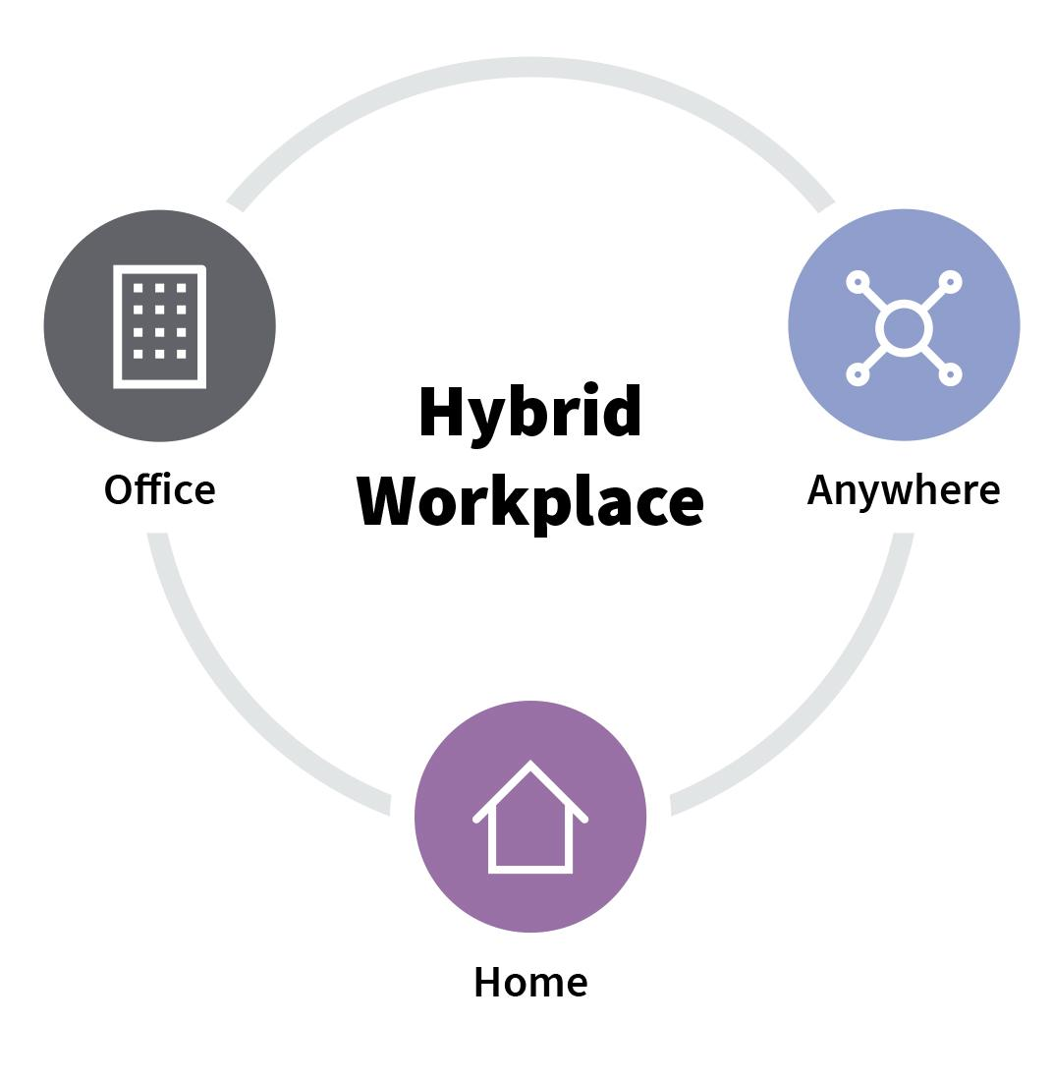
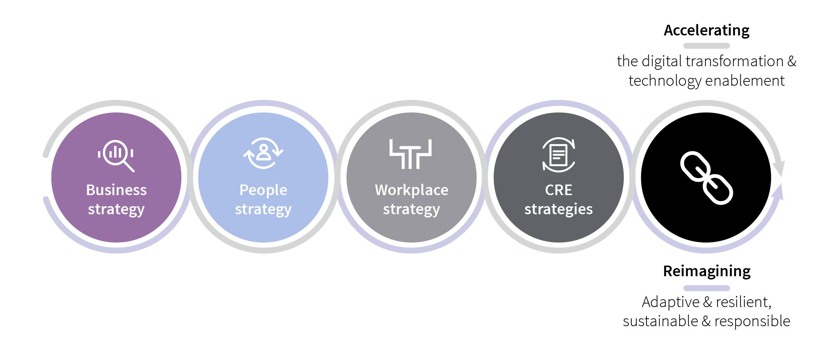
JLL - The Hybrid Continuum
Hybridization
Reimagine
Purpose
Work From Anywhere
Reimagine the
Future of Work
A Worker Centric World
Source: JLL Reimagine Framework 2021

Slide 20
Download the Executive Summary
Download the FREE Executive Summary
Experts.IFMA.org

Slide 21
Panel Discussion - The Impact on FM
MODERATOR & PANELISTS

Slide 22
AUDIENCE POLL
What is the main business driver for FM post-vaccine?
ⓘ Start presenting to display the poll results on this slide.
Notes:
📣 This is Slido interaction slide, please don't delete it. ✅ Click on 'Present with Slido' and the poll will launch automatically when you get to this slide.

Slide 23
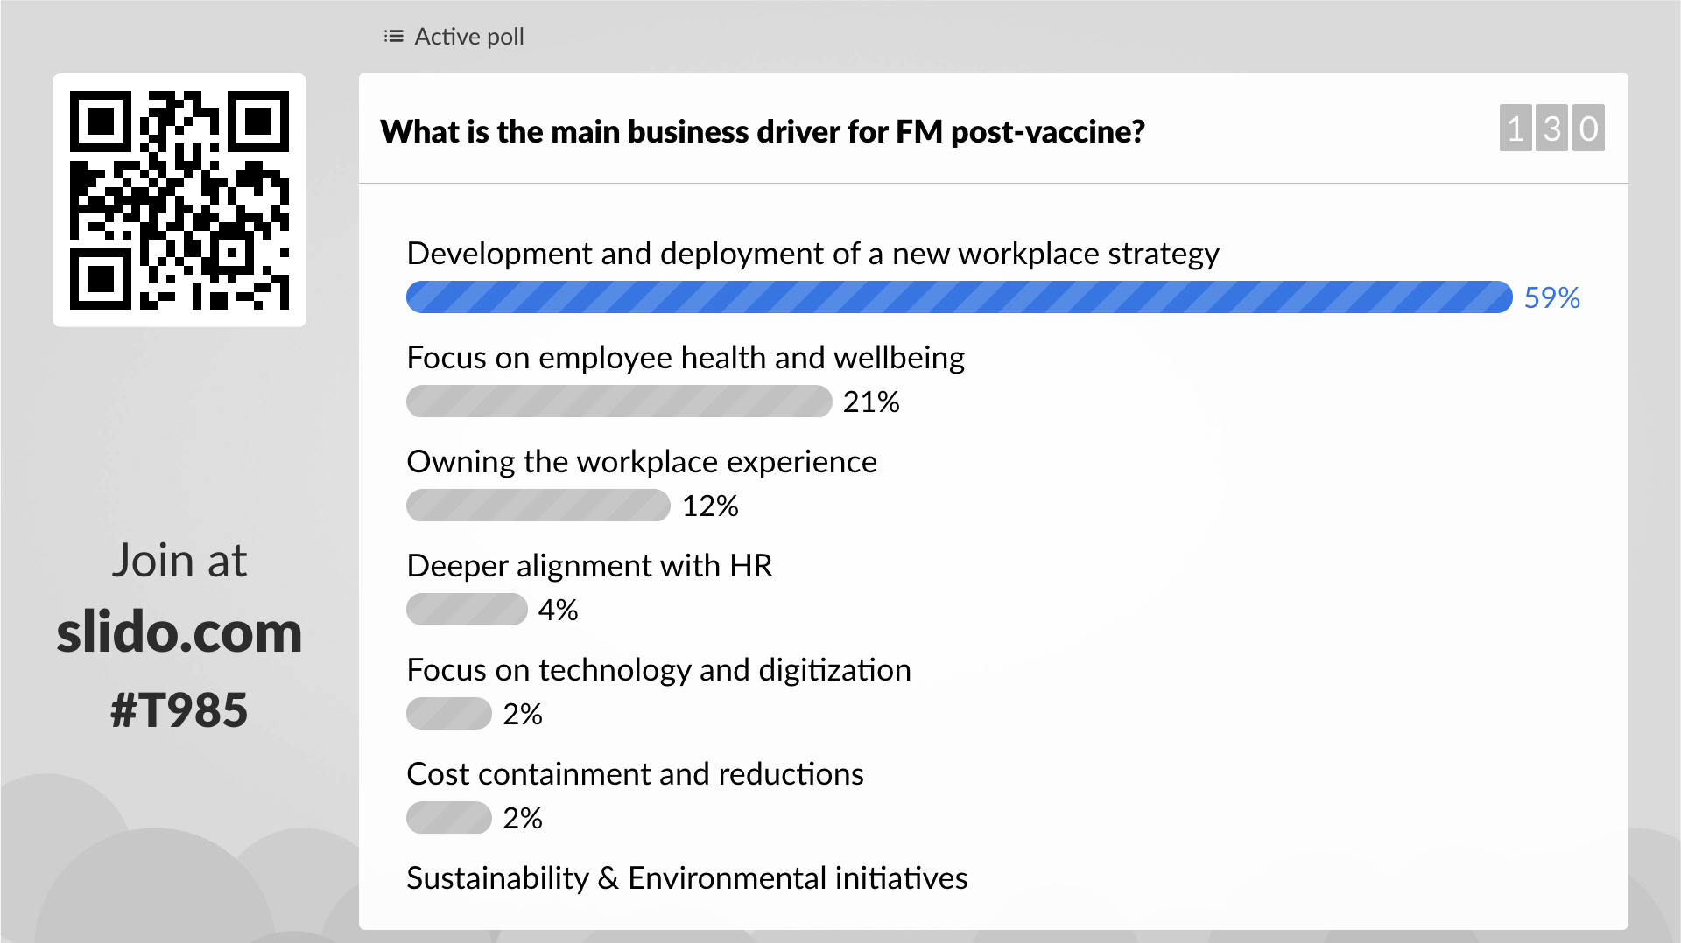

Slide 24
1.000 people
@ 10m2/head
= 10.000 m2
500 people
Remote working
500 people
@10m2/head
= 5.000 m2
500 people
@100 people/day
@20 m2/day
= 2.000 m2
+amenities
= 3.000 m2
Pre-COVID-19
Pre-COVID-19
Adjusted
Smart Scheduling
Source: Gospace, 2020

Slide 25
STRATEGY SETTING
SMEs top four for setting the workplace strategy agenda
HR
CEO Office/ Business Management
Workplace Management
Facility Management
Facebook, Twitter, Gitlab and Quora have hired “Heads of remote work,” while Hewlett Packard Enterprise have appointed a cross functional team under their VP for CRE.

Slide 26
What workplace entities are setting the strategic priorities in the organizations you advise?

Slide 27
BUDGETS
The Experts’ Assessment expect
56%
Budgets for investments into AI technologies in the workplace to increase
Budgets shifting from real estate to digital experiences
74%
54%
Budgets for investing in efficiency improvements will increase

Slide 28
What recommendations would you provide to FM’ers in the ongoing budgeting process?

Slide 29
BUDGETS AND RESPONSIBILITY FOR REMOTE WORKERS – WHO PAYS?
SME’s expect that companies pay for:
70% of remote workers have purchased equipment to be able to work remotely.¹
Audio Devices Headphones & Conference Audio
Computers
But companies save $11,000 annually for each remote worker. How will you invest them?²
Memberships for coworking/ flexible working arrangements
Monitors
62% of SMEs expect that regulations will mandate that organizations provide equipment and training on ergonomic working conditions for remote workers
But were split according to geographies over
Desks
Chairs
Source: Lenovo, 2020 and Global Workplace Analytics, 2020

Slide 30
What types of home services are you seeing organizations offer? What role will FM play?

Slide 31
TECHNOLOGY PLATFORMS
Real Estate and Finance
Flexible Space
Management
Internet of Things / Smart Buildings
Construction Tech
Data and Analytics
Visualization

Slide 32
How are platforms transforming the end-user experience? What examples have you found to be particularly interesting to follow?

Slide 33
AUDIENCE POLL
What will be the main responsibility for FM post-vaccine?
ⓘ Start presenting to display the poll results on this slide.
Notes:
📣 This is Slido interaction slide, please don't delete it. ✅ Click on 'Present with Slido' and the poll will launch automatically when you get to this slide.

Slide 34
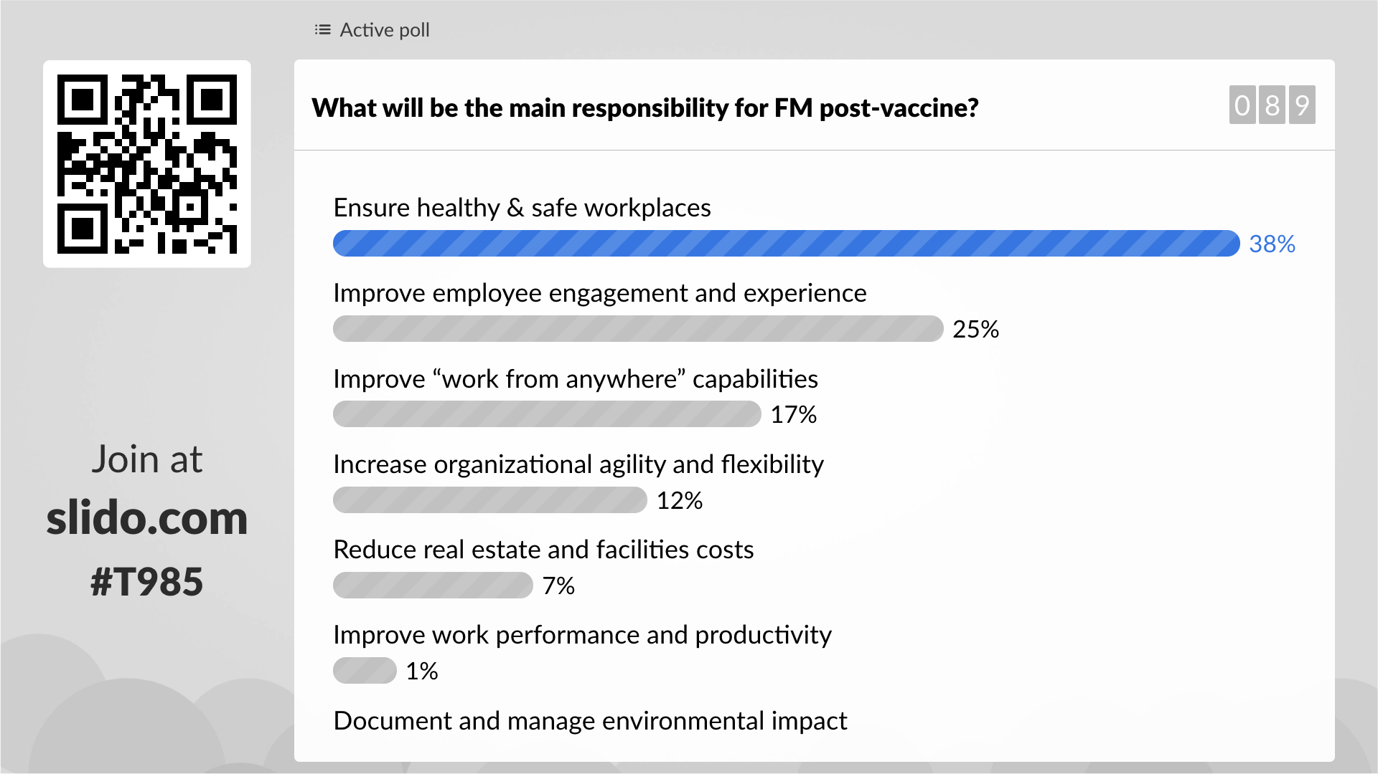

Slide 35
FACILITY MANAGERS: BUSINESS DRIVERS & RESPONSIBILITIES
Business Drivers
Deeper alignment with HR, IT, etc.
More focus on driving a healthy building
Owning the workplace experience
Deployment of a workplace strategy
Responsibilities
Ensure healthy and safe workplaces
Increase organizational agility and flexibility
Improve work performance and productivity
Reduce real estate and facilities costs

Slide 36
Coronavirus Resource Center
ifma.org/coronavirus
IFMA.org

Slide 37
Download the Executive Summary
Download the FREE Executive Summary
Experts.IFMA.org

