Slide 1


WORK FROM HOME:
THE NEW GLOBAL REALITY
Best Practices + Tips from Experts in Teleworking, Workplace Experience and FM
IFMA.org

Slide 2
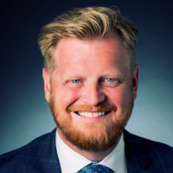

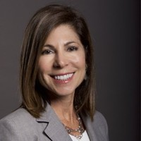
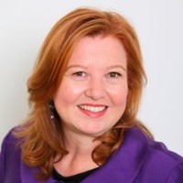

Peter Ankerstjerne
MBA, COP, FRICS,
IFMA Fellow/1st Vice Chair, Global FM & Employee Services Lead for JLL – Jones Lang LaSalle
Kate Lister
President, Global Workplace Analytics
Dr. Anita Kamouri
Vice-President,
Co-Founder,
Iometrics
Lucy Jeynes
Founder,
Managing Director, Larch Consulting
WORK FROM HOME:
THE NEW GLOBAL REALITY

Slide 3

Who wants to?
Who can?
Who offers?
Who does?
© 2018 Global Workplace Analytics

Slide 4

Compatible = 56%
Wants to = 82+%
Does Occasionally = 43%
Does Often = 3.6%
Global Workplace Analytics 2017 State of Telecommuting in the U.S.
Federal Employee Viewpoint Survey 2018 / Citrix one poll 2019
Gallup 2016 State of American Workforce
American Community Survey / Global Workplace Analytics 2019
© 2018 Global Workplace Analytics
Notes:
Our research shows that 56% of the population holds a job that’s at least partially compatible with telecommuting. A recent survey by Citrix (n=5k) shows 62% emps say they could work remotely 1x week.
Between 70% and 90% of employees say they would if they could

Slide 5

Millennials Who Would Change Jobs for:
Flextime 63%
Insurance Other than Health 60%
Flexible Location Part-Time 50%
Flexible Location Full Time 47%
Student Loan Reimbursement 45%
Tuition Reimbursement 45%
Paid Maternity Leave 44%
Gallup State of the American Workforce 2017
© 2019 Global Workplace Analytics
Notes:
According to Gallup, Flexibility is one of the highest ranked benefits by Millennials ….even higher than student loan or tuition reimbursement
63% would change jobs for flex time and about half for full or part time telework. (30% would actually take a paycut for the privilege)
Boomers rank these similarly, thought the percentages are 15 to 20 points lower.
Flextime (47%), Insur (43%), telework pt (33%), telework ft (31%)

Slide 6
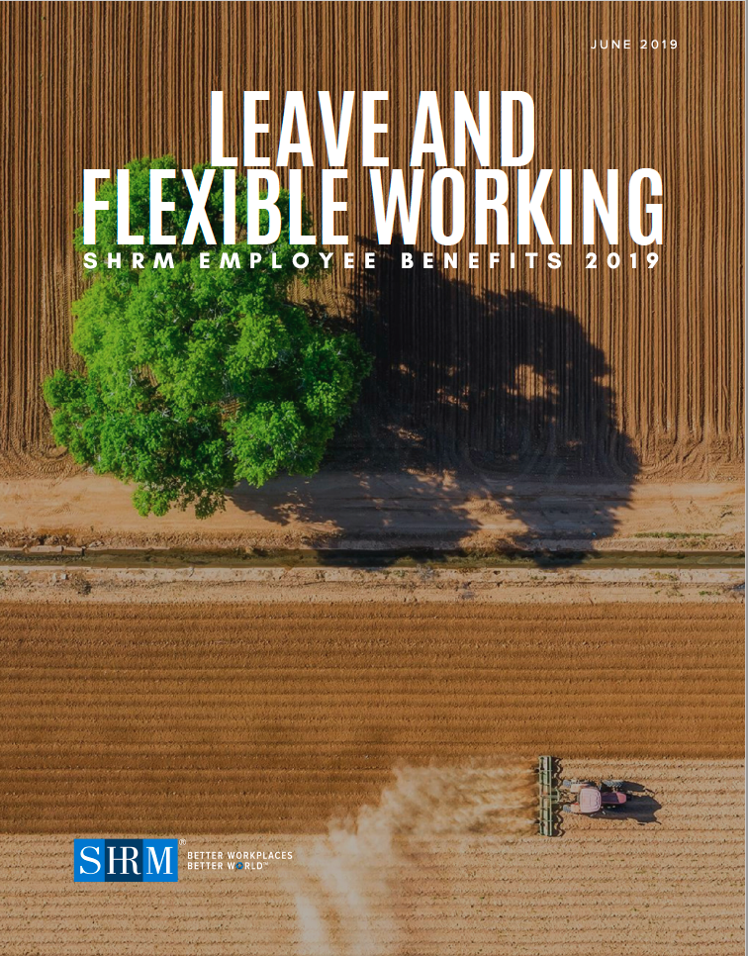
Who Offers?
Ad-Hoc 69%
Part-Time 42%
Full Time 27%
SHRM 2019 Employee Benefits Survey (n=2,672 HR professionals)
© 2019 Global Workplace Analytics

Slide 7

The 7% Privilege
Bureau of Labor Statistics 2019
© 2019 Global Workplace Analytics

Slide 8

Employer Savings =
$11,000
Per half-time telecommuter/year *
* Assumes $48k salary/year
© 2018 Global Workplace Analytics

Slide 9

30,000,000,000/Day
© 2018 Global Workplace Analytics

Slide 10
Peter Ankerstjerne
MBA, COP, FRICS,
IFMA Fellow/1st Vice Chair, Global FM & Employee Services Lead for JLL – Jones Lang LaSalle
Kate Lister
President, Global Workplace Analytics
Dr. Anita Kamouri
Vice-President,
Co-Founder,
Iometrics
Lucy Jeynes
Founder,
Managing Director, Larch Consulting
WORK FROM HOME:
THE NEW GLOBAL REALITY

Slide 11


A first-of-its kind global survey to gather much-needed data about the impact of Covid-19 on how and where people are working
WHAT
Global
Work
from
Home Experience Survey
Provide critical insights into the impact COVID-19 will have on the future of work and the workplace
WHY
Results will be shared via reports, webinars, press releases, and publications through our supporters
HOW

Slide 12
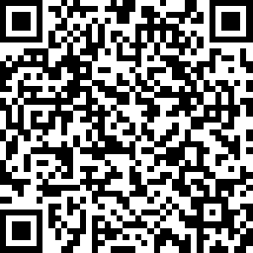
Help us learn from this Global Experiment
please take the
Global Work-from-Home Experience Survey
https://www.research.net/r/IFMA-WFH

Slide 13

Coronavirus Preparedness Resource Center
ifma.org/coronavirus
IFMA.org

Slide 14

WEDNESDAY WEBINAR
SERIES
Best Practices + Tips from Experts and Thought Leaders from Around the Globe
IFMA.org

